Slide 1
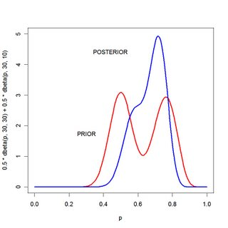
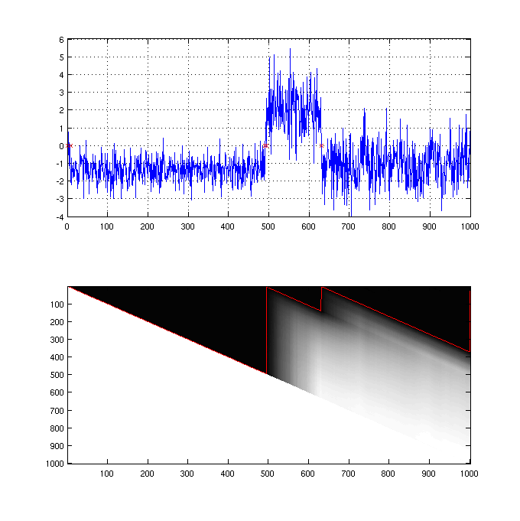
LECTURE 23: CONJUGATE PRIORS AND MAP VARIANCE ESTIMATION
Objectives: Conjugate Priors Multinomial Gaussian MAP Variance Estimation Example
Resources: Wiki: Conjugate Priors GN: Bayesian Regression DF: Conjugate Priors and Posteriors GK: MAP Estimation of Parameters PML: Bayesian Statistics: An Introduction
• URL: .../publications/courses/ece_8423/lectures/current/lecture_23.ppt
• MP3: .../publications/courses/ece_8423/lectures/current/lecture_23.mp3

Slide 2
Introduction
Recall our maximum a posteriori (MAP formulation):
Let the likelihood function be considered fixed; the likelihood function is usually well-determined from a statement of the data-generating process.
We have discussed the need to assume a form for the prior distribution, g(θ), that makes the mathematics tractable, and yet is a reasonable model.
A conjugate prior is referred to as a choice of the prior that makes the posterior have the same form (or class) as the prior (but different parameters).
A conjugate prior is an algebraic convenience: otherwise a difficult numerical integration may be necessary (or a complex set of equations might result).
Another important reason to use a conjugate prior relates to the way we iteratively estimate parameters. It is common to assume a prior, estimate a posterior, then use that posterior as a prior to estimate the posterior for some additional data:
With the use of a conjugate prior, we can be assured the form of the distribution will not change with each iteration.

Slide 3
Conjugate Prior Examples
Recall when we developed the MAP estimate of the mean for a Gaussian distribution, we assumed a Gaussian prior:
and observed that the posterior is also a Gaussian (with a different mean and variance), and hence the Gaussian prior (unknown mean) is a conjugate prior.
Next, consider a binomial distribution (k outcomes or “successes” in n trials):
The conjugate prior for this distribution is a Beta distribution:
and B() is a Beta function (which is defined in terms of a Gamma function).
The posterior is given by:

Slide 4
Conjugate Prior for Multinomial and Multivariate Gaussian
We can define a generalization of the binomial known as the multinomial distribution that describes the probability of k possible outcomes of n independent trials, where x_{i} is the number of times the k^{th} outcome is observed:
The conjugate prior for this distribution is known as a Dirichlet density:
Note that this Dirichlet prior was used for the mixture weight prior in MAP estimation of the mixture weights in an HMM.
For a multivariate Gaussian distribution with an unknown mean and precision (precision is the inverse of the covariance), the conjugate prior is a Normal-Wishart distribution:
This was used to model the priors for the means and covariances in the Gaussian mixture distribution in an HMM.

Slide 5
MAP Variance Adaptation (Scalar Gaussian RV)
Given a set of new observations, , we would like to update our estimate of the mean and variance using MAP adaptation.
The likelihood of variance given data is:
Let us simplify this expression by defining some constants:
The posterior is the likelihood multiplied by the prior:
Once again, we have the usual problem of what to assume for the prior distribution. In the case of a Gaussian likelihood where the mean was unknown, assuming a Gaussian prior for the mean was a conjugate prior.
But in this case, assuming a Gaussian prior does satisfy our condition for a conjugate prior, and even if we persevered, the equations that would result are too complicated (requiring numerical solution). Also, most likely, the solution would not deliver significantly better performance. Is there a better choice?

Slide 6
Prior Distribution: Normal-Wishart
Conjugate Prior: In the scalar case, the Normal-Wishart form for precision (inverted form for variance) reduces to an inverse Chi-squared distribution:
S₀ represents an estimate of the variance computed on the prior data, or it can be optimized based on prior beliefs about the data. (This topic is again part of the parameter estimation material we discuss in Pattern Recognition.)
κ is a parameter that we introduce to allow the prior to have a similar form to the likelihood, but also give us some freedom to optimize the prior to better match our prior beliefs of the data. For example, we could also estimate κ from prior training data.
For reasons that will make sense shortly, let . This is just a definition for convenience; it does not alter the model in any way.
Combining all these results, we can write our posterior as:

Slide 7
Maximizing the Posterior Distribution
Our posterior for the variance resembles an inverse Chi-squared (χ²) distribution, while the inverse of the variance, which we call precision, resembles a Chi-squared distribution:
We can differentiate with respect to λ to obtain the MAP solution (which is also the MAP solution for σ²):

Slide 8
Dealing with the Parameters of the Prior Distribution
We have two parameters that are unresolved: .
If we have prior knowledge of the mean and variance, based on some estimates from the training data, we can equate these with the inverse Chi-squared distribution and solve for the values of :
The mean and variance of this distribution are well-known:
We can solve for :
To recap the adaptation process:
For a training data set, estimate the expected value of the variance (the mean of the variance) and the variance of the variance.
Estimate .
Estimate S from the new data:
Estimate :

Slide 9
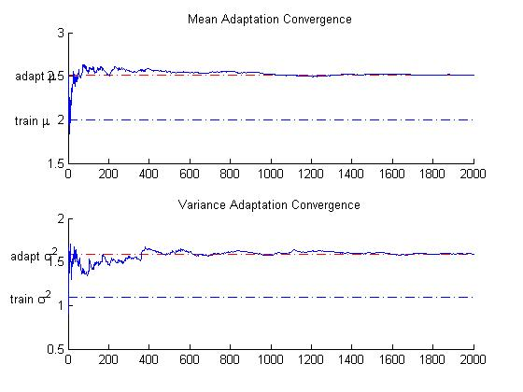
Example: MAP Adaptation Convergence

Slide 10
Summary
Introduced the concept of a conjugate prior.
Introduced several priors that are commonly used in statistical modeling and signal processing.
Derived adaptation of the variance of a scalar Gaussian random variable using MAP.
Demonstrated the convergence properties of the estimate on a simple example using MATLAB.
Next: Adaptation using discriminative training.

Slide 11
MATLAB
%%
%% map_gauss.m
%%
%% MAP Adaptation for Gaussian r.v. for:
%% 1) Mean with Gaussian prior assuming known variance
%% 2) Variance with inverse Chi-Squared prior
%% assuming known mean.
%%
clear;
N=5000;
M=2000;
% Training data and parameters
%
mu_train=2.0;
var_train=1.1;
x_train=mu_train+randn(1,N)*sqrt(var_train);
%Test data and parameters
%
mu_test=2.5;
var_test=1.5;
x_test=mu_test+randn(1,M)*sqrt(var_test);

Slide 12
MATLAB (Cont.)
% Initialization
%
x=x_test;
mu_hat=[];
var_hat=[];
% Prior for mean estimation
%
mu_m=mu_train;
var_m=5.0;
% Prior for variance estimation
%
mu_var=var_train;
vari_var=10;
v=2*mu_var^2 / vari_var + 4;
S0=mu_var*(v-2);
for i=2:1:length(x)
x_test=x(1:i);
n=length(x_test);
m=mean(x_test);
var1=var(x_test);

Slide 13
MATLAB (Cont.)
% MAP adaptation for mean
%
vari=1/(1/var_m + n/var1);
mu_hat=[mu_hat vari*(mu_m/var_m + m/(var1/n))];
% MAP adaptation for variance
%
S=sum((x_test-m).^2);
var_hat=[var_hat (S0+S)/(v+n+2)];
end;
subplot(211);line([1,M],[mu_train, mu_train],'linestyle','-.');
hold on;
subplot(211);line([1,M],[m, m],'linestyle','-.','color','r');
subplot(211);plot([2:M],mu_hat);
text(-260, mu_train, 'train \mu');
text(-260, m, 'adapt \mu');
title('Mean Adaptation Convergence');
subplot(212);line([1,M],[var_train, var_train],'linestyle','-.');
hold on;
subplot(212);line([1,M],[S/M, S/M],'linestyle','-.','color','r');
subplot(212);plot([2:M],var_hat);
text(-285, var_train, 'train \sigma^2');
text(-285, S/M, 'adapt \sigma^2');
title('Variance Adaptation Convergence');

