Slide 1
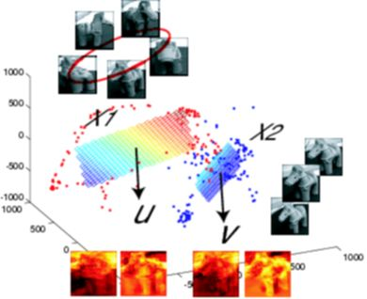
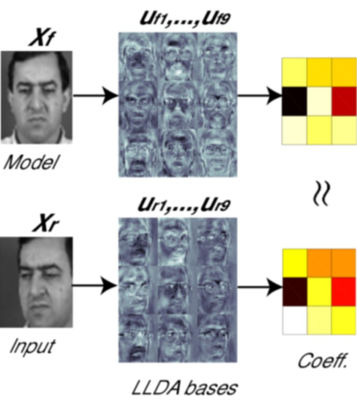
LECTURE 26: UNSUPERVISED DISCRIMINATIVE ADAPTATION
Objectives: Adaptation Challenges Historical Perspective Discriminative Linear Transforms Discriminative Mapping Transforms Optimization Criteria Experimental Results
Resources: KY: Unsupervised Training
• URL: .../publications/courses/ece_8423/lectures/current/lecture_26.ppt
• MP3: .../publications/courses/ece_8423/lectures/current/lecture_26.mp3

Slide 2
Motivation
Today’s lecture will review an interesting paper recently presented at the 2008 International Conference on Acoustics, Speech and Signal Processing:
K. Yu, M.J.F. Gales and P.C. Woodland, “Unsupervised Discriminative Adaptation Using Discriminative Mapping,” in Proceedings of the International Conference on Acoustics, Speech and Signal Processing, pp. 4273-4276, Las Vegas, Nevada, U.S.A., March 2008.
Though this paper is focused on speech processing, the techniques described can be applied to any data set that demonstrates similar characteristics of speaker-dependent (data common to an experimental condition) and speaker-independent (multiple independent samples of the experimental conditions).
The key contributions of this paper are with respect to the ability to estimate a discriminative transform that gives improved performance on unsupervised data. That is a problem common to most pattern recognition applications.
The core idea is to separate discrimination and ML-based adaptation.

Slide 3
Historical Perspective on Adaptation
Linear transforms (e.g., MLLR) are the most common form of adaptation for applications involving limited data.
ML must be used for unsupervised adaptation; discriminative models can be estimated on training data (where transcriptions are known) but are rarely appropriate for real applications.
Performance gains for discriminative models in unsupervised adaptation have been limited:
One approach is to use the “recognizer” to generate the most likely transcription of the data and to use that transcription for supervision.
If the accuracy of the recognizer is high, this can work well.
However, discriminative training/adaptation is very sensitive to transcription errors, so in practice, when performance is low, and you need adaptation to improve performance, this method does not work well.
Confidence measures and lattices can be used to minimize the effects of transcription errors, but this also reduces the impact of adaptation:
The data you most need to adapt on is the data with the lowest confidence or poorest recognition performance.
Hence, discriminative adaptation has had limited success and has provided only marginal improvements in practice over ML.

Slide 4
Discriminative Mapping Transform
A number of methods to combine ML adaptation with discriminatively-trained models have been explored, including “speaker-adaptive” transforms and feature-based adaptation (to be discussed later). These approaches attempt to combine a good “speaker-independent” discriminatively trained model with unsupervised speaker-dependent transformations.
A criterion-mapping function is defined as an attempt to map a speaker-independent transform from one condition to another via some form of mapping (linear or nonlinear).
In this work, the goal is to map a “speaker-specific” ML-estimated linear transform to be more similar to a Minimum Phone Error (MPE) discriminatively trained transform.
Recall, MPE is one of three discriminative training techniques in which the phone, or sub-sequence errors, are minimized.
A linear transform will be estimated and used for this mapping. This transform is referred to as a discriminative mapping transform (DMT).
In theory this approach can be applied to any form of linear transform, either mean, covariance or features.
Here, the focus will be on adaptation of the means.

Slide 5
Linear Transforms
MLLR was an approach to estimate a linear transform of the mean:
The parameters of this transform were estimated using ML.
We have explored ways to estimate this transform discriminatively:
We have explored an MMI approach to estimating the transform and briefly mentioned MCE and MPE approaches that are based on loss functions:
To estimate the loss function, we need to know the transcription, H^{(s)}. This approach has worked well for supervised adaptation, but not as well for unsupervised adaptation.
We have seen that MMI trained models can be combined with ML trained adaptation to produce reasonable gains in performance.
MMI can be applied to features, models (e.g., Gaussian mixtures), or most other forms of transformations.

Slide 6
Discriminative Mapping Transforms
Criterion mapping functions (CMFs) use the same approach, but introduces a speaker independent transformation of the speaker-specific transforms:
This CMF attempts to map ML-trained transforms into discriminative transforms (a transform on top of another transform).
The mapping function is trained in a speaker-independent manner so that it can be applied to any speaker.
One form of this transform that has been investigated is a linear transform:
where vec() maps the transformation matrix to a vector (to reduce parameters).
If we restrict H_{dl} to a block diagonal matrix, then this transformation can be simplified to:
For mean adaptation, this further simplifies to:
The speaker independent transform can be estimated in a manner similar to our previous DLT approach.

Slide 7
Optimization Criterion
The training criterion for the DLT can be expressed as:
This is computed on the training data, and is computed using the ML-derived transform for each speaker, and then summed over all speakers. The advantage of this is that we have much more supervised data to use to estimate the discriminative transforms.
So, in training this transform, this approach essentially adjusts W to minimize the loss function using ML parameter estimates derived from the training data. In recognition mode, this transform is used in conjunction with the ML-adapted estimates from the unsupervised adaptation.
Hence, we are attempting to decouple adaptation and discrimination, hoping that the discriminative aspects are independent of the change in environment.
Instead of training a single transformation over all data, multiple transformation matrices can be estimated using a process similar to regression classes in MLLR. For example, the mean vectors can be clustered, and a transformation matrix can be built for each cluster. Alternately, this can be clustered by decision trees, phonetic characteristics, or both.

Slide 8
Experimentation
General framework: 5,000 speakers and 256 hours of training data; 144 speakers and 6 hours of adaptation/test data.
Performance as a function of the number of transforms:
Performance as a function of the source of the supervision hypothesis:

Slide 9
Summary
Introduced a hybrid approach to adaptation that attempts to separate discrimination from ML adaptation.
Described a new framework for robust discriminative unsupervised adaptation that uses a speaker-independent criterion mapping function (CMF) estimated during training to map the ML estimated speaker-dependent transforms to a more discriminative form.
The transform is not highly sensitive to the adaptation hypotheses, which is a major issue with standard discriminative estimation of linear transforms.
A simple initial implementation of the CMF based on linear transforms is described. This is referred to as a discriminative mapping transform (DMT).
Future work: A number of alternative transforms and applications will be investigated
Next: unsupervised adaptation using large amounts of data.

