Slide 1
LECTURE 28: STATE OF THE ART
Objectives: Language Modeling in ASR Discriminative Feature Mapping Example System Course Evaluations
Resources: MB: Unsupervised LM Adaptation RS: Statistical Language Modeling DP: Discriminatively Trained Features AS: Discriminative Adaptation IBM: GALE Mandarin
• URL: .../publications/courses/ece_8423/lectures/current/lecture_28.ppt
• MP3: .../publications/courses/ece_8423/lectures/current/lecture_28.mp3

Slide 2
Statistical Approach To Speech Recognition

Slide 3
Speech Recognition Architectures
Core components:
transduction
feature extraction
acoustic modeling (hidden Markov models)
language modeling (statistical N-grams)
search (Viterbi beam)
knowledge sources
Our focus will be on the acoustic modeling components of the system.

Slide 4
Statistical Language Modeling: N-Gram Models
The probability of a word sequence, , can be decomposed as:
Clearly, estimating this for every unique word history is prohibitive. A practical approach is to assume this probability depends only on an equivalence class:
There are three common simplifications, known as N-grams, we can make:
Of course, there are many ways to merge histories, such as based on linguistic context (e.g., parts of speech such as article, noun), and we can use higher-order N-grams.

Slide 5
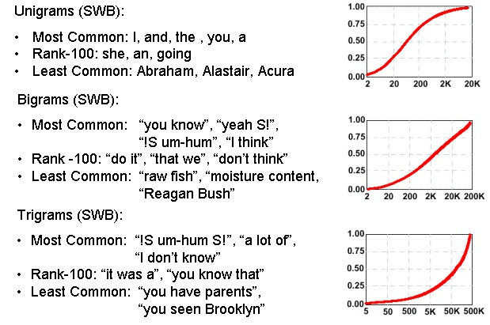
N-Gram Models Require Adaptation

Slide 6
MAP Language Model (LM) Adaptation
The LM adaptation problem is often described as an interpolation problem between an existing LM and an LM estimated from new data.
Any of the approaches we have previously discussed can be employed. MAP adaptation can be shown to simplify to:
If additional assumptions about the priors for the histories are made, this simplifies further to:
Most of the adaptation methods we have discussed previously can be applied to this problem because a language model at its core is just a likelihood model.
However, language models must also deal with the problem of unseen events, and hence models must be smoothed to account for sparseness of data.

Slide 7
Discriminatively-Trained Features
Features can also be adapted using a similar transformational approach that we used for Gaussian means:
where h_{t} represents a transformation high-dimensional features and M represents a dimensionality reduction transformation. This approach combines the large-margin classification approaches (e.g., support vector machines) with traditional GMM approaches.
The transformation M is typically estimated using an MPE criterion, and hence this method is often called fMPE.

Slide 8
State of the Art Systems (IBM GALE)

Slide 9
State of the Art Systems (IBM GALE)

Slide 10
Summary
Discussed adaptation of language models and showed the process is similar to that for feature vectors.
Discussed feature-space adaptation.
Reviewed a state of the art system that uses many forms of adaptation.
Course evaluations…

