Slide 1
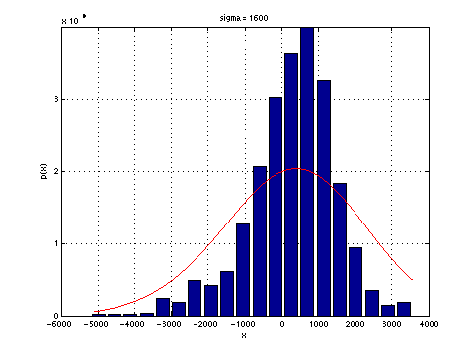
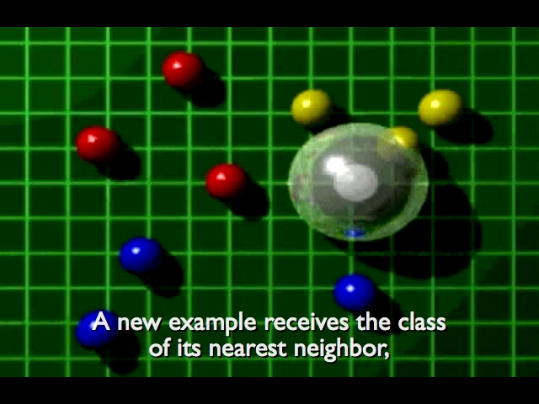
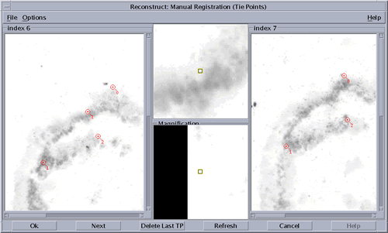
LECTURE 14: NONPARAMETRIC TECHNIQUES
Objectives: Density Estimation Parzen Windows k-Nearest Neighbor Properties of Metrics
Resources: DHS: Chapter 4 (Part 1) DHS: Chapter 4 (Part 2) EB&OS: Parzen Windows MS: Nonparametric Density KT: K-Nearest Neighbor Rule SOSS: KNN Tutorial
• URL: .../publications/courses/ece_8443/lectures/current/lecture_14.ppt

Slide 2
Principles of Density Estimation
Supervised learning assumes we know the form of the underlying density function, which is often not true in real applications.
All parametric densities are unimodal (have a single local maximum), such as a Gaussian distribution, whereas many practical problems involve multi-modal densities. (We discussed mixture distributions as a way to deal with this.)
Nonparametric procedures can be used with arbitrary distributions and without the assumption that the forms of the underlying densities are known. They are data-driven (estimated from the data) and of course suffer the same challenges with respect to overfitting.
There are two types of nonparametric methods:
Estimating P(x|ω_{j} ).
Bypass probability and go directly to a-posteriori probability estimation, P(ω_{j} |x). Examples of this approach include many forms of neural networks.
The basic idea in density estimation is that a vector, x, will fall in a region R with probability: . P is a smoothed or averaged version of the density function p(x).

Slide 3
Principles of Density Estimation (Cont.)
Suppose n samples are drawn independently and identically distributed (i.i.d.) according to p(x). The probability that k of these n fall in R is given by:
and the expected value for k is: E[k] = nP.
The ML estimate, , is .
Therefore, the ratio k/n is a good estimate for the probability P and hence for the density function p(x).
Assume p(x) is continuous and that the region R is so small that p(x) does not vary significantly within it. We can write: where is a point within R and V the volume enclosed by R, and .
A demonstration of nonparametric density estimation. The true probability was chosen to be 0.7. The curves vary as a function of the number of samples, n. We see the binomial distribution peaks strongly at the true probability.

Slide 4
Principles of Density Estimation (Cont.)
However, V cannot become arbitrarily small because we reach a point where no samples are contained in V, so we cannot get convergence this way.
Alternate approach:
V cannot be allowed to become small since the number of samples is always limited.
One will have to accept a certain amount of variance in the ratio k/n.
Theoretically, if an unlimited number of samples is available, we can circumvent this difficulty.
To estimate the density of x, we form a sequence of regions R₁, R₂,… containing x: the first region contains one sample, the second two samples and so on.
Let V_{n} be the volume of R_{n}, k_{n} the number of samples falling in R_{n} and p_{n}(x) be the n^{th} estimate for p(x): p_{n}(x) = (k_{n}/n)/V_{n} .
Three necessary conditions should apply if we want p_{n}(x) to converge to p(x):

Slide 5
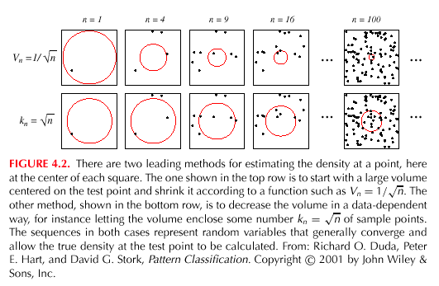
Principles of Density Estimation (Cont.)
There are two different ways of obtaining sequences of regions that satisfy these conditions:
Shrink an initial region where and show that . This is called the Parzen-window estimation method.
Specify k_{n} as some function of n, such as ; the volume V_{n} is grown until it encloses k_{n} neighbors of x. This is called the k_{n}-nearest neighbor estimation method.

Slide 6
Parzen Windows
Parzen-window approach to estimate densities assume that the region R_{n} is a d-dimensional hypercube:
ϕ((x-x_{i})/h_{n}) is equal to unity if x_{i} falls within the hypercube of volume V_{n} centered at x and equal to zero otherwise.
The number of samples in this hypercube is:
The estimate for p_{n}(x) is:
p_{n}(x) estimates p(x) as an average of functions of x and the samples {x_{i}} for i = 1,… ,n. This reminiscent of the Sampling Theorem. These sampling functions, ϕ, can be general!
Consider an example in which we estimate p(x) using normal distributions:

Slide 7
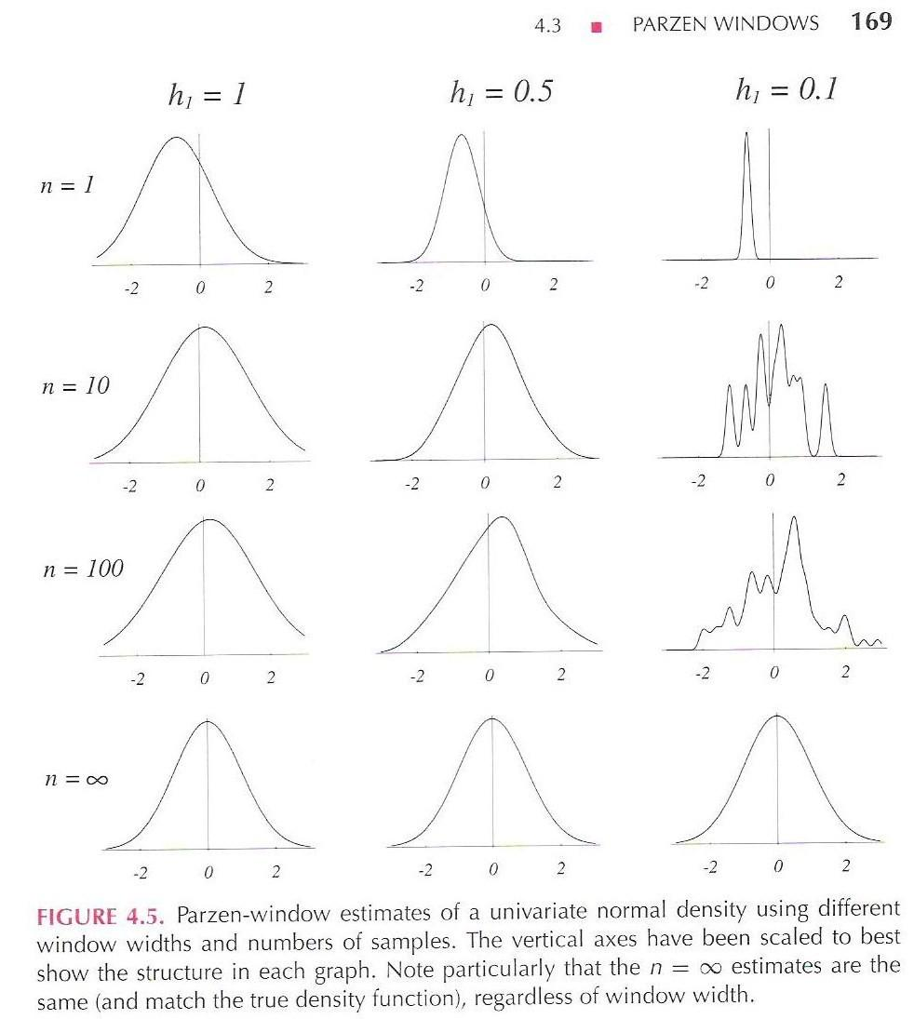
Example of a Parzen Window (Gaussian Kernels)
Case where p(x) →N(0,1)
Let ϕ(u) = (1/√(2π) exp(-u²/2) and h_{n} = h₁/√n (n>1), where h₁ is a known parameter.
Thus:
and is an average of normal densities centered at the samples x_{i}.

Slide 8
K-Nearest Neighbor Estimation
Goal: a solution for the problem of the unknown “best” window function.
Approach: Estimate density using real data points.
Let the cell volume be a function of the training data.
Center a cell about x and let it grow until it captures k_{n} samples: k_{n} = f(n)
k_{n} are called the k_{n} nearest-neighbors of x.
Two possibilities can occur:
Density is high near x; therefore the cell will be small which provides good resolution.
Density is low; therefore the cell will grow large and stop until higher density regions are reached.
We can obtain a family of estimates by setting k_{n}=k₁/√n and choosing different values for k_{1.}

Slide 9
K-Nearest Neighbor Estimation
Goal: a solution for the problem of the unknown “best” window function.
Approach: Estimate density using real data points.
Let the cell volume be a function of the training data.
Center a cell about x and let it grow until it captures k_{n} samples: k_{n} = f(n)
k_{n} are called the k_{n} nearest-neighbors of x.
Two possibilities can occur:
Density is high near x; therefore the cell will be small which provides good resolution.
Density is low; therefore the cell will grow large and stop until higher density regions are reached.
We can obtain a family of estimates by setting k_{n}=k₁/√n and choosing different values for k_{1.}

Slide 10
Estimation of A Posteriori Probabilities
Goal: estimate P(ω_{i}|x) from a set of n labeled samples.
Let’s place a cell of volume V around x and capture k samples.
k_{i} samples amongst k turned out to be labeled ω_{i} then: p_{n}(x, ω_{i}) = (k_{i}/n)/V.
A reasonable estimate for P(ω_{i}|x) is: .
k_{i}/k is the fraction of the samples within the cell that are labeled ω_{I} .
For minimum error rate, the most frequently represented category within the cell is selected.
If k is large and the cell sufficiently small, the performance will approach the best possible.

Slide 11
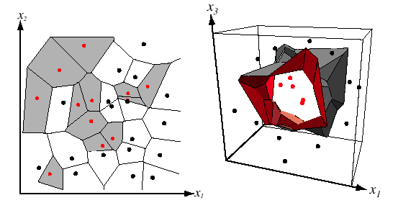
The Nearest-Neighbor Rule
Let D_{n} = {x₁, x₂, …, x_{n}} be a set of n labeled prototypes.
Let x’ ∈ D_{n} be the closest prototype to a test point x.
The nearest-neighbor rule for classifying x is to assign it the label associated with x’
The nearest-neighbor rule leads to an error rate greater than the minimum possible: the Bayes rate (see the textbook for the derivation).
If the number of prototypes is large (unlimited), the error rate of the nearest-neighbor classifier is never worse than twice the Bayes rate.
If n → ∞, it is always possible to find x’ sufficiently close so that: P(ω_{i} | x’) ≅ P(ω_{i} | x)
This produces a Voronoi tesselation of the space, and the individual decision regions are called Voronoi cells.
For large data sets, this approach can be very effective but not computationally efficient.

Slide 12
The K-Nearest-Neighbor Rule
The k-nearest neighbor rule is a straightforward modification of the nearest neighbor rule that builds on the concept of majority voting.
Query starts at the data point, x, and grows a spherical region until it encloses k training samples.
The point is labeled by a majority vote of the class assignments for the k samples.
For very large data sets, the performance approaches the Bayes error rate.
The computational complexity of this approach can be high. Each distance calculation is O(d), and thus the search is O(dn²).
A parallel implementation exists that is O(1) in time and O(n) in space.
Tree-structured searches can gain further efficiency, and the training set can be “pruned” to eliminate “useless” prototypes (complexity: O(d³n^{(d/2)}ln(n))).

Slide 13
Properties of Metrics
Nonnegativity:
Reflexivity:
Symmetry:
Triangle Inequality:
Euclidean Distance:
The Minkowski metric is a generalization of a Euclidean distance:
and is often referred to as the L_{k} norm.
The L₁ norm is often called the city block distance because it gives the shortest path between a and b, each segment of which is parallel to a coordinate axis.

Slide 14
Summary
Motivated nonparameteric density estimation.
Introduced Parzen windows.
Introduced k-nearest neighbor approaches.
Discussed properties of a good distance metric.

