Slide 1
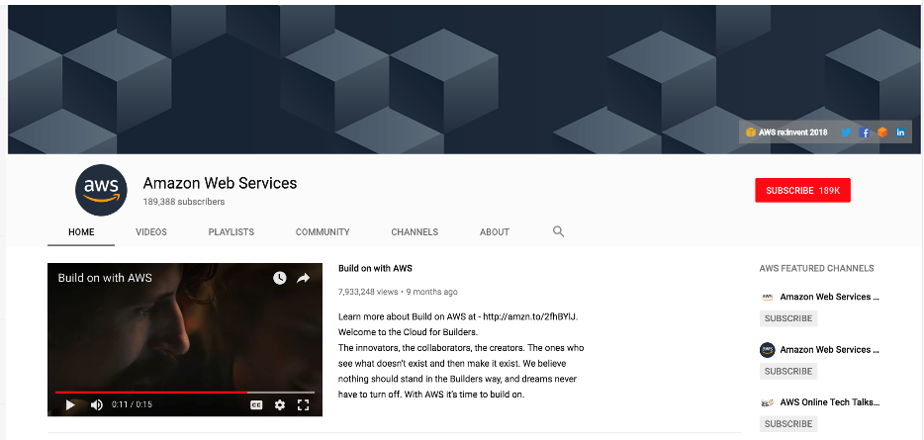
Getting Started: Amazon AWS Account Creation

Slide 2
Step 1: Install A Terminal Tool
Mac Users: You will be able to use the Mac Terminal Tool to connect to the virtual machine (VM) that we have created in addition to your browser. No additional tools need to be installed.
A simple tutorial on the Mac Terminal Tool can be found here:
https://www.youtube.com/watch?v=QROX039ckO8&ab_channel=MacOSPro
Windows Users: You will need to install a terminal tool so that you can easily interact with the VM from the command line. We recommend you install MobaXterm (http://mobaxterm.mobatek.net).
A simple tutorial on MobaXterm can be found here:
https://www.isip.piconepress.com/courses/temple/unvs_0822/resources/cluster_login.mp4
Other useful tutorials can be found here:
https://www.youtube.com/watch?v=PmmK6_WEpV4&ab_channel=DanielHeater

Slide 3
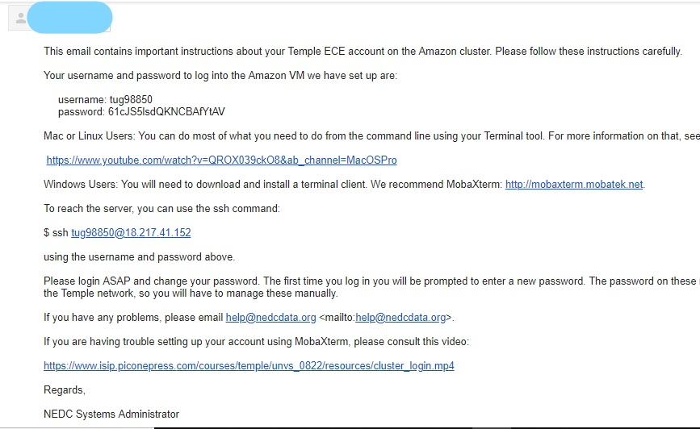
Step 2: Email Notification
You will receive an email from the course instruction team with the subject line: “Amazon AWS ECE Account”.
This email will contain your account username and initial password.
If you are on a Mac, create a terminal window using the terminal tool and follow the instructions in the email to log in.
If you are on Windows machine, please follow the instructions describing how to install MobaXterm, and how to use MobaXterm to log into the VM.
Next, you must log into the VM and change your password.

Slide 4
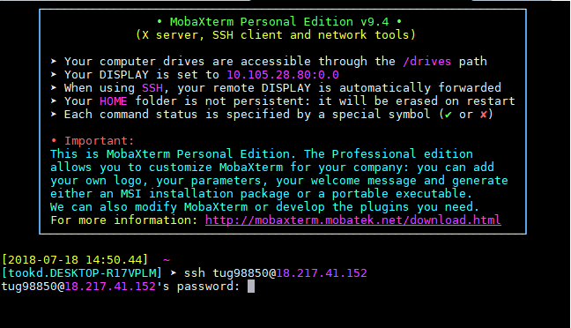
Step 3: Changing Your Password
To ssh into the VM, type this at the command line prompt:
ssh <tuid>@54.234.94.88
“<tuid>” should be your Accessnet username (e.g., tug12345).
Windows users will see the screen to the right; Mac users will see a simplified version of this screen directly in their terminal window.
Type the password from the email (or use your copy and paste tools). Note that the keyboard tool does not echo your keystrokes as you type. This is a security feature.
You should see a prompt for your current password. Again type the password from the email you received and hit enter or return.
You will now be prompted for a new password, and be asked to verify this password twice by retyping it. If all goes well, you will see the message shown to the right and be logged off.
Log in again to verify your new password using the same ssh command.

Slide 5
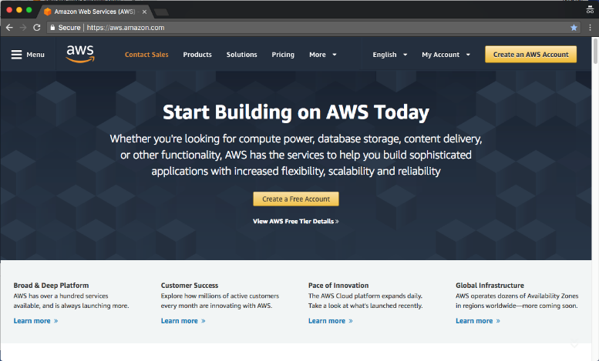
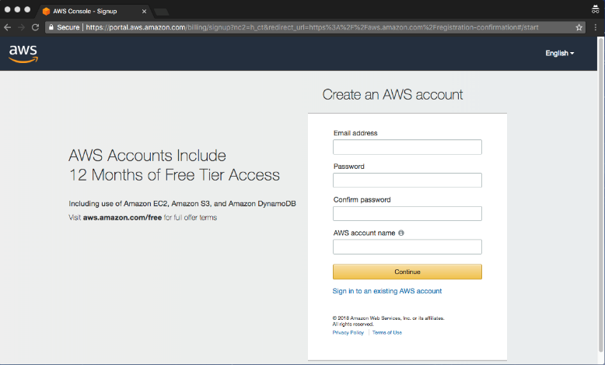
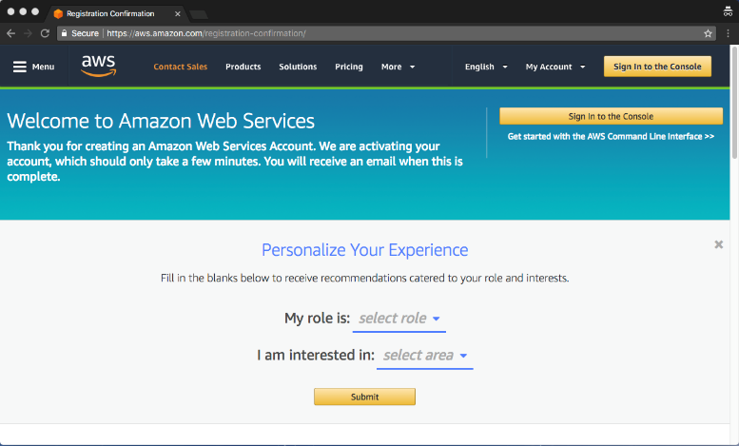
Step 4: Creating Your Amazon AWS Account
Go to the Amazon AWS Home Page (https://aws.amazon.com/).
Click on “Create an AWS Account” in the upper right.
Enter your TU email address (e.g., tug12345@temple.edu), a password, and your Accessnet username (e.g., tug12345) for the AWS account name.
Fill out the following pages requesting contact information, credit card information, and telephone verification.
Note that you will not exceed the free tier limits for this account if you follow our instructions this semester, and hence, you will not be billed for the use of this account.
Select the “Basic Plan” which is free on the following page titled “Select a Support Plan”.
If you have reached the page shown at the bottom right you have successfully created your account.
Select “Academic/Researcher” for your role.
Select whatever you like for “I am interested in”.
When you hit ”Submit” you will complete the registration process.
Next, we will create your Cloud9 environment.

Slide 6
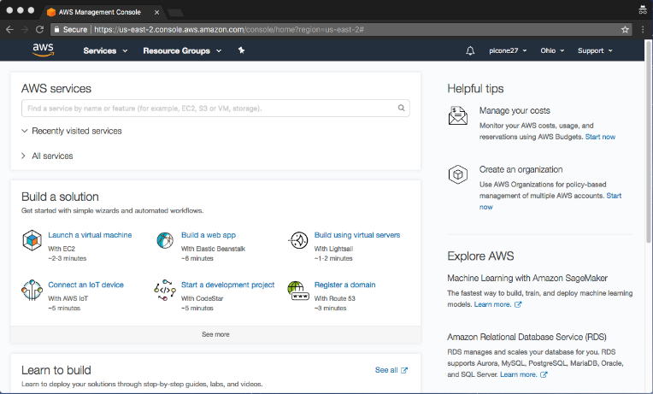
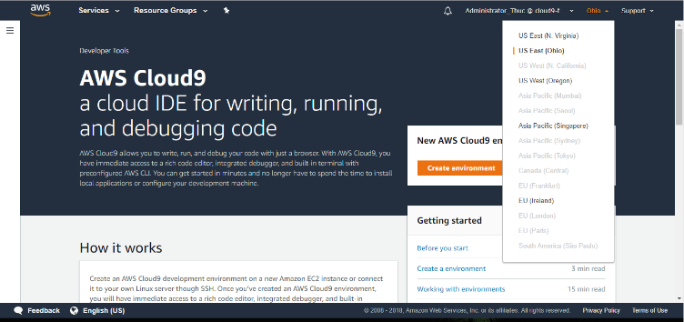
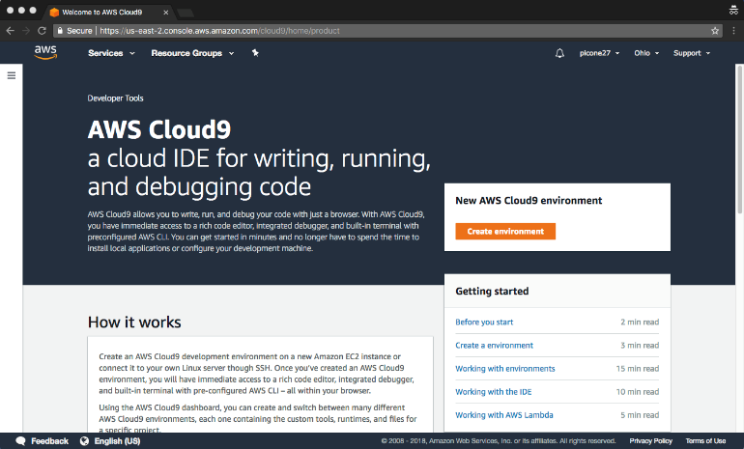
Step 5: Creating a Cloud9 Environment
Once you have successfully created your account, from the registration services page, select ”Sign in to the Console”. Enter your username, Captcha code and password to log in.
From the AWS services page shown to the right, type “Cloud9” in the search bar and click on the drop down tab (as circled in the image to the right) to go to Cloud9 home page.
You will arrive at the AWS Cloud9 Home Page shown to the right. On the top right corner, select the drop down menu if it says “Ohio” and select “US East (N. Virginia)”.
Click on “Create environment”.
Enter “ECE_1111” for the name of the environment. Then hit “Next step” on the lower right. This will bring you to the “Configure settings” page.
Select the SSH option for environment type.
Enter your login name (TUID) and the IP address that you use when accessing the VM (ECE 1111 will use an IP address of 54.234.94.88).

Slide 7
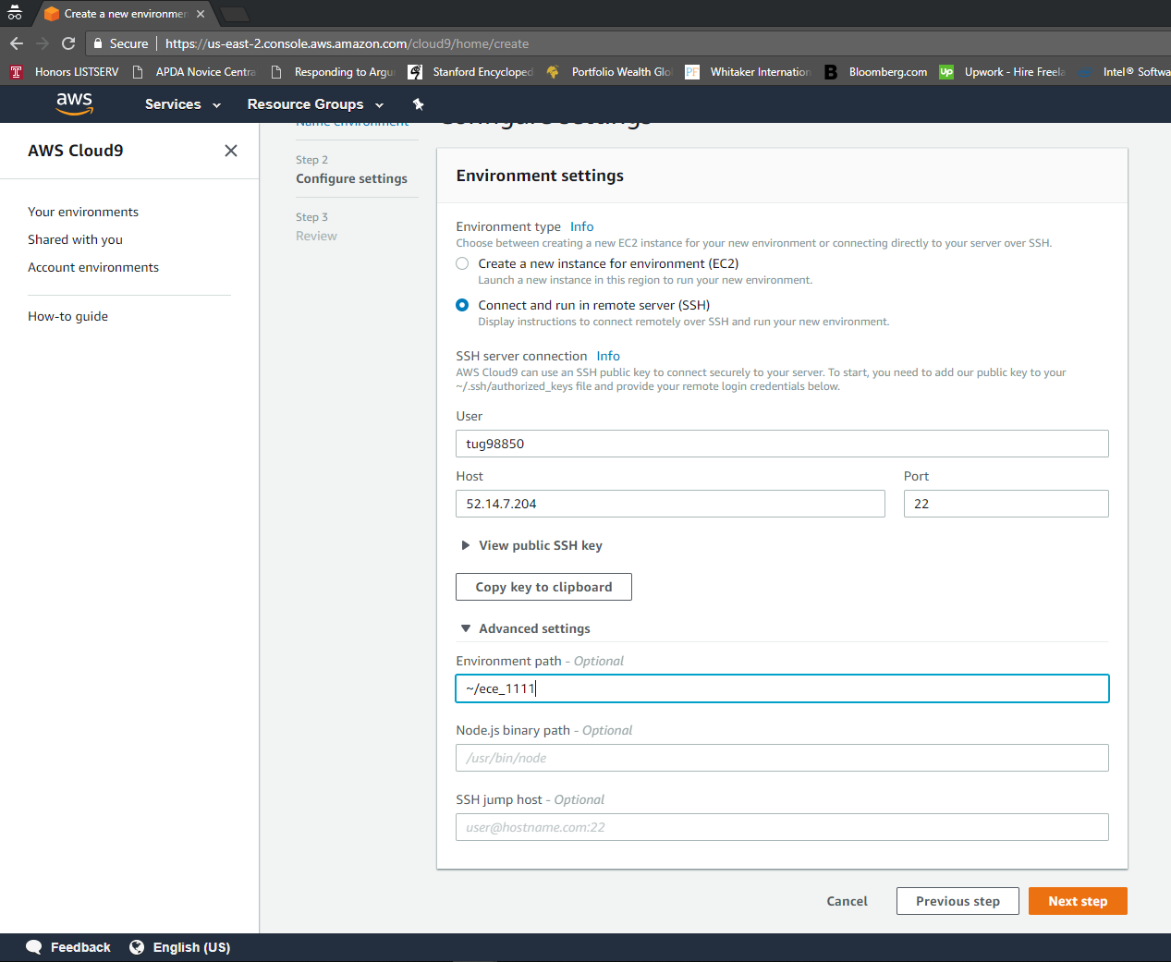
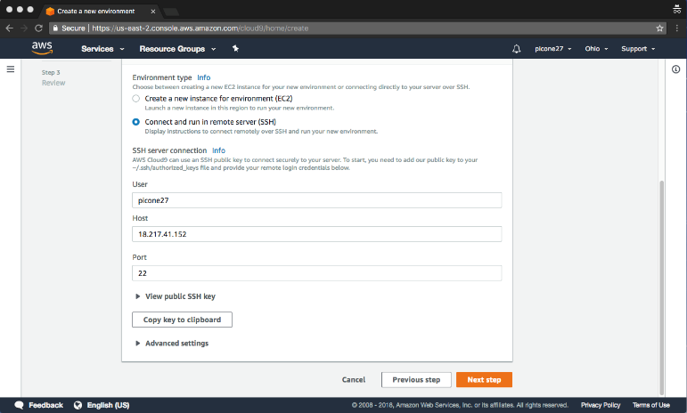
Step 6: Specifying the Environment Path
Once you have entered the appropriate user name and IP address, click on “Advanced settings”.
In the box beneath “Environment path”, type in:
~/ece_1111
Click on “Copy key to clipboard”.
Next, we will set up an automated login process using the key you created.

Slide 8
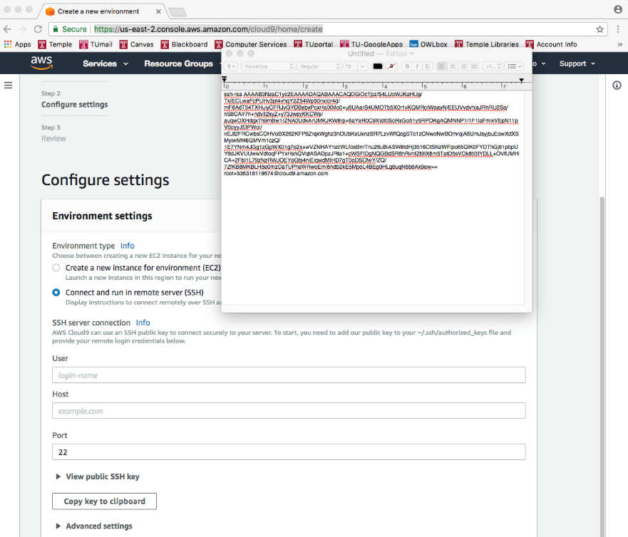
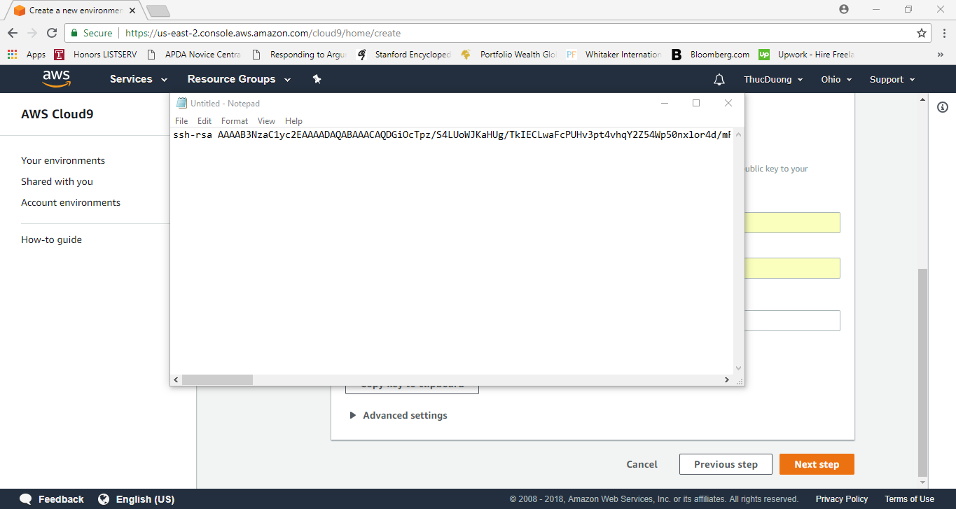
Step 7: Saving an SSH Key to a File
Mac Users: Open TextEdit (or any text editor you are familiar with)
On the first line of the empty text editor, right click and select “Paste” to paste the SSH key; you will see the message shown to the right.
Make sure the format of the file is plain text (the details will vary based on the editor you use). A typical sequence is:
Format ➔ Plain Text ➔ Select OK
Save the file to disk as a plain text file:
File ➔ Save ➔ Enter “mykey.txt”
Make sure you select UTF-8 as the Plain Text Encoding system at the bottom of the pop up window.
Window Users: Open Notepad
On the first line of the empty text editor, right click and select “Paste” to paste the SSH key; you will see the message shown to the right.
Save the file to disk as a plain text file:
File ➔ Save ➔ Enter “mykey.txt”
All: Note the location of the file, since we will need to access this file by its full filename. The following instructions assume you wrote this file to your desktop.

Slide 9
Step 8: Copy the SSH key to the VM
Mac Users:
Open a terminal using the terminal tool.
From the command line, type (all on one line):
cat ~/Desktop/mykey.txt | ssh <tuid>@54.234.94.88 ‘cat >> .ssh/authorized_keys’
Note the use of the single quote. The first argument to “cat” is the full pathname of your ssh key file generated on the previous slide.
Enter your password.
Window Users:
Open MobaXTerm and select the + button or “Start local terminal” tab.
Once you are in the local terminal, type this command (one line):
cat /home/mobaxterm/Desktop/mykey.txt | ssh <tuid>@54.234.94.88 ‘cat >> .ssh/authorized_keys’
Enter your password.
All:
If the copy was successful, you will return to your command line prompt and no error messages will be displayed.

Slide 10
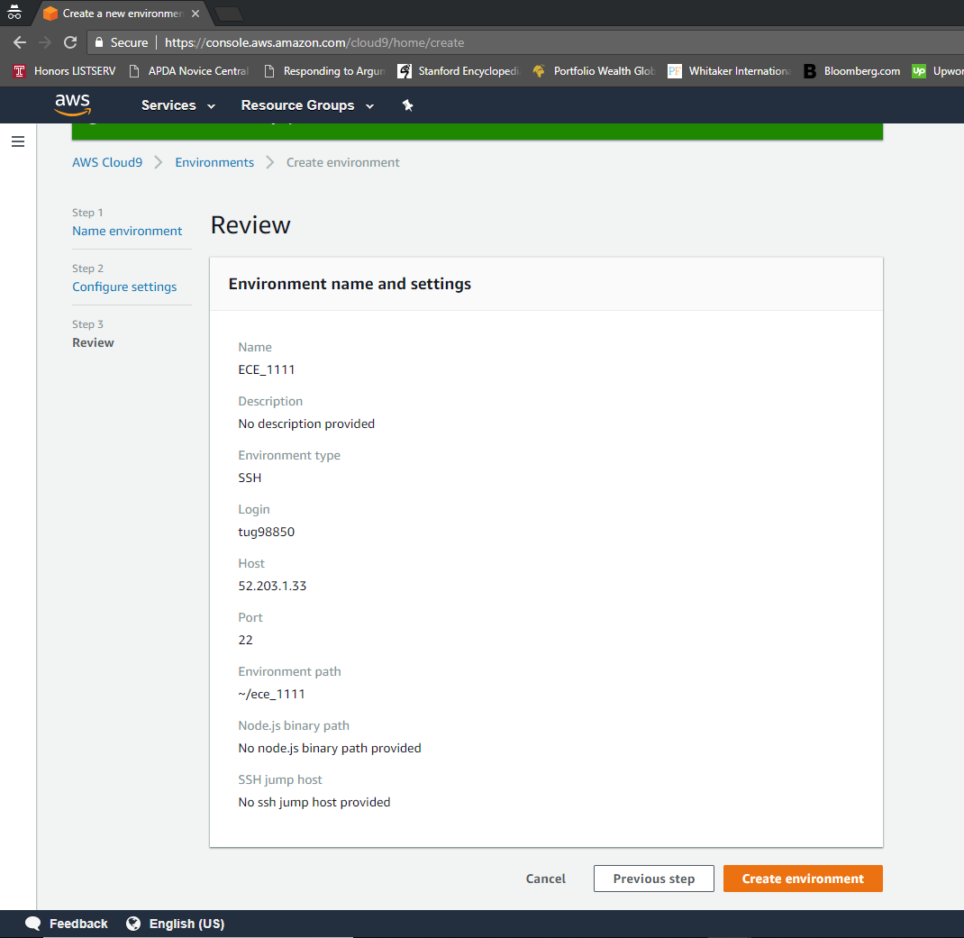
Step 9: Finish Creating The Environment
Return to the AWS “Configure settings” page in your web browser and select “Next Step”. This will take you to the “Review” page shown below.
On the “Review” page, double-check these fields:
name is “ECE_1111”
login name is your TUID
host is “54.234.94.88”.
Click on “Create environment” tab at the bottom right.

Slide 11
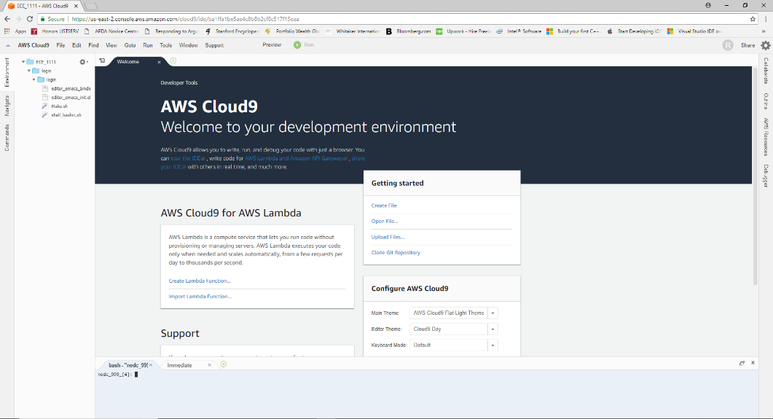
Step 10: Package Installation
After you complete the Cloud9 environment installation, a page will pop up asking if you want to install some packages.
Click Next.
Keep everything checked EXCEPT c9.ide.lamda.docker.
Select the Next button (the installation may take a couple of minutes)
Select Next then Finish.
This will lead you straight to the Cloud9 IDE environment.

Slide 12
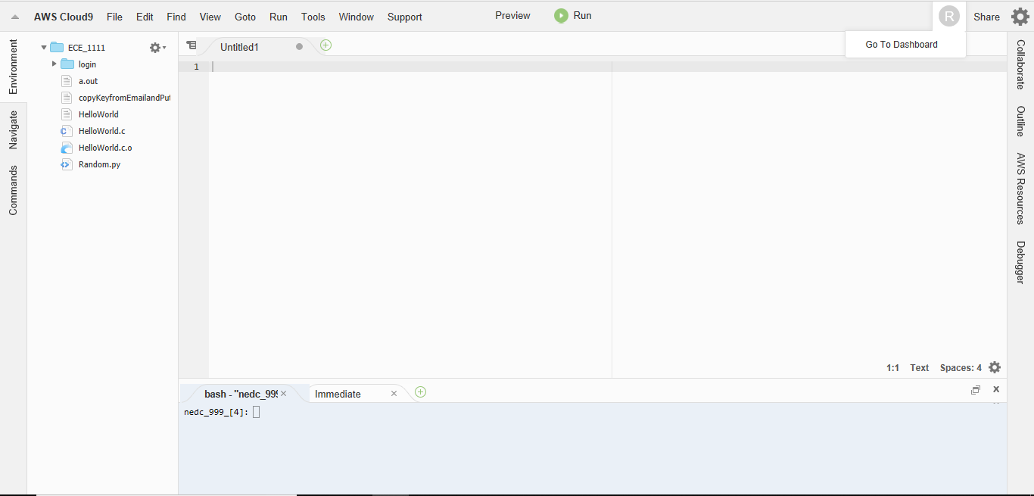
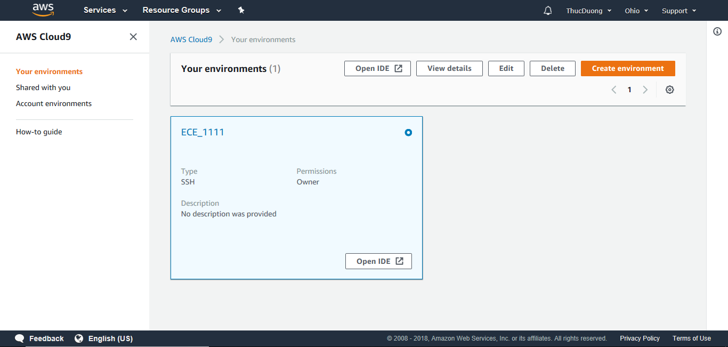
Step 11: Navigating the Cloud9 Environment
To exit the Cloud9 environment, you need to log out from the AWS Cloud9 home page, also known as the dashboard:
Click on the circle icon in the upper right labeled “Go To Dashboard”
Close the Cloud9 tab on your browser and log out of the AWS Cloud9 dashboard.
To open a new session in the Cloud 9 environment:
Go to this URL: https://us-east-2.console.aws.amazon.com/cloud9/home
Select “ECE_1111” (if you only have one environment installed, this will be done automatically).
The circle should have a white dot in it.
Select the “Open IDE” button to open up the environment.

Slide 13
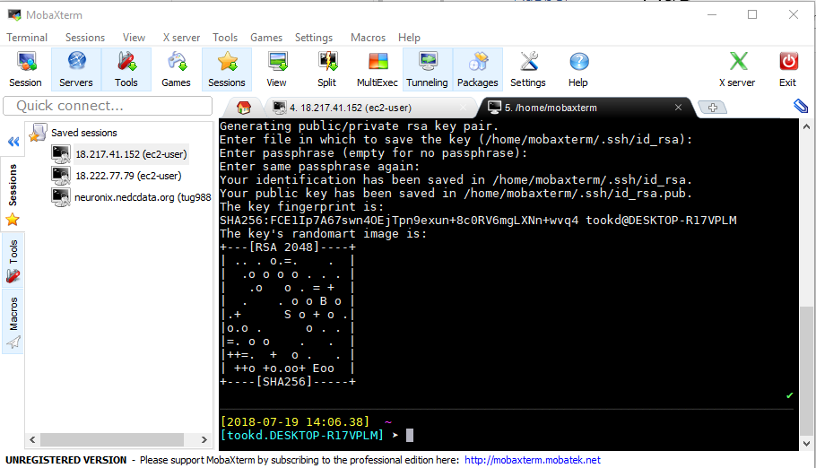
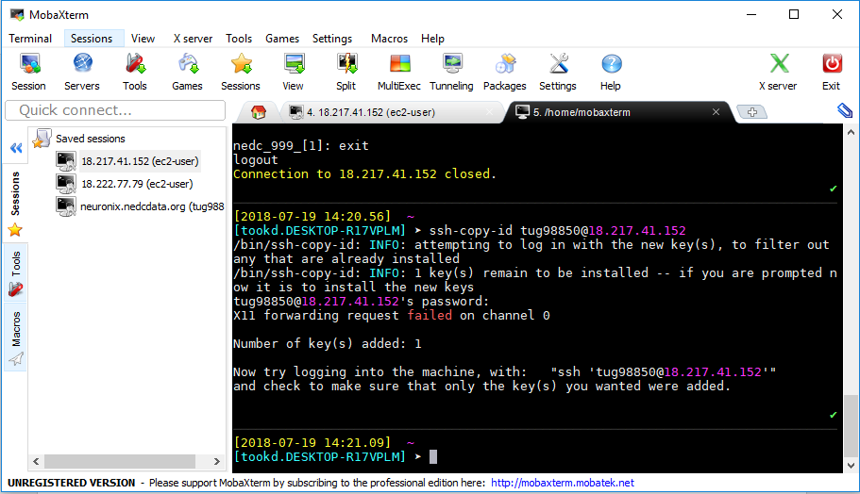
Step 12: Automatic Login
It is highly desirable that you set up ssh keys so that you do not have to type your password.
To generate a key pair to do this, type this command:
ssh-keygen
Press enter/return 4 times to use the default parameters.
Windows users will see the screen to the right; Mac users will see a simplified version of this screen.
To generate a key pair, type this command:
ssh-copy-id <tuid>@54.234.94.88
Enter your password.
Log in again and you should not be prompted for a password.

