Slide 1
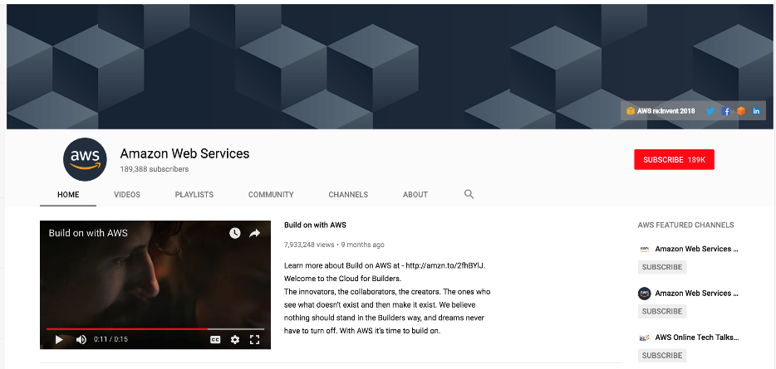
Getting Started: Accessing Our Amazon AWS Server

Slide 2
Step 1: Install A Terminal Tool
Mac Users: You will be able to use the Mac Terminal Tool to connect to the virtual machine (VM) that we have created in addition to your browser. No additional tools need to be installed.
A simple tutorial on the Mac Terminal Tool can be found here:
https://www.youtube.com/watch?v=QROX039ckO8&ab_channel=MacOSPro
Windows Users: You will need to install a terminal tool so that you can easily interact with the VM from the command line. We recommend you install MobaXterm (http://mobaxterm.mobatek.net).
A simple tutorial on MobaXterm can be found here:
https://www.isip.piconepress.com/courses/temple/unvs_0822/resources/cluster_login.mp4
Other useful tutorials can be found here:
https://www.youtube.com/watch?v=PmmK6_WEpV4&ab_channel=DanielHeater

Slide 3
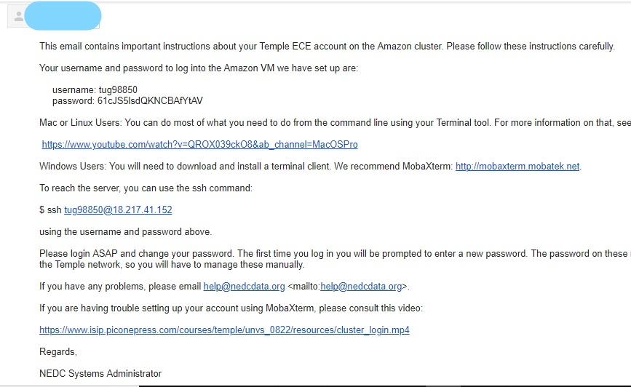
Step 2: Email Notification
You will receive an email from the course instruction team with the subject line: “Amazon AWS ECE Account”.
This email will contain your account username and initial password.
If you are on a Mac, create a terminal window using the terminal tool and follow the instructions in the email to log in.
If you are on Windows machine, please follow the instructions describing how to install MobaXterm, and how to use MobaXterm to log into the VM.
Next, you must log into the VM and change your password.

Slide 4
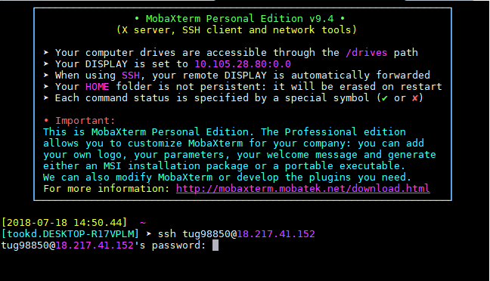
Step 3: Changing Your Password
To ssh into the VM, type this at the command line prompt:
ssh <tuid>@54.234.94.88
“<tuid>” should be your Accessnet username (e.g., tug12345).
Windows users will see the screen to the right; Mac users will see a simplified version of this screen directly in their terminal window.
Type the password from the email (or use your copy and paste tools). Note that the keyboard tool does not echo your keystrokes as you type. This is a security feature.
You should see a prompt for your current password. Again type the password from the email you received and hit enter or return.
You will now be prompted for a new password, and be asked to verify this password twice by retyping it. If all goes well, you will see the message shown to the right and be logged off.
Log in again to verify your new password using the same ssh command.

Slide 5
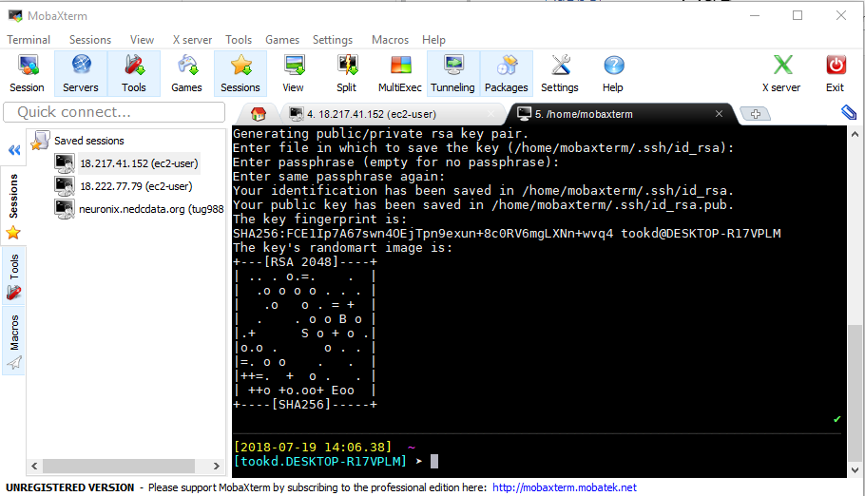
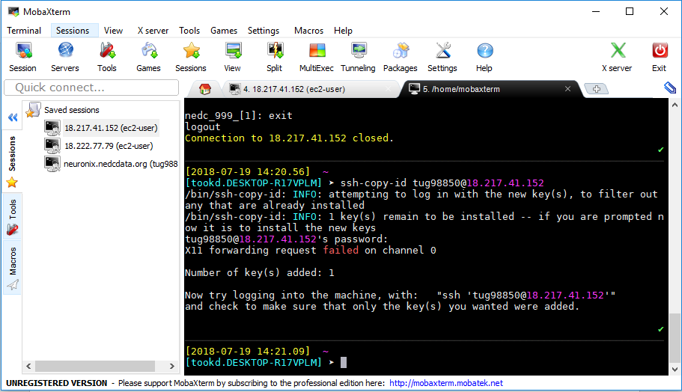
Step 4: Automatic Login
It is highly desirable that you set up ssh keys so that you do not have to type your password.
To generate a key pair to do this, type this command:
ssh-keygen
Press enter/return 4 times to use the default parameters.
Windows users will see the screen to the right; Mac users will see a simplified version of this screen.
To generate a key pair, type this command:
ssh-copy-id <tuid>@54.234.94.88
Enter your password.
Log in again and you should not be prompted for a password.

