Slide 1
Review: Normal Distributions
Recall the definition of a normal distribution (Gaussian):
$$p\left(x\right)=\frac{1}{{\left(2π\right)}^{d/2}{\left|Σ\right|}^{1/2}}e^{−\frac{1}{2}\left(\left(x−μ\right)Σ^{−1}{\left(x−μ\right)}^{t}\right)}$$
Why is this distribution so important in engineering? (Hint: least constrained solution consistent with the data.)
Mean: $μ=E\left[x\right]=\int{xp\left(x\right)dx}$
Covariance: $Σ=E\left[\left(x−μ\right){\left(x−μ\right)}^{t}\right]$= $\int{\left(x−μ\right){\left(x−μ\right)}^{t}p\left(x\right)dx}$
What does it mean for the components of $x$ to be statistically independent?
$$Σ=σ^{2}I$$
For a Gaussian distribution, what is true about the higher-order moments? How does this relate to the principle known as Occam’s Razor?
What is the entropy of a continuous Gaussian distribution? Is this a maximum value? minimum value? other?
What are the statistics of a linear combination of Gaussian random variables?
How does this relate to the Central Limit Theorem?

Slide 2
Review: Univariate Normal Distribution
A normal or Gaussian density is a powerful model for modeling continuous-valued feature vectors corrupted by noise due to its analytical tractability.
Univariate normal distribution: $p\left(x\right)=\frac{1}{\sqrt{2π}σ}e^{−\frac{1}{2}{\left(\frac{x−μ}{σ}\right)}^{2}}$
where the mean and covariance are defined by:
Mean: $μ=E\left[x\right]=\int{xp\left(x\right)dx}$
Variance: $σ^{2}=E\left[{\left(x−μ\right)}^{2}\right]$= $\int{{\left(x−μ\right)}^{2}p\left(x\right)dx}$
Statistical Independence: N/A since there is only one dimension
The entropy of a univariate normal distribution is given by:
$$H\left(x\right)=−\int_{−∞}^{∞}{p\left(x\right)ln\left(p\left(x\right)\right)dx=\frac{1}{2}ln\left(2π{eσ}^{2}\right)}$$

Slide 3
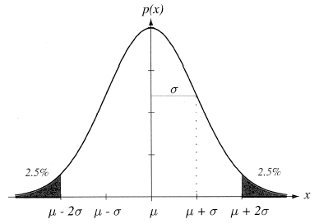
Review: Mean and Variance
A normal distribution is completely specified by its mean and variance:
The peak is at: $p\left(μ\right)=\frac{1}{\left(\sqrt{2π}\right)σ}$ .
$66\%$ of the area is within one σ; $95\%$ is within $2$; $99\%$ is within $3$.
A normal distribution achieves the maximum entropy of all distributions having a given mean and variance.
Central Limit Theorem: The sum of a large number of small, independent random variables will lead to a Gaussian distribution.
Can you provide an intuitive explanation for this? (Hint: convolution.)

Slide 4
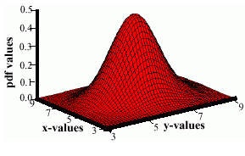
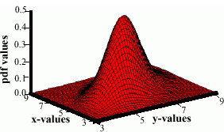
Review: Multivariate Normal Distributions
Recall the definition of a normal distribution (Gaussian):
$$p\left(x\right)=\frac{1}{{\left(2π\right)}^{d/2}{\left|Σ\right|}^{1/2}}e^{−\frac{1}{2}\left(\left(x−μ\right)Σ^{−1}{\left(x−μ\right)}^{t}\right)}$$
where $μ$ represents the mean (row vector) and $Σ$ represents the covariance matrix, and $x$ represents the input data as a (row) vector.
Note the exponent term is really a dot product or a weighted Euclidean distance. This can be computed very efficiently on modern processors.
The covariance is always symmetric and positive semidefinite.
How does the shape vary as a function of the covariance?

Slide 5
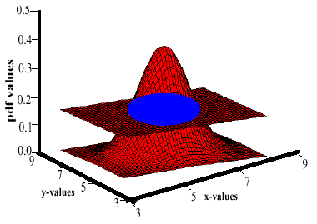
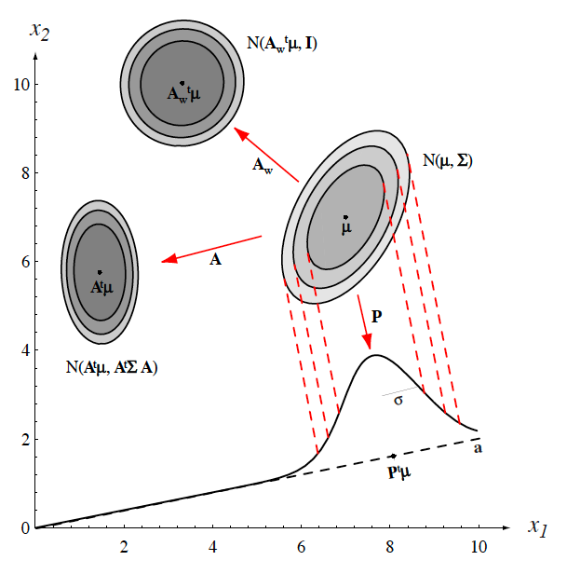
Review: Support Regions
The pdf of 2D random vector requires 3D to visualize (the third dimension is the value, or height, of the pdf).
We cannot directly visualize the pdf of a 3D random vector since this would require four dimensions. Also, it is difficult to visualize a 3D function and understand its shape.
A support region is the obtained from the intersection of a Gaussian distribution with a horizontal plane (the locus of points that the same probability).
For a horizontal plane, this generates an ellipse whose points are of equal probability density.
The shape of the support region is defined by the covariance matrix.

Slide 6
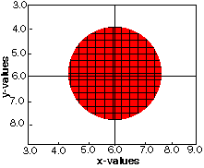
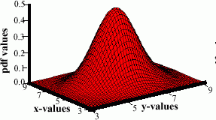
Review: Identity Covariance
A Gaussian random vector with a covariance matrix that is a scaled identity matrix has equal variance in all directions:
$$Σ=\left[\begin{matrix}σ^{2} & 0 \\ 0 & σ^{2}\end{matrix}\right]$$
The support region, shown on the right, is a circle in 2D and a sphere in 3D.

Slide 7
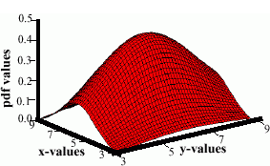
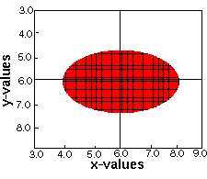
Review: Unequal Variances
A Gaussian random vector with a covariance matrix that has unequal variances but still a diagonal matrix:
$Σ=\left[\begin{matrix}5 & 0 \\ 0 & 2\end{matrix}\right]$ $Σ=\left[\begin{matrix}2 & 0 \\ 0 & 5\end{matrix}\right]$
The support region is an ellipse with a major dimension aligned in the direction of greatest variance.

Slide 8
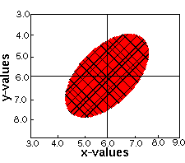
Review: Nonzero Off-Diagonal Elements
A Gaussian random vector with a covariance matrix that has non-zero off-diagonal elements:
$Σ=\left[\begin{matrix}1 & 0.5 \\ 0.5 & 1\end{matrix}\right]$ $Σ=\left[\begin{matrix}1 & −0.5 \\ −0.5 & 1\end{matrix}\right]$
The support region is an ellipse rotated at a 45$°$ angle with respect to the original coordinate axes.

Slide 9
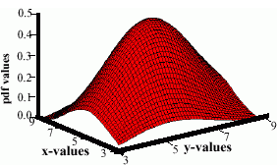
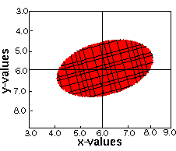
Review: Unconstrained or “Full” Covariance
A Gaussian random vector with a covariance matrix that has a fully-populated covariance matrix:
$Σ=\left[\begin{matrix}5 & 0.5 \\ 0.5 & 2\end{matrix}\right]$ $Σ=\left[\begin{matrix}5 & −0.5 \\ −0.5 & 2\end{matrix}\right]$
The support region is an ellipse. The angle of rotation and the relationship between the major and minor axis can be predicted analytically.

