Slide 1
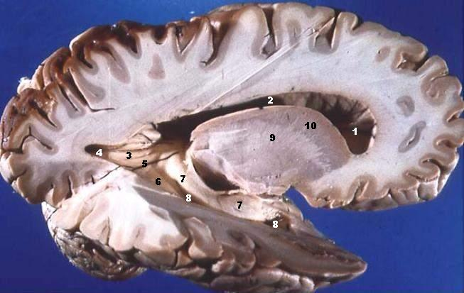
grey matter in the brain
Meysam Golmohammadi

Slide 2
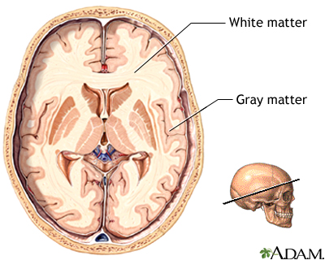
Grey Matter vs. White Matter
The central nervous system - CNS - has two kinds of tissue:
Grey matter: has a pinkish-grey color in the living brain and is a major component of the central nervous system,
White matter: is made of axons connecting different parts of grey matter to each other.

Slide 3
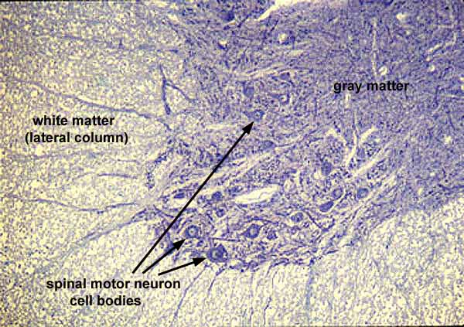
Grey and White Matter Tissues
Grey Matter mostly consists of :
neuronal cell bodies
neuropil : is a broad term defined as any area in the nervous system composed of mostly unmyelinated axons, dendrites and glial cell processes that forms a synaptically dense region containing a relatively low number of cell bodies.
glial cells.
synapses
capillaries.
White matter mostly consists of:
glial cells
myelinated axons

Slide 4
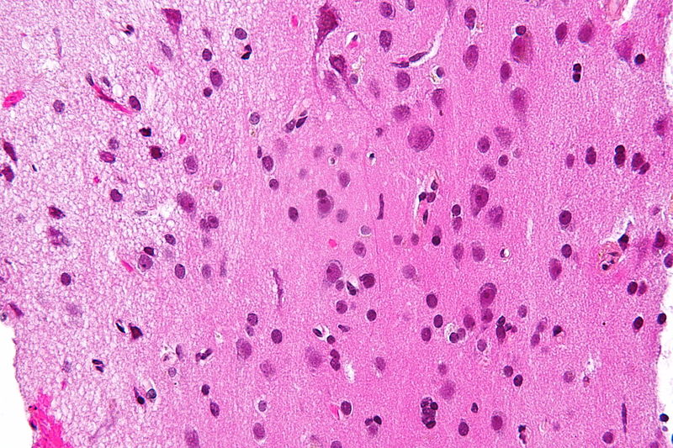
Why Is Gray Matter Gray?
The color difference between white matter and green matter is related mainly to the whiteness of myelin.
In living tissue, grey matter actually has a very light grey color with yellowish or pinkish hues, which come from capillary blood vessels and neuronal cell bodies.
White matter tissue of the freshly cut brain appears pinkish white to the naked eye because myelin is composed largely of lipid tissue veined with capillaries.

Slide 5
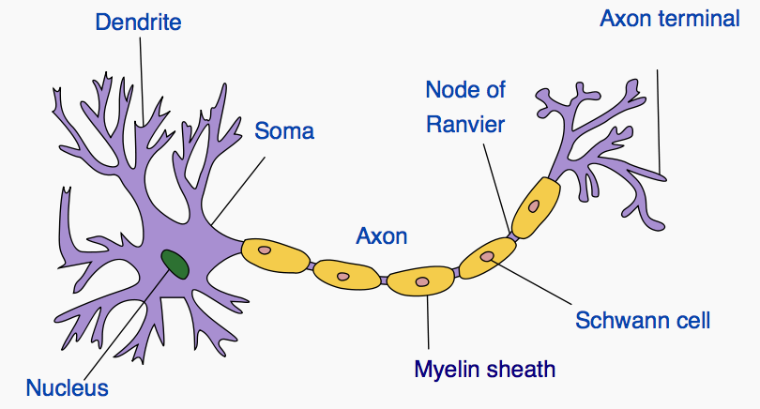
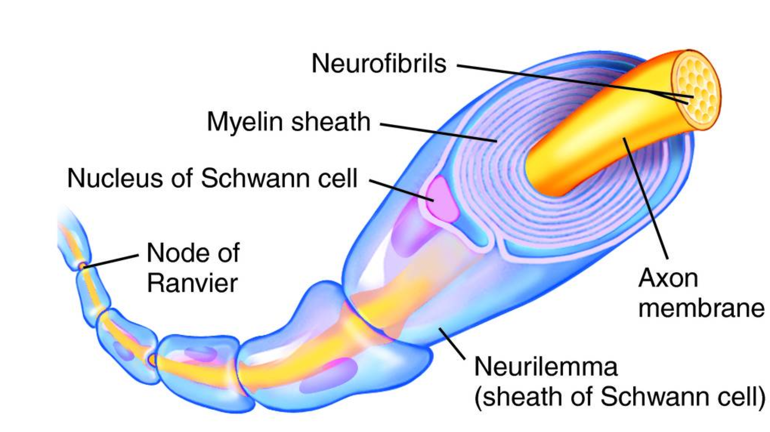
Myelin
Myelin is a fatty white substance that surrounds the axon of some nerve cells, forming an electrically insulating layer.
The thicker the myelin sheath – the faster and more efficient the nerve fiber becomes.
It is essential for the proper functioning of the nervous system.
It is an outgrowth of a type of glial cell.
Myelination occurs during the learning process.
It allows you to develop skills, like drumming, over time. The more you practice, the more your myelin grows.

Slide 6
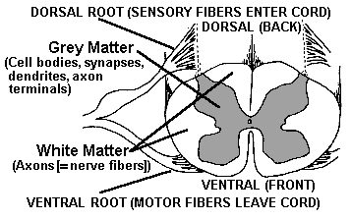
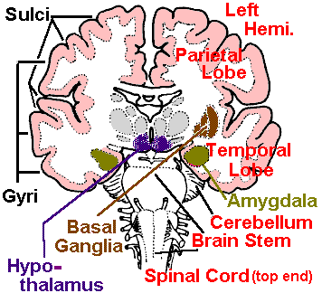
Where is Gray Matter
The surface of the cerebral hemispheres or cerebral cortex
The surface of the cerebellum or cerebellar cortex.
Deep within the cerebrum in the hypothalamus, thalamus, subthalamus and in the structures that make up the basal ganglia (the globus pallidus, putamen, and nucleus accumbens).
Deep within the cerebellar in the dentate nucleus, emboliform nucleus, fastigial nucleus and globose nucleus.
In the brainstem in the red nucleus, olivary nuclei, substantia nigra and the cranial nerve nuclei.
In the spinal grey matter including the anterior horn, the lateral horn and the posterior horn.

Slide 7
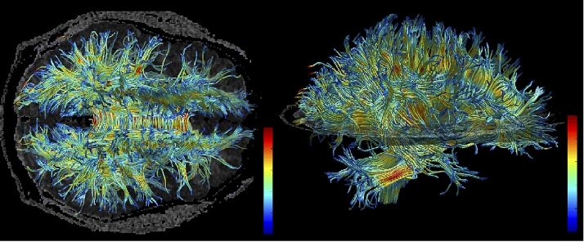
Gray and White Matter Functions
The grey matter includes regions of the brain involved in muscle control, and sensory perception such as seeing and hearing, memory, emotions, speech, decision making, and self-control. Grey matter makes up 40% of brain matter. white matter comprises the other 60%.
White matter is composed of bundles of myelinated nerve cell projections (or axons), which connect various grey matter areas (the locations of nerve cell bodies) of the brain to each other, and carry nerve impulses between neurons.

