Slide 1
Verify that a 10-20 is a subset of a 10-10 EEG

Slide 2
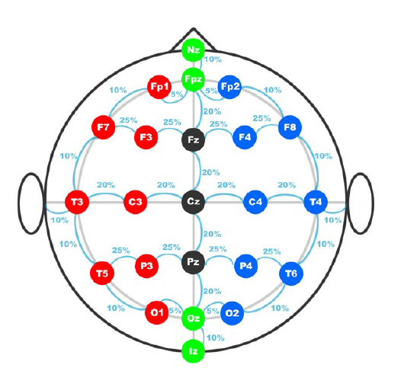
10-20 system positioning
21 electrode
Increasing need for higher density electrode setting. Therefore 10-10 system was introduced.

Slide 3
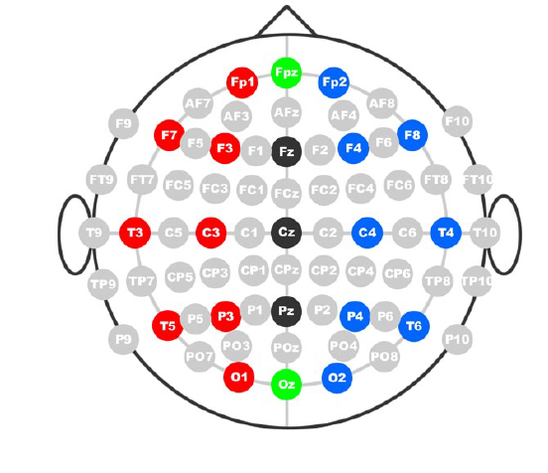
10-10 system positioning
75 electrodes
Divided from Nz to Iz LPA to RPA, in 10% increments.

Slide 4
Conclusion
10-20 system positioning is subset of 10-10 system positioning.

Slide 5
References
[1] A. M. Husain, Practical Epilepsy: Springer Publishing Company, 2015.( page:92-93)
[2] V. Jurcak, D. Tsuzuki, and I. Dan, "10/20, 10/10, and 10/5 systems revisited: their validity as relative head-surface-based positioning systems," Neuroimage, vol. 34, pp. 1600-1611, 2007.

