Slide 1
Brain Imaging with MRI
MRI of Neuronal Network Structure, Function, and Plasticity
Henning U. Voss, Nicholas D. Schiff
Progress in Brain Research, Vol. 175 2009
Weill Cornell Medical College

Slide 2
Overview
Styles of MRI
Diffusion Tensor Imaging
Resting state fMRI
Resolution
Spatial – 5mm to 1mm
Temporal – 1s
MRI impact on trauma analysis
Shifts in resting state networks

Slide 3
Two Main Approaches
Diffusion Tensor Imaging (DTI)
Resting State fMRI
Thermal diffusion of water protons
Effective in targeting white matter networks
Can determine direction, specific to location
Fractional Ansiotrophy (FA), directional dependence of diffussion
Reliant on BOLD
Blood Oxygen Level Dependent
Reliant on algorithms to resolve blood flow into a cohesive pattern
Broad results confined to areas of interest

Slide 4
DTI and Brain Injury
Traditional MRI does not revel white matter fiber
Fiber Tracking methods of DTI have been shown to be equal or exceed accuracy of anatomical atlases
DTI is sensitive to degree of myelination and axonal density, due to water based imaging
Very useful for detecting axonal reorganization and regrowth
Cases studies against coma patients and controls and controls against those with traumatic brain injuries to highlight unique imaging responses

Slide 5
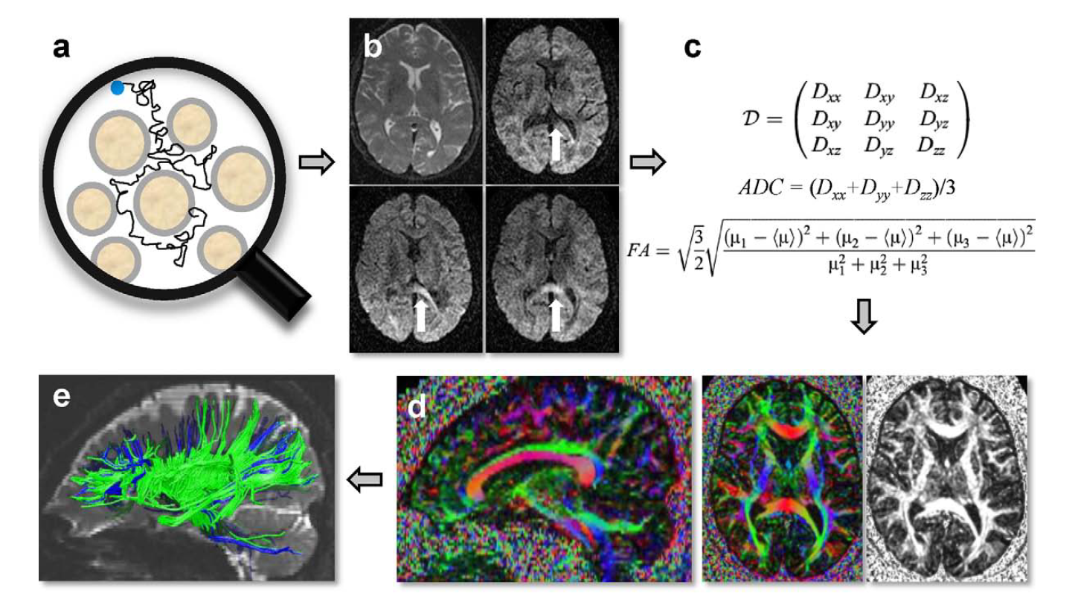

Slide 6
fMRI – known resting state network modes
RSN 1 : default network mode - posterior cingulate and precuneus, medial prefrontal cortex, dorsal lateral perforntal cortex, inferior parietal cortex
RSN 2 : dorsal attention network - intraparietal sulci, areas at the intersection of precentral and superior frontal sulcus, central precentral, middle frontal gyrus
RSN 3 : visual processing network - retinoptic occipital cortex, temporal-occipital regions
RSN 4 : auditory-phonological network - superior temporal cortices
RSN 5 : sensory-motor network - precentral/postcentral/medial frontal gyri, primary sensory-motor cortices, supplementary motor area
RSN 6 : self-referential network - medial-ventral prefrontal cortex, pregenual anterior cingulate, hypothalamus, cerebellum

Slide 7
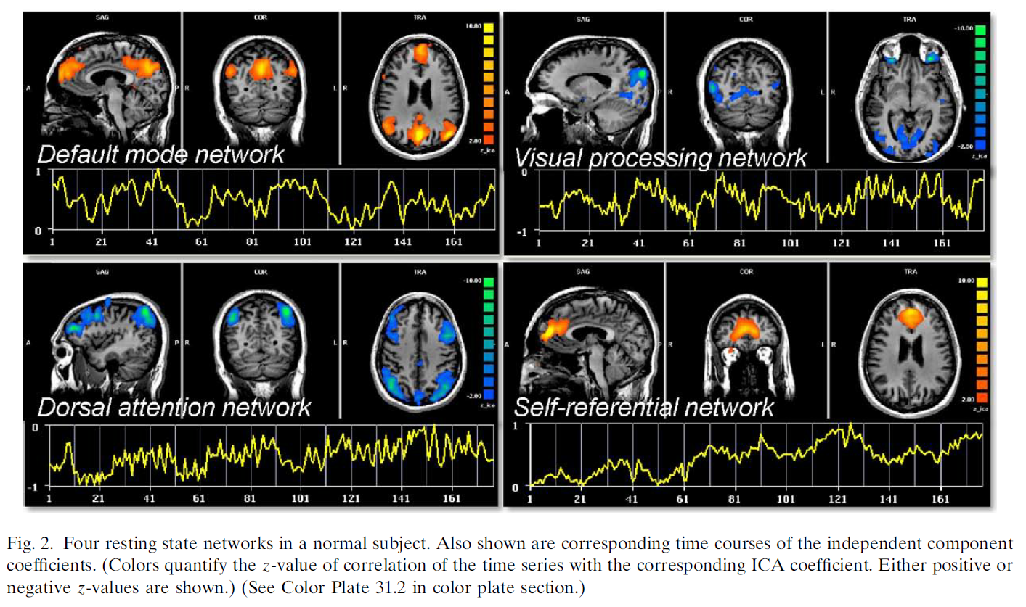

Slide 8
Disease detection via fMRI
Known to present in those with the following conditions:
Alzheimer’s Disease, aging brains, blindness, schizophrenia, ADHD, epilepsy
Most studies conclude with the networks overlapping in the thalamic structures
Hopeful of a quick way to give a brain assessment via the state of this one region
Able to distinguish between control, minimally conscious states and vegetative states

