Slide 1
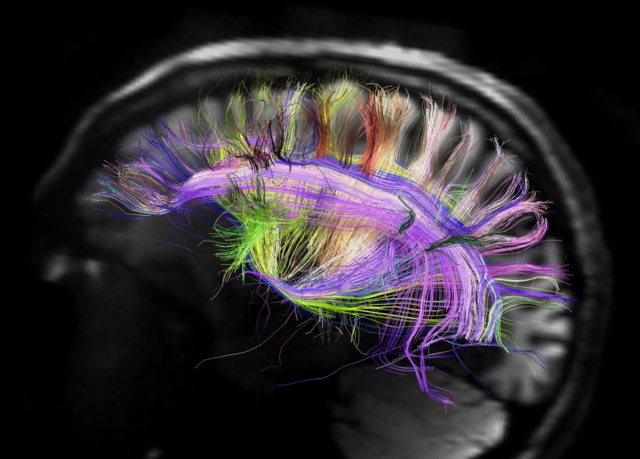
Diffusion Magnetic Resonance Imaging (dMRI)
Meysam Golmohammadi

Slide 2
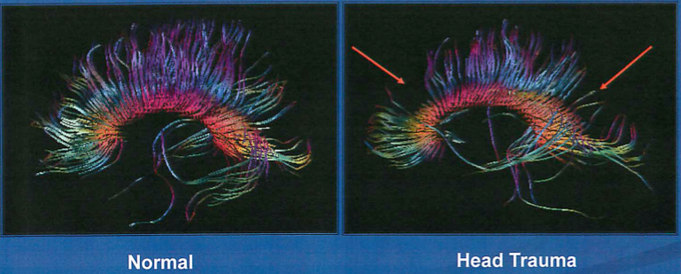
What is dMRI?
allows the mapping of the diffusion process of molecules, mainly water, in biological tissues, in vivo and non-invasive.
The first diffusion MRI images of the normal and diseased brain were made public in 1985.
the study and treatment of neurological disorders, especially for the management of patients with acute stroke.

Slide 3
MRI vs fMRI vs dMRI
diagnose soft tissues of the human body
investigation of the human brain for revealing the peculiarities of anatomical
indispensable when it comes to diagnosis of abnormalities developing in the human brain.
MRI measures the molecule called hydrogen nuclei.
create the image of what is going inside the human brain
focus on the processes in the human bran as they will develop in time.
maps the image via measuring the blood flw levels in the human brain.
shows changes in the metabolic functioning in the brain.
FMRI measures oxygen levels flowing into the brain and calculates the differences in tissue with respect to time.
understanding of brain structural connectivity
measure macroscopic axonal organization in nervous system tissues.
reveal abnormalities in white matter fiber structure and provide models of brain connectivity
the measurement of the restricted diffusion of water in tissue
MRI
fMRI
dMRI

Slide 4
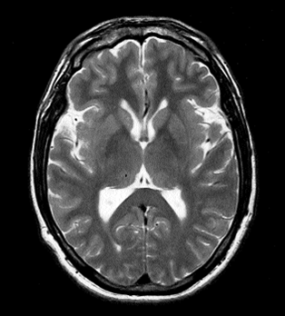
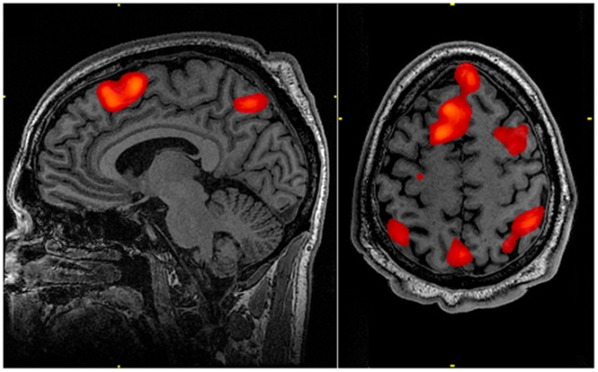
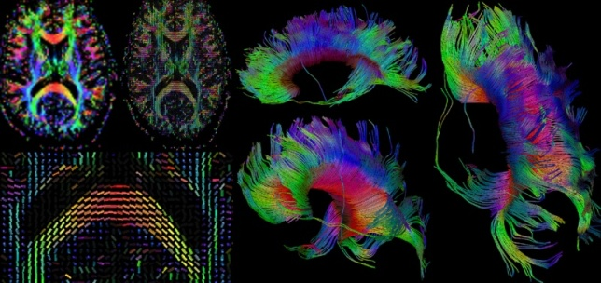
MRI vs fMRI vs dMRI
MRI
fMRI
dMRI

Slide 5
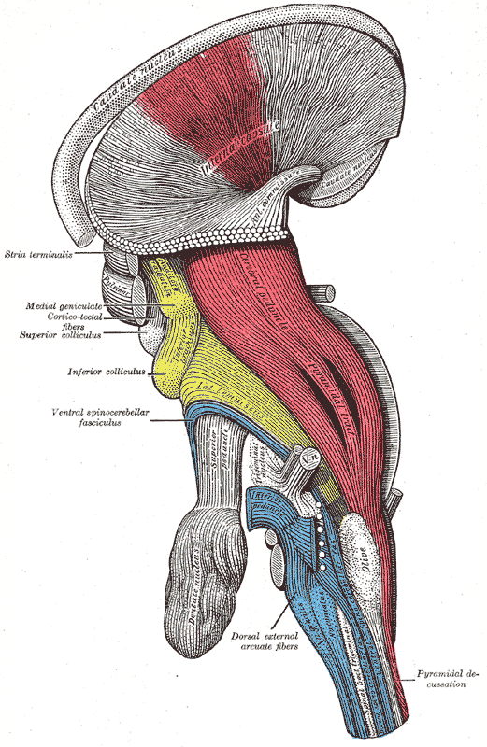
White-matter imaging
Axons measure um in width
They group together in bundles that traverse the white matter
We cannot image individual axons but we can image bundles with diffusion MRI
Useful in studying neurodegenerative diseases, stroke, aging, development…

Slide 6
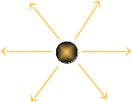
Diffusion in brain tissue
Gray matter: Diffusion is unrestricted: isotropic
White matter: Diffusion is restricted: anisotropic

Slide 7
Approach
Magnetic resonance imaging can provide “diffusion encoding”
Magnetic field strength is varied by gradients in different directions
Image intensity is attenuated depending on water diffusion in each direction
Compare with baseline images to infer on diffusion process

Slide 8
Types
Diffusion Weighted Imaging (DWI): most applicable when the tissue of interest is dominated by isotropic water movement e.g. grey matter in the cerebral cortex and major brain nuclei,
Diffusion Tensor Imaging (DTI): important when a tissue, such as the neural axons of white matter in the brain or muscle fibers in the heart, has an internal fibrous structure.
More recently, a new field has emerged, diffusion functional MRI (DfMRI).

Slide 9
I am interested in dMRI because …
Its application in neurodiagnost ic tests like:
For years, neuroscientists have defined epilepsy as a case when too many nerve cells in the brain fire at once, provoking a seizure. Now, researchers have determined that it isn’t just a matter of function – the brains of people with epilepsy structurally differ from those of people without the disorder. According to lead researcher Steven Stufflebeam, a neuroradiologist at Massachusetts General Hospital, the differences between the two brains suggest new ways to diagnose and treat epilepsy moving forward.
I hope to gain insight into the relationship between structure and function in the human brain.
I believe memory in brain is implemented also inside the structure. I hope to understand the influence of architecture on learning and memory,
understanding how the topology of cortical connectivity can be embedded into 3-dimensional physical space.

