Slide 1
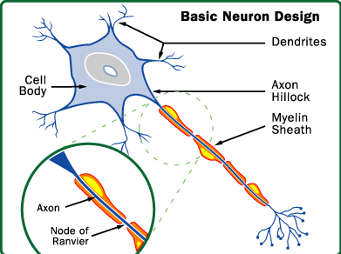
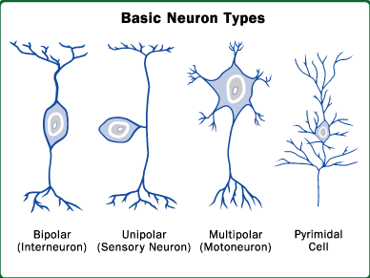
Largest Contributors to the EEG Signals are the Pyramidal Cells.
Radially oriented in the cortex.
They fires at a same time with same polarity so Electro-Magnetic
Fields of these co-aligned and co-activated neurons add up.
Our brain believes in synchronization meaning that the neurons
Fires at the same time with certain regular rates. So , during idle
Condition fired signal does not travel through the different regions.

Slide 2
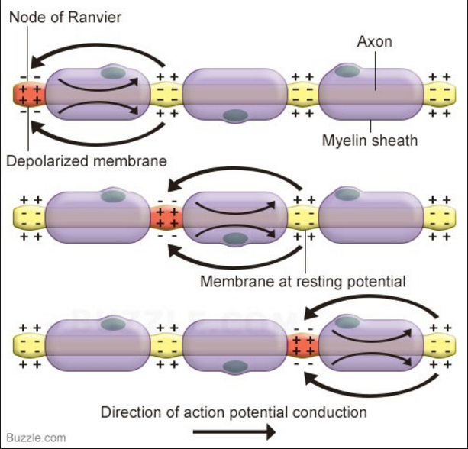
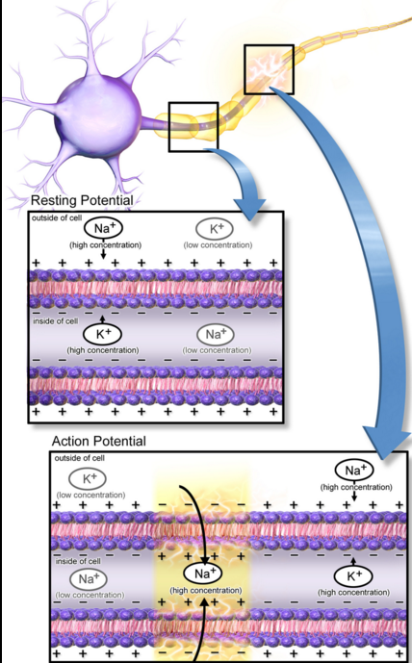
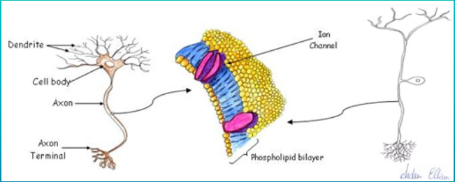
When a neuron fires, it gives permission to the bilipid layers to open the gates for a little while. But here, an interesting phenomenon happens, even though Ion concentration is lower at outside of the layer Sodium has very high tendency to rush in side the cell.. But wait, this is not a straight flow of ions in axons…Thanx to Myelin sheath.

Slide 3
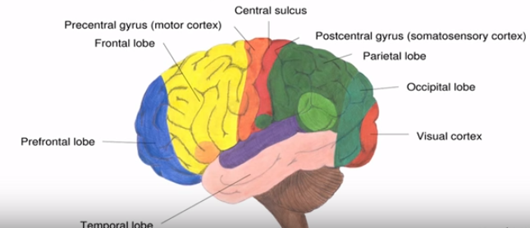
Can’t be observed the root where neuron fired but cascaded effects can be seen.
When talking about synchroni, if we are observing broad patch of neurons which are not connected directly by fiber tracts….These neurons are rather unlikely to fire together.
Because of no machanism to synchronize their selves, Propagation from one neuron from one to other takes too long and can be observed.
That means spatially compact populations of neurons fire together.
Sometimes compact population of neurons gives us nothing because opposite polarities firing at the same time cancels each other. (i.e. Amygdala)
We can assign different kinds of functions to the various parts of the
Brain. (Sensory neurons and control neurons (motor/ Somatic Nervous sys) )
i.e. Hand movements in/ around Central sulcus; Visual Contex processes
on eye activities.
There are also areas in the brain very far from anything related to sensory
Or motor events (i.e. Frontal lobe). No further information but probably for
More abstract activities like for memory.. ( Brain Atlas)

Slide 4
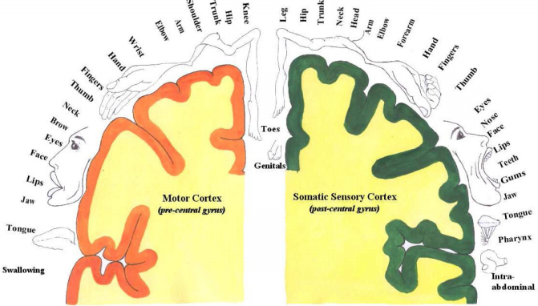
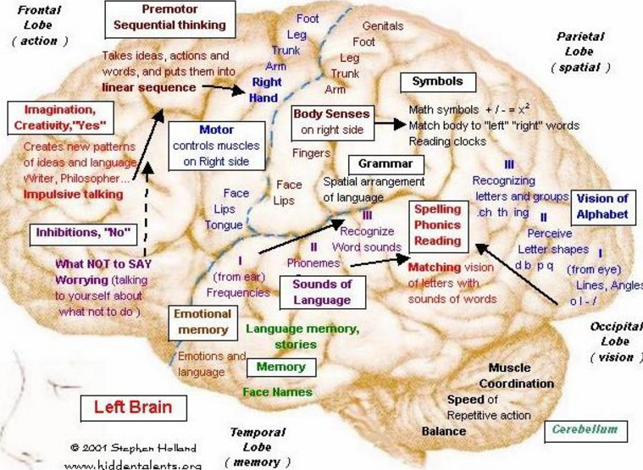
Functional Mapping Observe sulcus Although we have this mapping , we still have to use machine learning algorithms in order to get rid of noise and eventually define an event..

Slide 5
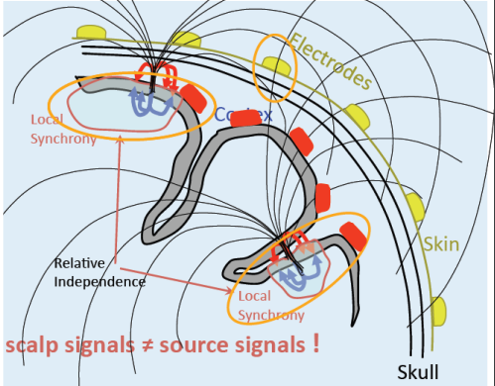
I said pyramidal cells are radially oriented in the cortex. But Wait !!! Our brain is not completely circular or elliptical.
Observe marked Circles (near Local Synchrony)
But what helps us in observing in EEG is :- This is system is completely Linear (just untangle the weighted sums).

Slide 6
Rhythms : ( note that, Not only Frequencies but Amplitudes also have importance)
Alpha:- Each region of brain have an alpha rhythm but it is being recorded with maximum
Amplitude in Occipital and Parietal region. In general, Amplitude of Alpha waves disappears
When subject open its eyes and/or attentive to the external stimuli.
Sensory areas (Visual Cortex, auditory Cortex) and motor areas (motor Cortex) exhibit strong
Alpha band oscillations when “idle” in most subjects.
Beta:-Beta rhythms occur in individuals who are alert and attentive to the external stimuli. Also occurs during deep sleep (REM).
So, Beta waves represents arousal of the cortex to a higher state of alertness and tension. ( during memories and remembering).
Motor Cortex often generates Beta oscillations
Theta:-Known to occur in “bursts” relative to events in certain brain areas (e.g. Frontal midline, lateral frontal,..)
Theta waves will occur for brief intervals during emotional responses to frustrating events or situations.
Delta:- Delta waves may increase during difficult mental activities requiring concentration.
Delta and Theta are low frequency EEG patterns that increase during sleep in normal adult. As people move from lighter to deeper levels of sleep, Alpha waves diminish and gradually replaced by low frequency Delta and Theta waves..

Slide 7
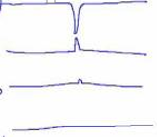
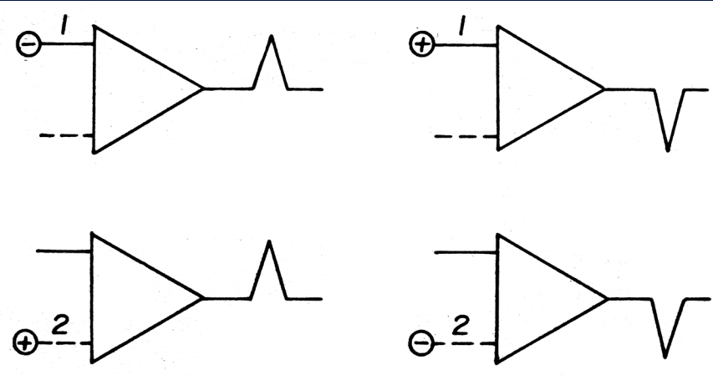
Let’s Jump in to learn how to read an EEG:-
Localization:-
FP 1 – F 3
FP1 is relatively more positive or F3 is relatively more negative..
F 3 – C 3
Similarly, F3 is relatively more negative or C3 is relatively more positive.
C 3 – P 3
P 3 – O 1
Observe the area of Phase-Reversal. It tells us the area of epileptical generation..
Notice and remember that downwards is Positive and Upwards is Negative in Graph.

Slide 8
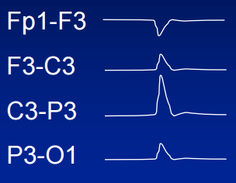
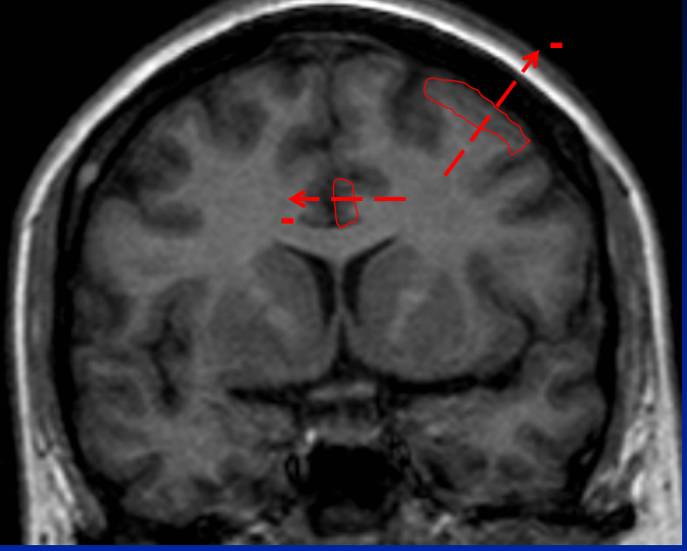
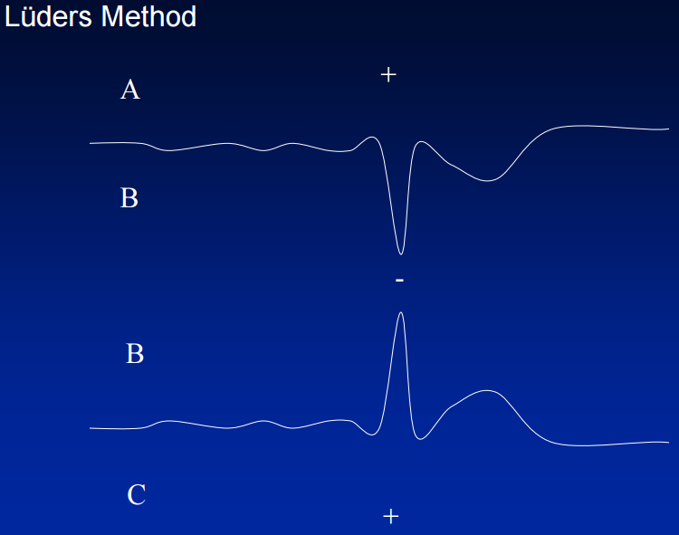
What is the center of the field ??
C 3 and P 3
F3
C3
P3-O1
O1
Fp1
Fp1-F3
Also , what is the polarity ????
So by looking at the polarity, Amplitudes of montages, we can assume the location of EM Field generation.

Slide 9
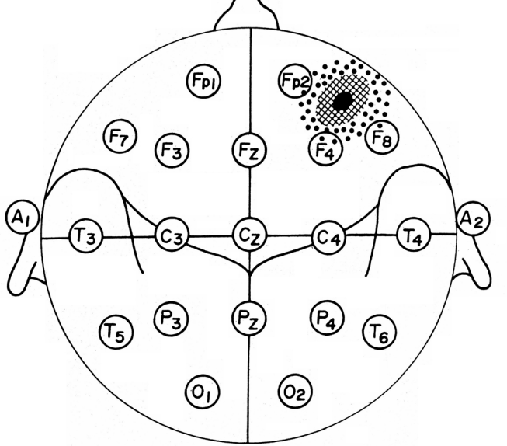
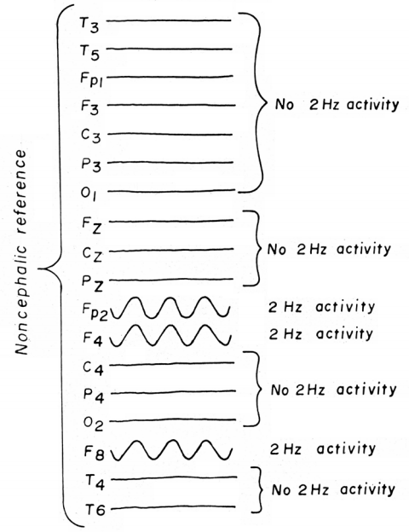

Slide 10
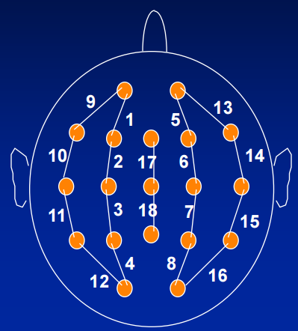
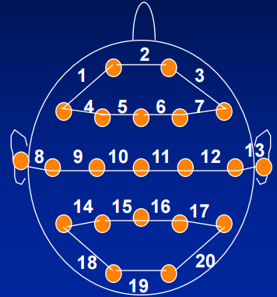
Bipolar Longitudinal and Transverse montages.

Slide 11
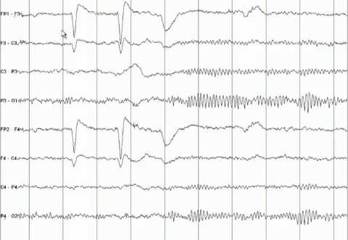
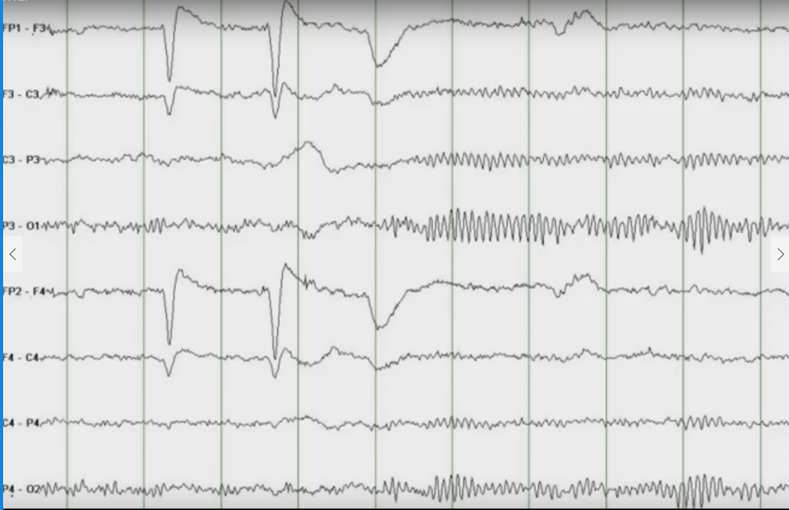
Normal EEG
Normal EEG
FP 1 –F 3
F 3 –C 3
C 3 – P 3
P 3 – O 1
FP 2 – F 4
F 4- C 4
C 4- P 4
P 4 – O 2

Slide 12
Normal EEG
Change from low amplitude – high frequency to Alpha Rhythm on Eye Closure is Called Reactivity.
Reactivity assigns behavior of a healthy brain.

Slide 13
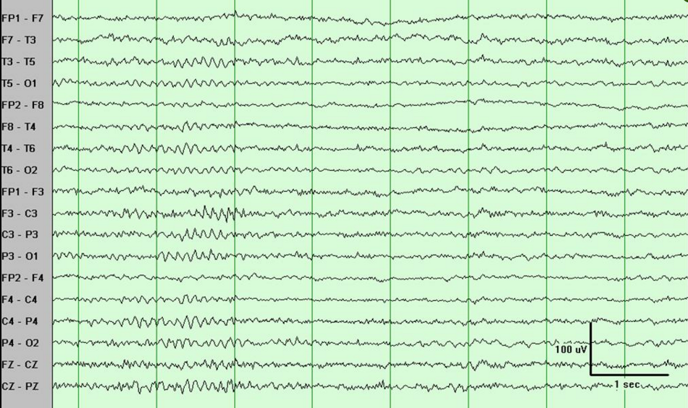
Stage 1 Sleep:- ( Drowsiness or Pre-sleep (Earliest stage of sleep) )

Slide 14
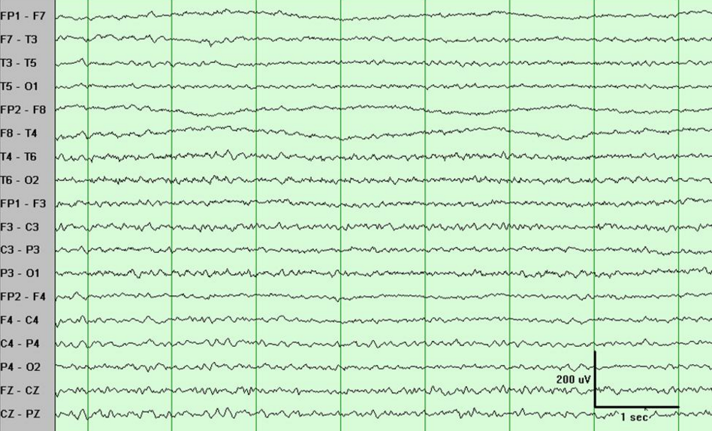

Slide 15
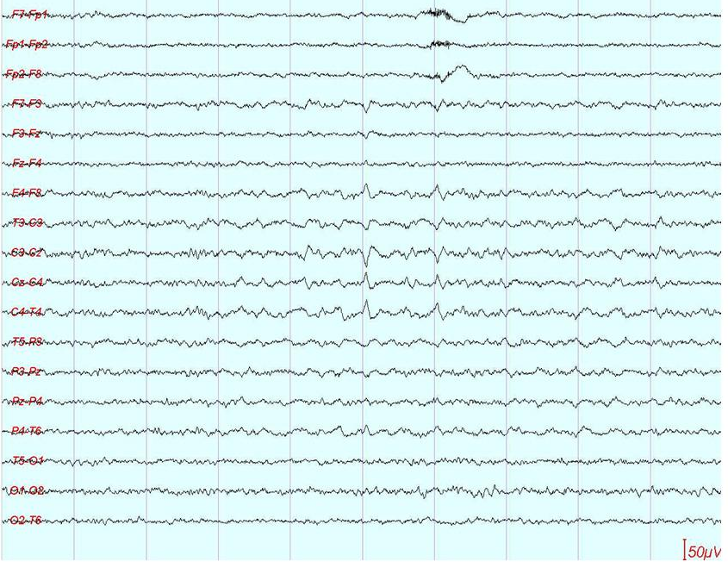
Observe vertex Sharp Transients:-
V waves are sharp waves occurs during sleep. They are large and most evident at vertex bilaterally and usually symmetrically. ( Usually occurs in sleep 2..)
Vertex waves would be sometimes missed in longitudinal bipolar-montages if it do not include midline channels (Cz-Fz-Pz).
See next figure for that…

Slide 16
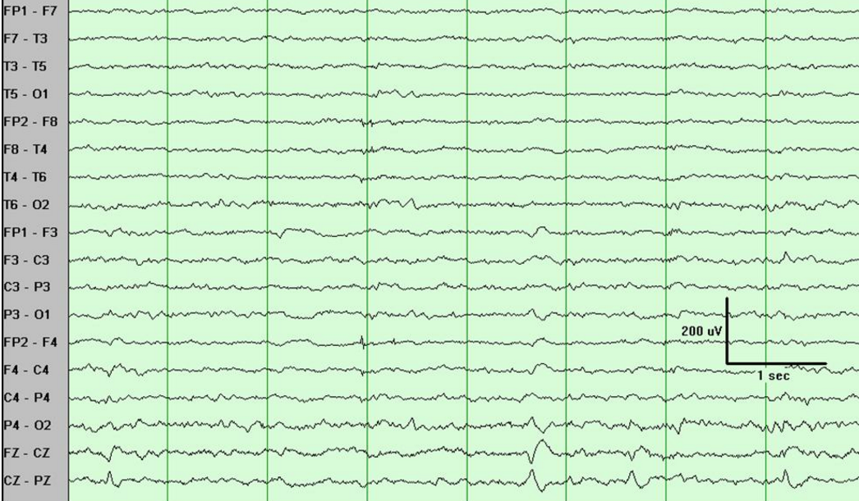

Slide 17
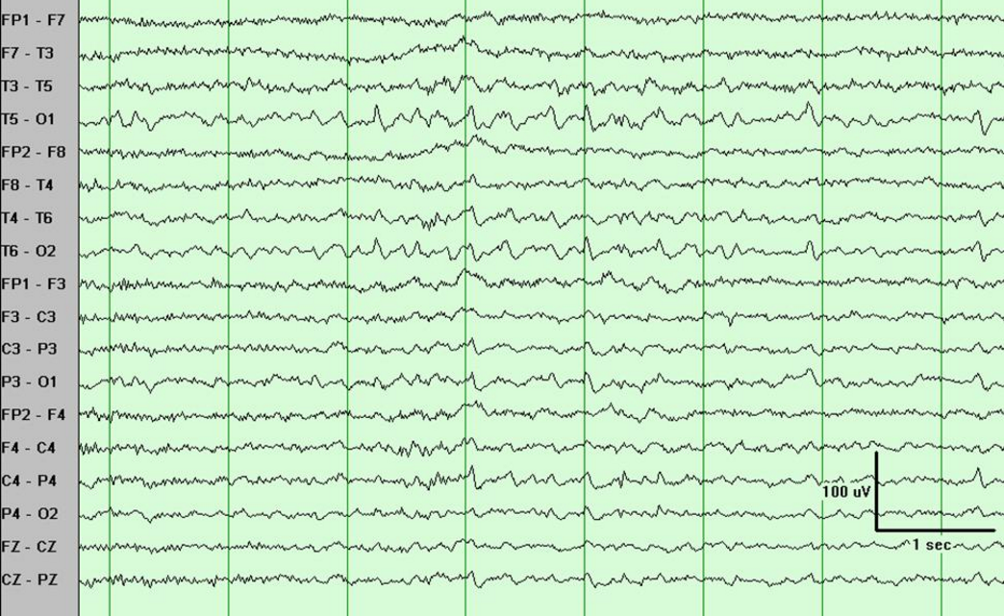
Observe POSTs Here
Positive Occipital Sharp Transients of Sleep :- (as the name suggests look at the regions )
(T5-P3-Pz-O1-P4-T6-O2)

Slide 18
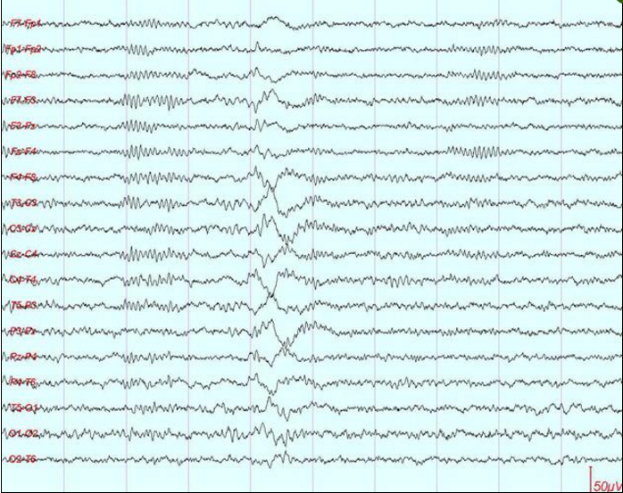
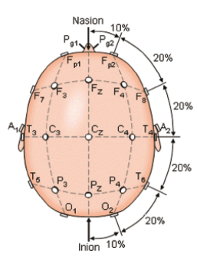
Observe Sleep spindles and K-complexes in this bi-polar Transverse montage
Some quick notes about K-complex : They are high amplitude, long duration, biphasic waveform followed by sleep spindles.
Observe Phase reversal at midline . (What would happen in longitudinal montage ?)
Stage 2 sleep

Slide 19
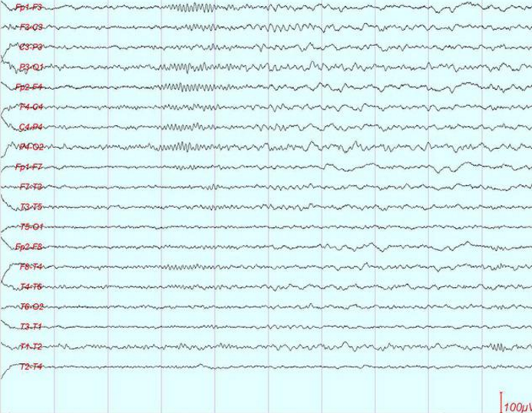
Typical Sleep-spindles with short lived waxing and waning of 15 Hz activity maximum in the fronto-central regions.
Note that associated slow (theta) frequency also characterizes stage 2 sleep.

Slide 20
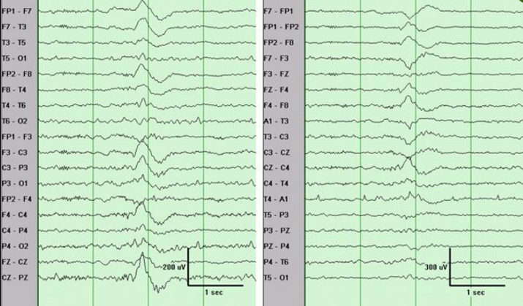
Comparison of K-complex in longitudinal and Transverse Montages.
On the longitudinal montage (left) , the K-complex appears to be more generalized.
However, the transverse montage clearly shows that the maximum (Phase reversal ) is at the midline.

Slide 21
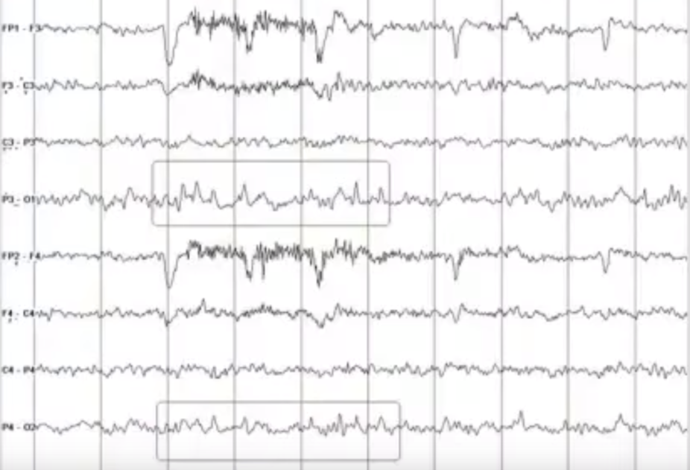
Benign EEG variants:-
What do we mean by Benign EEG variants ??
The waveforms that can be misinterpreted as epileptiform discharges….
Observe the lambda rhythm indicated in boxes.
During Eye-blink artifacts, if Sharp discharges at p3-o1-T5 or p4-o2-T6 are observed (Lambda waves), those sharp waves should not be interpreted as epileptiform discharges….

Slide 22
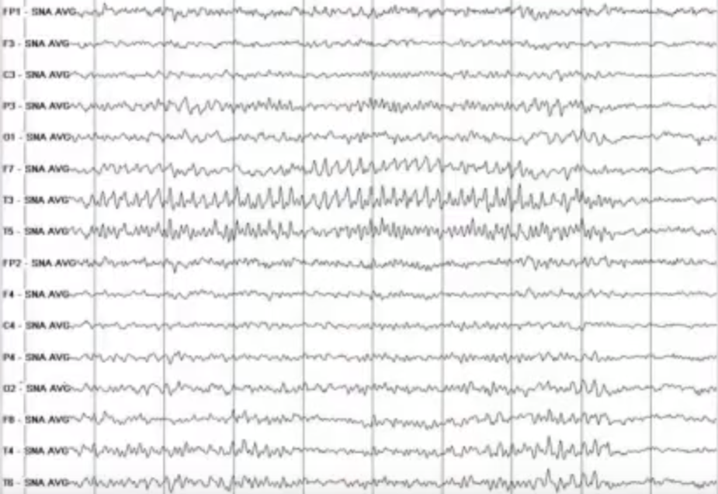
Psychomotor Variant
Rhythmic Activity(theta waves) does not evolve in frequency a lot. This is also called Rhythmic mid-temporal theta of drownsiness.
If this kind of pattern evolves in frequency and spreads then there can be some possibilities of Temporal lobe Epilepsy occuring. (Here it is not)
When person is awake, this is pattern is not called psychomotor variant.

Slide 23
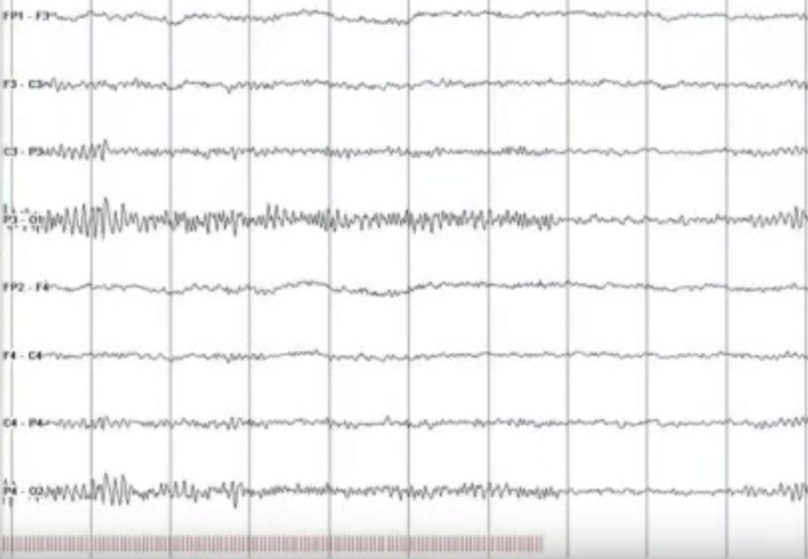
Photic Stimulation
Observe the vertical bars at the bottom, which indicates strobe light stimulation frequency.
Observe the response of occipital region with freq. of strobe lights.
This is called Photo driving response.
If person is having photo-sensitive epilepsy then with photic simulation then epileptiform discharges can be observed.

Slide 24
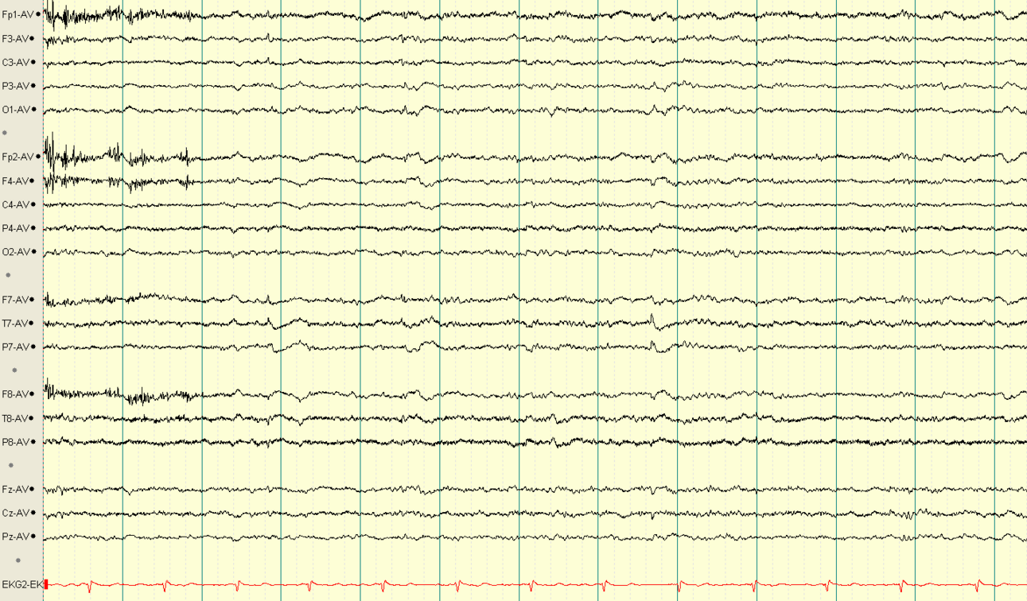
Small Sharp Spikes
Small sharp spikes also known as benign epileptiform transients of sleep which are typically less than 50 microvolts and of duration less than 30 milliseconds observed during sleep are benign.

Slide 25
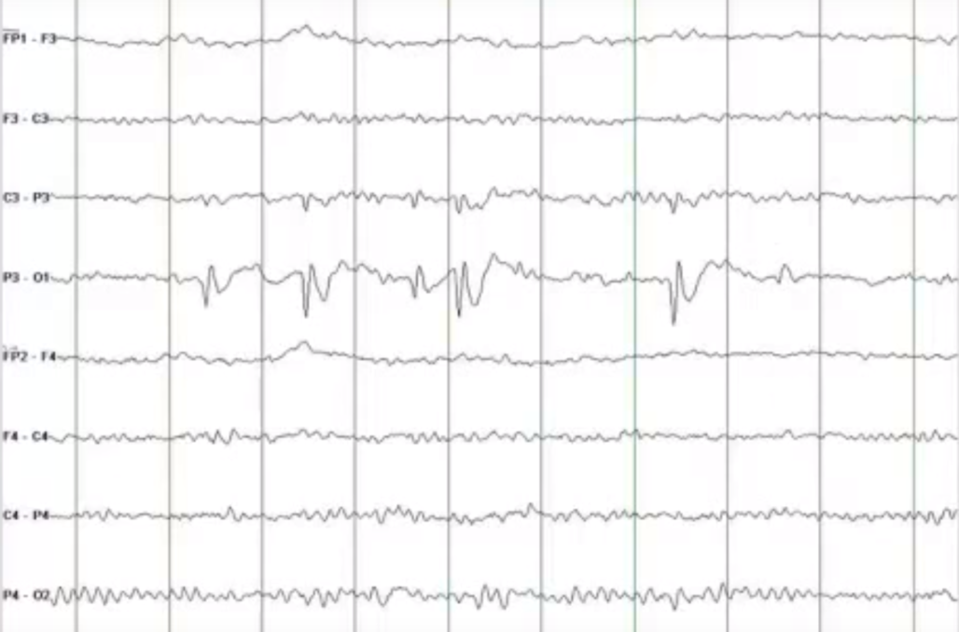
Occipital Sharp Waves
Should not be confused with lambda waves or POSTS
Can be an indication of epileptiform discharges.

Slide 26
Lateral Rectus Spikes
Right before succurd, a small sharp wave occurring at F7 F8 are called Lateral Rectus Spikes (Lateral Muscle Spikes)
Also known as presaccatic spike potentials.

Slide 27
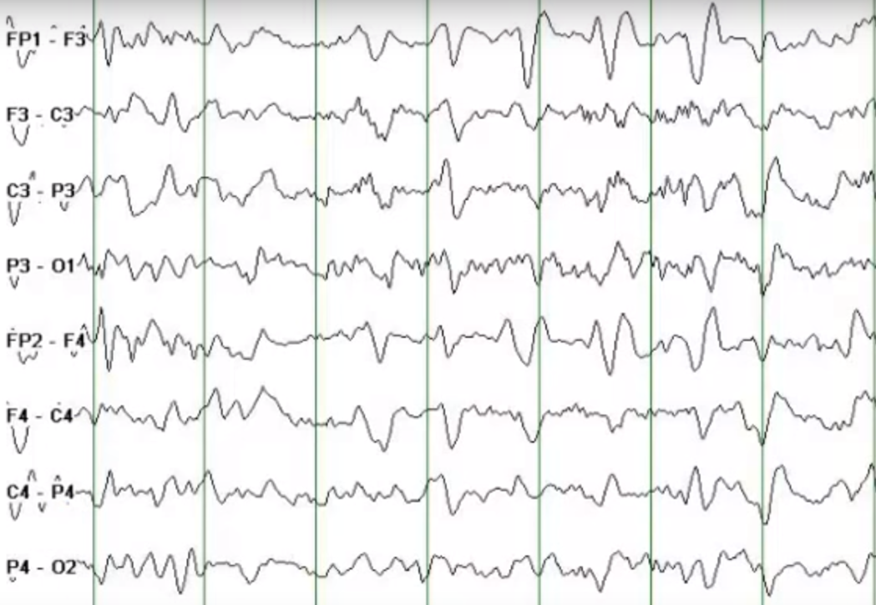
Tri-phasic Waves:-
High Amplitude , Positive waves seen with maximum amplitude in frontal head region.
Positive deflection preceded and followed by negatives.
Occurs with maximum intensity at FP1-F3 / FP2-F4 and can be seen upto occipital lobe.
Sometimes lags can be seen from Frontal to occipital region. Those can not be described by electrographic seizures.
Shows periodicity but no evolution.
Non-specific waves.

Slide 28
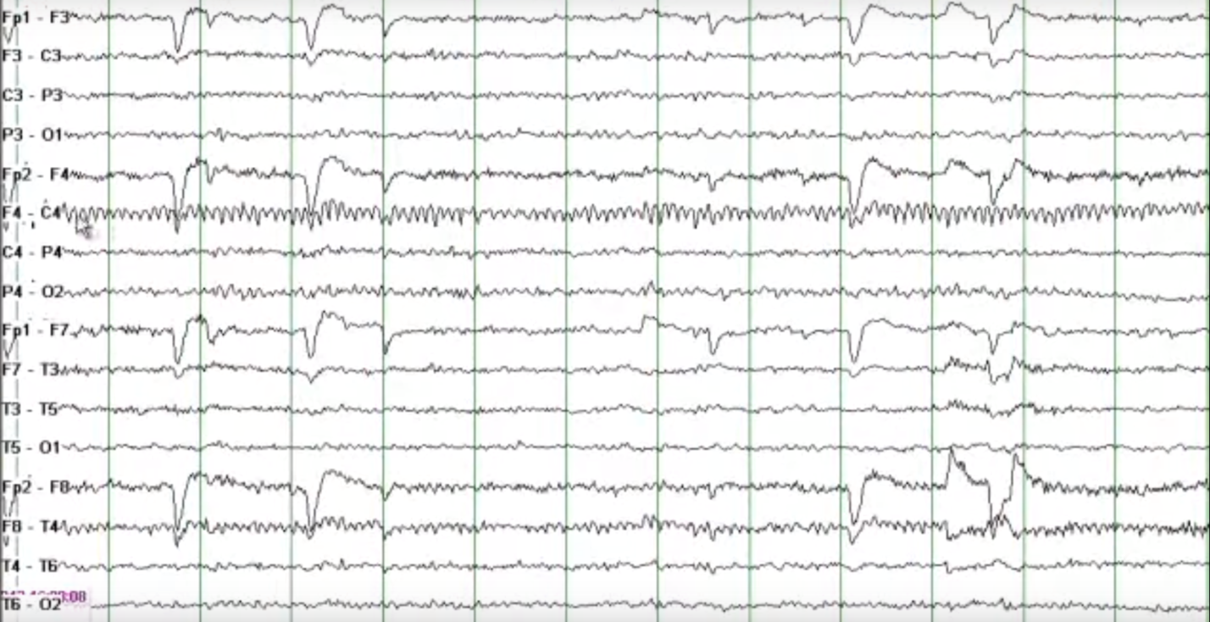
Mu Rhythm:- Observed at Central head Region and has no reactivity.

Slide 29
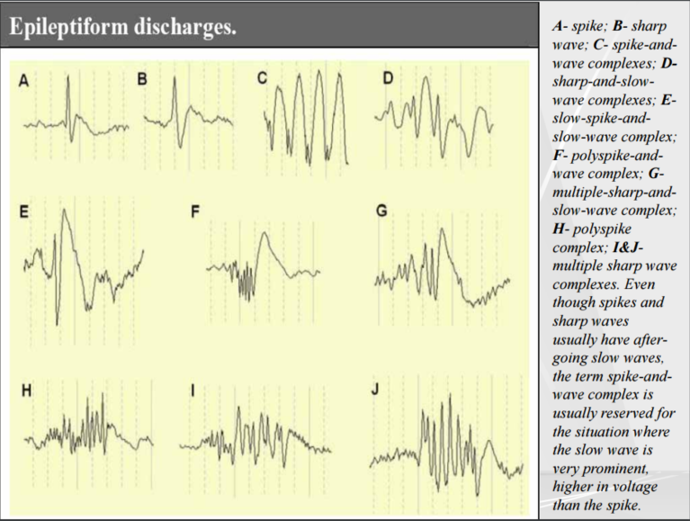

Slide 30
Summary:-

