Slide 1
My Summer Vacation
Richard Cohen

Slide 2
My Summer Vacation
Outline
Where we went - what we did, what we saw
How much time it took
What it cost

Slide 3
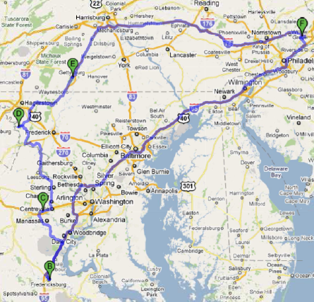
Where We Went

Slide 4
First Day Route

Slide 5
First Day - Travel
Home
SW on My Street toward Next St - go 0.2 mi - total 0.2 mi
Continue straight onto Next St - go 305 ft - total 0.2 mi
Next Rd bends left to Following Rd - go 0.6 mi - total 0.8 mi
Turn left at Byberry Rd - go 0.6 mi - total 1.4 mi
Take the 2nd left onto Evans St - go 0.1 mi - total 1.5 mi
Take the 1st right onto Woodhaven Rd - go 0.5 mi - total 2.0 mi
Continue onto PA-63 E - go 2.9 mi - total 4.9 mi
Take the exit onto I-95 S toward Central Phila Partial toll road
Through Del – Enter Md - About 2 hours 28 mins - go 140 mi - total 145 mi

Slide 6
First Day - Travel (cont.)
Exit 27, merge onto I-495 W toward Silver Spring Entering Va
About 36 mins - go 29.7 mi - total 174 mi
Take exit 57A toward VA-644 - go 0.8 mi - total 175 mi
Follow I-95 S/Richmond, merge onto I-395 Connector S/I-95 Connector S - go 0.6 mi - total 176 mi.
Merge onto I-95 S - About 39 mins - go 36.3 mi - total 212 mi
Exit 133A to merge onto US-17 BUS S/Warrenton Rd toward Falmouth - 2.1 mi - total 214 mi
Continue onto VA-218 E/Butler Rd/Co Rd 664 - go 1.1 mi - total 215 mi
Turn right at Chatham Heights Rd - go 0.4 mi - total 216 mi
Turn right at Lee Ave/Pratt Ave - go 0.3 mi - total 216 mi
Total: 216 mi – about 4 hours 2 mins – up to 4 hours 50 mins in traffic

Slide 7
First Day
Checked into motel
Toured local attractions
Ate dinner

Slide 8
Second Day
Ate breakfast
Continued to tour sights in neighborhood
Ate lunch
Got in car to drive to second destination

Slide 9
Second Day Route

Slide 10
Second Day - Travel
NE on Lee Ave/Pratt Ave toward Jefferson St - go 0.2 mi
Take the 1st left onto Hamilton St - go 0.2 mi - total 0.4 mi
Continue onto Rodney Ln - go 0.1 mi - total 0.5 mi
Turn left at Chatham Heights Rd - go 0.2 mi - total 0.7 mi
Left at VA-218 W/Butler Rd - go 1.1 mi - total 1.9 mi
Right at US-1 N/Cambridge St - go 3.1 mi - total 5.0 mi
Turn right at Stafford Airport - go 0.6 mi - total 5.6 mi
Take I-95 N ramp to Washington - About 18 mins - go 16.6 mi - total 22.2 mi
Exit 152B to VA-234 N/Dumfries Rd toward Manassas - About 29 mins - go 22.0 mi - total 44.2 mi
Turn right at Balls Ford Rd - go 0.4 mi - total 44.6 mi

Slide 11
Second Day (cont.)
Turn left at Groveton Rd - go 1.3 mi - total 45.9 mi
Turn right at US-29 N/Lee Hwy - go 1.7 mi - total 47.7 mi
Destination will be on the left
Total: 47.7 mi – about 1 hour 4 min
Checked into motel
Toured local attractions
Ate dinner

Slide 12
Third Day
Ate breakfast
Continued to tour local sights
Ate lunch
Got in car to drive to third destination

Slide 13
Third Day Route

Slide 14
Third Day - Travel
East on US-29 N/Lee Hwy - go 4.1 mi - total 4.1 mi
Left to I-66 E toward Washington - go 1.0 mi - total 5.1 mi
Exit 53 to VA-28 toward Dulles Apt. - go 15.0 mi - total 20.1 mi
Continue onto VA-7 - go 6.7 mi - total 26.9 mi
Take US-15 N ramp to Frederick MD - go 0.5 mi - total 27.3 mi
Continue on US-15 N - Entering Md - go 13.5 mi - total 40.9 mi
Turn left at MD-464 W - go 6.9 mi - total 47.8 mi
Turn right at MD-464 W/Souder Rd - go 1.0 mi - total 48.8 mi
Continue straight onto MD-17 N - go 1.1 mi - total 49.9 mi
At circle, continue straight on MD-17 N - 0.2 mi - total 50.1 mi
Left on US-340 W toward MD-180 W - 2.7 mi - total 52.8 mi
MD-67 exit toward Boonsboro - go 0.1 mi - total 52.9 mi

Slide 15
Third Day – Travel (cont.)
Slight right at MD-67 N - go 6.4 mi - total 59.3 mi
Turn left at Trego Rd - go 1.5 mi - total 60.9 mi
Continue onto Mt Briar Rd - go 0.6 mi - total 61.4 mi
Slight left at Porterstown Rd - go 2.9 mi - total 64.4 mi
Turn left at MD-34 W - go 1.9 mi - total 66.3 mi
Destination will be on the left
Total: 66.3 mi – about 1 hour 31 mins

Slide 16
Third Day
Checked into motel
Toured local attractions
Ate dinner

Slide 17
Fourth Day
Ate breakfast
Continued to tour sights in neighborhood
Ate lunch
Got in car to drive to fourth destination

Slide 18
Fourth Day Route

Slide 19
Fourth Day - Travel
East on MD-34 E toward N Potomac St - go 6.8 mi
Left at N Main St/Old National Pike - go 0.5 mi - total 7.3 mi
Slight right at MD-66 N - go 6.8 mi - total 14.0 mi
At the traffic circle, onMD-66 N - go 3.6 mi - total 17.6 mi
Right at MD-64 E/Jefferson Blvd - go 1.1 mi - total 18.7 mi
Take the 3rd right onto MD-77 E - go 9.6 mi - total 28.4 mi
Turn left at W Main St – go 0.5 mi - total 28.9 mi
Left merge onto US-15 N, Entering Pa. - 10.8 mi - total 39.7 mi
Take the exit toward US-15 BUS N - go 0.2 mi - total 39.9 mi
Turn left at Emmitsburg Rd - go 6.1 mi - total 46.0 mi
Continue onto US-15 BUS N - go 0.7 mi - total 46.6 mi
Turn left at Baltimore St - go 0.5 mi - total 47.1 mi – about 1 hour 13 minutes

Slide 20
Fourth Day
Checked into motel
Toured local attractions
Ate dinner

Slide 21
Fifth Day
Ate breakfast
Continued to tour sights in neighborhood
Ate lunch
Continued touring
Ate Dinner
Returned to motel
Slept

Slide 22
Sixth Day
Ate breakfast
Continued to tour sights in neighborhood
Ate lunch
Got in car to drive home

Slide 23
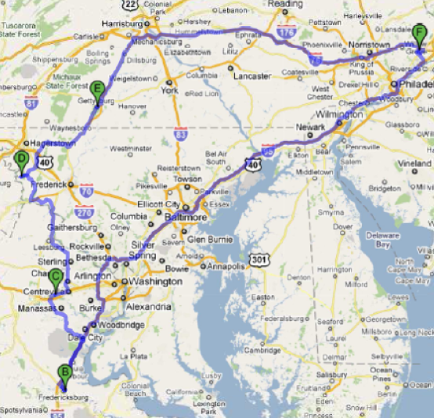
Sixth Day Route

Slide 24
Sixth Day - Travel
Head east on US-30 E - go 2.3 mi - total 2.3 mi
Right onto US-15 N toward Harrisburg - 27.9 mi - total 30.2 mi
Take I-76/Pennsylvania Turnpike toward Philadelphia Partial toll road
go 90.7 mi - total 121 mi - about 1 hour 34 mins
Continue onto I-276 E Toll road - go 24.9 mi - total 146 mi
Take exit 351 for US-1 toward Philadelphia - total 146 mi
Keep right to US-1 S - go 1.4 mi - total 148 mi
Slight right at Roosevelt Blvd - go 0.4 mi - total 148 mi

Slide 25
Sixth Day – Travel (Cont.)
Right onto My Neighborhood Rd - go 1.0 mi - total 149 mi
Turn right at My Local Rd - go 0.2 mi - total 149 mi
Continue onto My Street - go 0.2 mi - total 150 mi
Destination will be on the left –
Total: 150 mi – about 2 hours 45 mins

Slide 26
Sightseeing Summary
First Destination – Day 1: 2 hours, Day 2: 3 hours, total: 5 hours
Second Destination – Day 2: 4 hrs, Day 3: 3 hrs
Third Destination – Day 3: 4 hrs, Day 4: 4 hrs
Fourth Destination – Day 5: 2 hrs, Day 5: 7 hrs, Day 6: 2 hrs
Total sightseeing: 31 hours

Slide 27
Sightseeing Summary
Sightseeing Chart
Sightseeing Figure
Destination | Hours
1 | 5
2 | 7
3 | 8
4 | 11

Slide 28
Driving Summary
Driving Hours
Driving Figure
Day | Time
1 | 4 hours, 50 min.
2 | 1 hour, 4 min.
3 | 1 hour, 31 min.
4 | 1 hour, 13 min.
5 | 0
6 | 2 hour, 45 min

Slide 29
Budget
Motels – Five nights @ $75/night = $375
Meals – Six days @ $28/person/night * 2 persons = $336
Gas – 12 gallons @$2.57/gallon = $31
Tolls – $25
Souvenirs & Miscellaneous – $150
Total – $886

Slide 30
Conclusion
We had a great time!

Slide 31
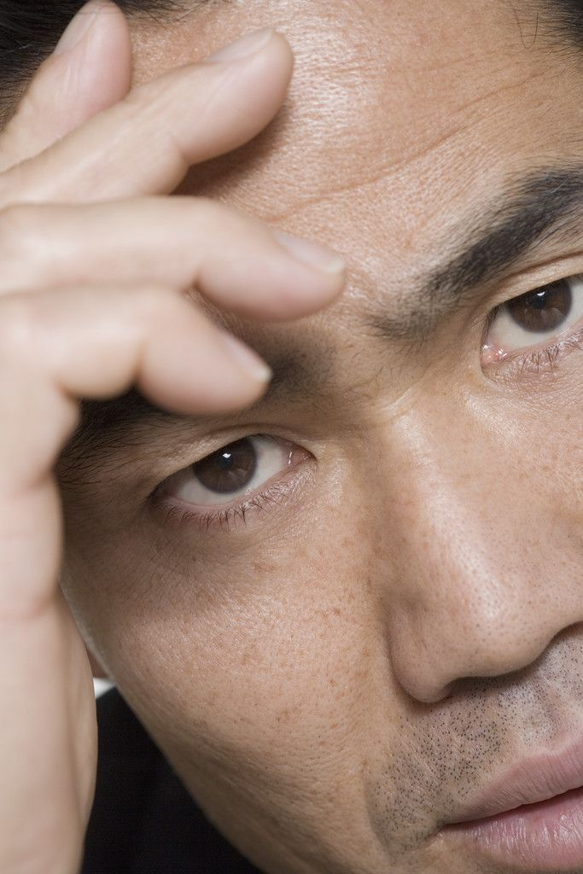
Questions?

Slide 32
Problems
Uninformative Title
No goals, only tasks
Too many details, irrelevant information
Uninformative table and graph titles
Conclusion that has no relation to the contents
And many more!

