Slide 1
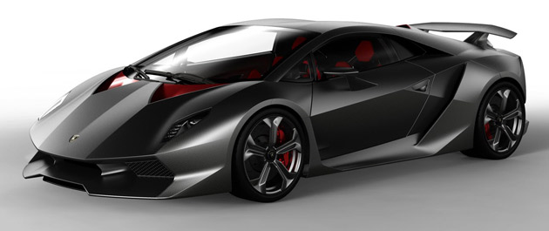
LECTURE 05: COST AND SCHEDULING
Question: What impacts the cost of a car?
Objectives: iPad Case Study The Calculus of Cost Project Scheduling
Resources: JH: :Lamborghini BAH: Earned Value Management
URL:
Audio:
Notes:
MS Equation 3.0 was used with settings of: 18, 12, 8, 18, 12.

Slide 2
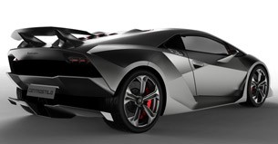
Cost Is Influenced By Many Competing Considerations
Only about 2,200 lbs. (999 kilograms, Lambo says), even though it has all-wheel drive, a heavy features.
It's made from very light CFRP -- carbon-fiber reinforced plastics.
Carbon is the sixth element in the periodic table, spawning the car's name (sesto is "sixth").

Slide 3
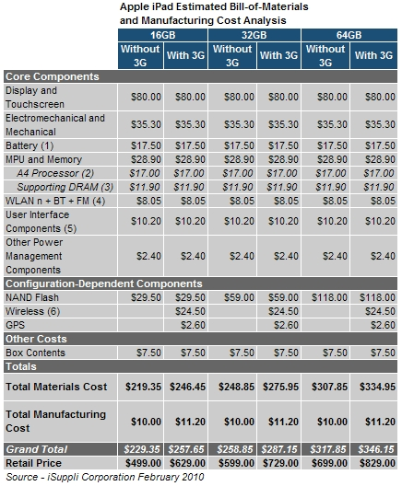
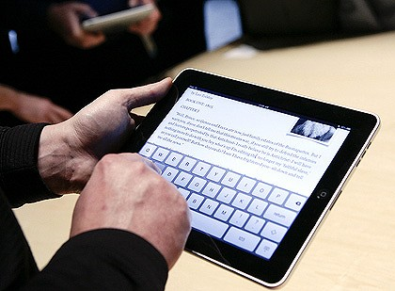
Case Study: iPad

Slide 4
Summary
Every senior design project must address cost and schedule.
Cost is quoted as manufacturing cost, not development costs.
Schedule should break the project down to individual tasks including duration and person responsible.

