Slide 1
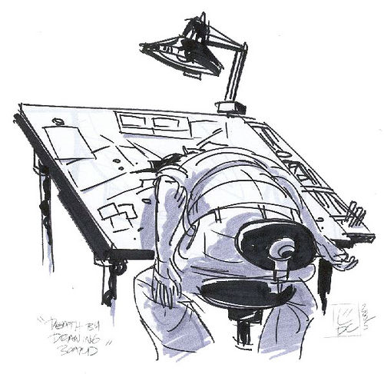
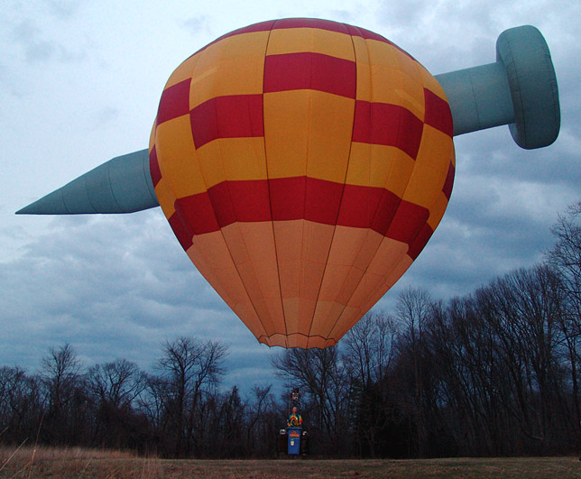
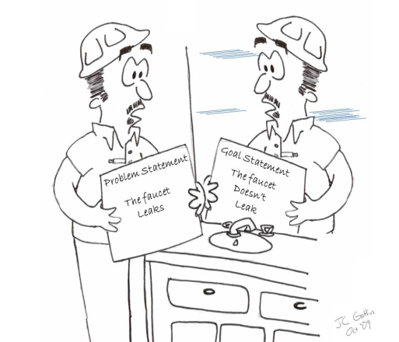
LECTURE 03: PROBLEM STATEMENTS
Question: Which is more important – the project title or abstract?
Objectives: Abstract Revision Exercise Project Title The Problem Statement
Resources: PK: Scientific Abstracts UCB: Writing Abstracts GDoc: Project Titles GF: Writing Exercise PSU: Problem Statements Wiki: Problem Statements
URL:
Audio:
Notes:
MS Equation 3.0 was used with settings of: 18, 12, 8, 18, 12.

Slide 2
Engineering Humor
Operating on Engineers
Five surgeons were taking a coffee break and were discussing their work.
The first said, “I think accountants are the easiest to operate on. You open them up and everything inside is numbered.”
The second said, “I think librarians are the easiest to operate on. You open them up and everything inside is in alphabetical order.”
The third said, "I like to operate on electricians. You open them up and everything inside is color-coded."
The fourth one said, "I like to operate on lawyers. They're heartless spineless, gutless, and their heads and their tails are interchangeable."
The fifth surgeon says "I like engineers . They always understand when you have a few parts left over at the end.“
Provided by http://www.basicjokes.com/djoke.php?id=5429.

Slide 3
Abstract
Characteristics of a good abstract:
Must contain information about what you did, how you did it, how did you assess your results, and what was impact of these results.
Between 150 and 200 words; about 6 to 8 sentences.
First two sentences are an introduction specific to the project.
Next two sentences describe what you did – your technical approach.
Next two sentences describe how you assessed your outcomes, including descriptions of the data you used.
Last two sentences describe the impact of your results.
Example:
Guitar effects based on vacuum tubes are enjoying resurgence in the music community. Ease of integration into digital systems remains an important goal, however. The goal of our project is to build a digitally-controlled tremolo special effects box. Our project will consist of two main sections: a digital control structure based on a low-cost PIC microcontroller, and an analog tremolo effect based on a 12AX7 vacuum tube. A user will be able to change the tempo of the effect by turning a knob on the face of the device or by using a footswitch. Target customers, such as guitarists and bassists, will benefit tremendously from the hands-free option that the footswitch offers. The footswitch will contain a tap-tempo, multipliers, and a bypass switch. The tap-tempo will allow the user to dictate the tempo of the device, while the 1/2x, 2x, and 3x multipliers will let the user make a quick tempo change. The bypass switch will give the user a switch to turn the effect on or off. The retail price of the unit is expected to be less than $100, thereby enabling hobbyists and entry-level musicians access to a high-quality but affordable special effects device.

Slide 4
The Project Title
Characteristics of a good project title:
Short and to the point:
Renewable Energy Using High-Efficiency Turbines
Action-oriented:
Avoid passive words like “study” or “research” in favor of action-oriented words like “stewardship” or “renewable.”
Longer titles are okay if they tease:
Good to Great: Why Some Companies Make the Leap... and Others Don't
Where do I find examples of good titles?
Amazon.com or Barnes & Noble of course!
Newspapers
The National Inquirer… well, sort of…
Some Senior Design Examples:
Standing Wave Ratio Analyzer
Programmable Digital Thermostat
… Your title goes here …

Slide 5
Abstract Exercise
Divide into groups of three people.
Rewrite one of the selected project abstracts (15 min.)
Suggest a new title for the project (5 min.)
Present your rewritten version to the class (10 min.)

Slide 6
What is a Problem Statement? (Wikipedia)
A problem statement is a clear concise description of the issues that need to be addressed by a problem-solving team and should be presented to them (or created by them) before they try to solve the problem.
A good problem statement should answer these questions:
What is the problem?
Who has the problem or who is the client/customer?
What form can the resolution be?
The primary purpose of a problem statement is to focus the attention of the problem-solving team. However, if the focus of the problem is too narrow or the scope of the solution too limited the creativity and innovation of the solution can be stifling.
A research-worthy problem statement is the description of an active challenge (i.e. problem) faced by researchers and/or practitioners that does not have adequate solutions available including the argumentation for its viability based on solid peer-reviewed sources as well as theoretical foundation.
The research-worthy problem statement should address all six questions: what, how, where, when, why, and who.

Slide 7
Your Problem Statement Template
Two pages following the design document template (e.g., 1” margins, 11-pt. Times New Roman font).
Makes heavy use of references; does not plagiarize or restate the obvious.
We will follow a numeric reference format:
☞ “Touch screen displays have been the dominant human computer interface on cell phones for the past decade [11].
Begin with a general introduction; then get progressively more detailed.
Must include a review of relevant/competing technology.
Some good examples are:
J. Wallace, M. Jackson, C. Rice, and J. Bjelobrk, Temperature Sensor Fabrication in Silicon Carbide, Mississippi State University, Spring 2001.
W. Draper, R. Miller, J. Burkett, and J. Heath, High Voltage CV Characterization of SiC, Mississippi State University, Spring 2001.
W. Parker, B. Roberts, J. Tatum, and W.Y. Kwan, Power Line Carrier Communication System, Mississippi State University, Fall 2000.

Slide 8
Summary
Revised abstracts, project titles and the first draft of the problem statements are due next week.
Next lecture: quantitative design constraints.

