Slide 1
National Reconnaissance Office Overview
UNCLASSIFIED//FOR OFFICIAL USE ONLY

Slide 2
(U) NRO Vision and Mission
(U) Vision
Vigilance From Above
(U) Mission
Innovative Overhead Intelligence
(U) Acquire and operate the most capable set of satellite intelligence collection platforms ever built
(U) Provide SIGINT, GEOINT and MASINT intelligence data in support of IC, DoD, and DHS
(U) Support covert and high priority operations
UNCLASSIFIED
Notes:
Vision and Mission
I mentioned our common mission. One of the first things I did when I arrived at the NRO in July was to establish new vision and mission statements, which flow out of that common mission.
A vision is a concept formed in our imagination and then rendered inspirationally. The NRO Vision – Vigilance From Above – is a pretty decent rendering of what we do. We keep watch for this nation and for much of the free world from above.
The NRO mission has also been updated to better reflect an evolving NRO. A mission is a pre-established or self-imposed objective. Our objective is to provide, “Innovative Overhead Intelligence Systems for National Security.” It’s broad, but it covers what the Nation expects of us.
UNCLASSIFIED
UNCLASSIFIED

Slide 3
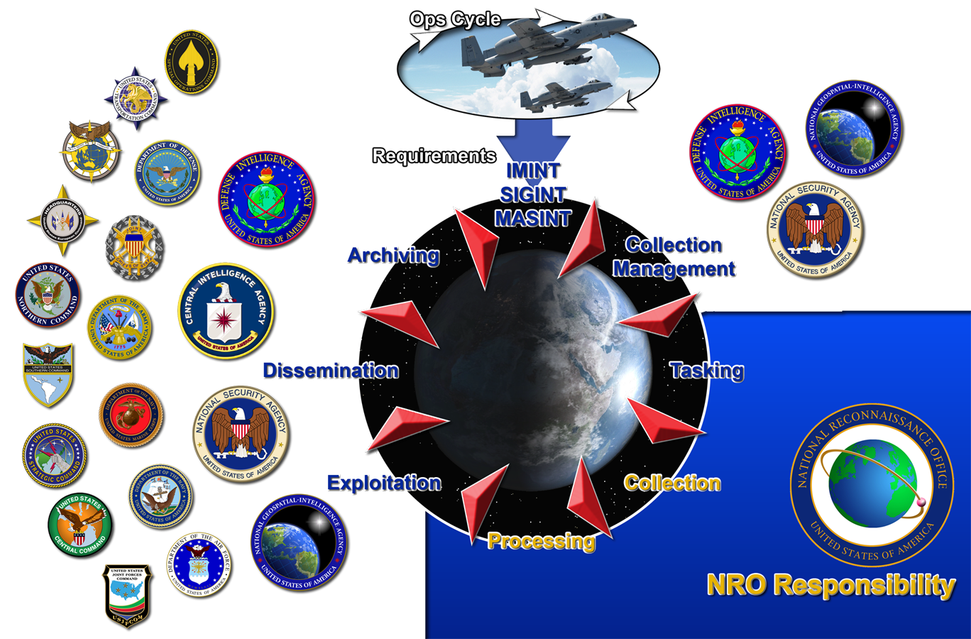
(U) Defense and National Communities
Text and Graphics are UNCLASSIFIED
UNCLASSIFIED

Slide 4
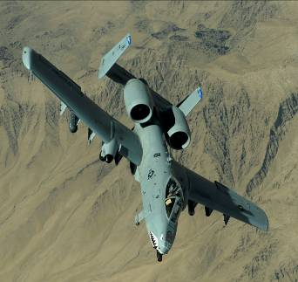
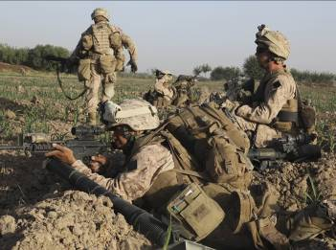
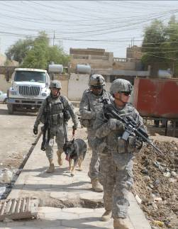
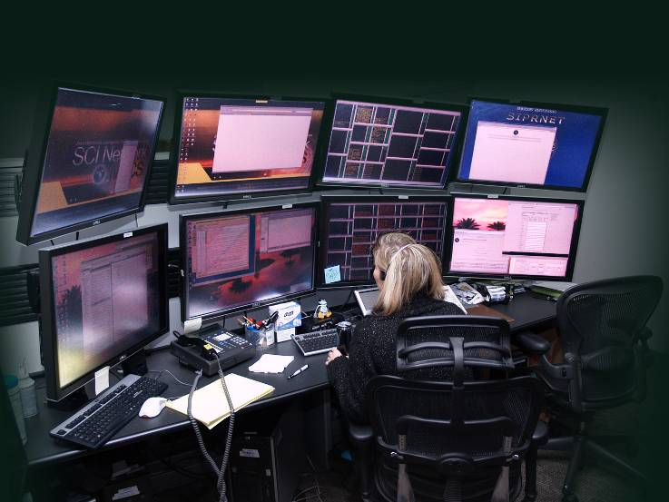

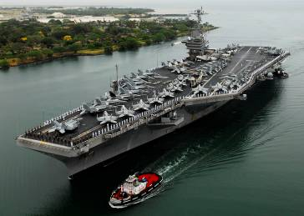



(U) Mission Partners Supporting Users
UNCLASSIFIED
Text and Graphics are UNCLASSIFIED
UNCLASSIFIED
UNCLASSIFIED
Notes:
Mission Partners Supporting Users
Although the NRO works collaboratively with all of our fellow IC organizations, we have a special relationship with our Mission Partners: NSA and NGA.
Together, we support our users, who range from intelligence analysts, to the men and women in the military, to senior government decision-makers, including the President. They depend on us, and we take that seriously, because at the end of the day, lives are at stake. We never lose sight of that.
UNCLASSIFIED
UNCLASSIFIED

Slide 5

(U) ) Overhead Reconnaissance Systems
UNCLASSIFIED
(U) Hard Problems
(U) Counter the IED threat
(U) Capture terrorists
(U) Warn of enemy attacks
(U) Prevent WMD proliferation
(U) Prevent drug trafficking
(U) Support natural disaster response
(U) Attributes of Overhead Systems
(U) Penetration of denied areas
(U) Rapidly responsive
(U) No need for diplomatic intervention
(U) No risk of loss of life
(U) Available 24/7/365
UNCLASSIFIED
Notes:
NRO Systems Help Attack Hard Problems
Speaking of results - Every morning, I have the privilege of hearing specifics of how our systems and our people are making a difference. Unfortunately, I can’t go into the details, but we are very involved in every major intelligence and military mission out there. We help others attack hard problems.

Slide 6
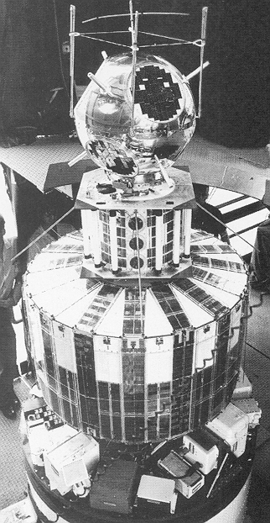
(U) NRO Past Systems
(U) CORONA
August 1960 – May 1972
(U) GRAB
June 1960 – April 1962
(U) U-2 Spy Plane
July 1956 - May 1960
Text and Graphics are UNCLASSIFIED
UNCLASSIFIED

Slide 7
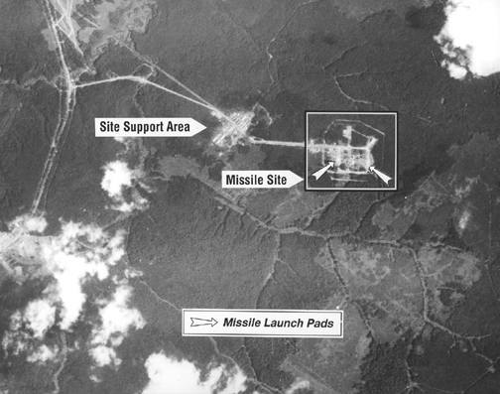
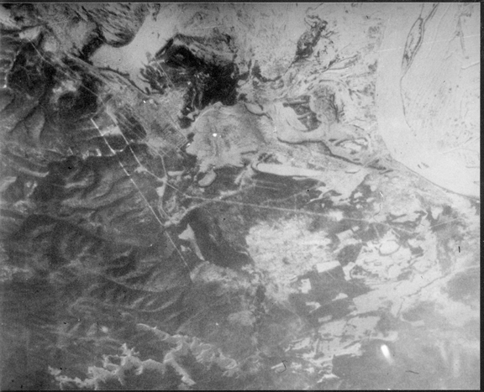
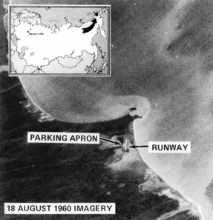
(U) CORONA Satellite Photos
Text and Graphics are UNCLASSIFIED
UNCLASSIFIED

Slide 8

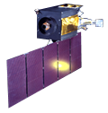

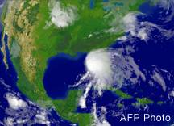
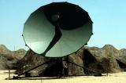
(U) Successful Operations Require the Integration of NRO and STRATCOM Assets
(U) White Space
(U) Navigation
(U) Early Warning
(U) Weapons Guidance
(U) Meteorological Data
(U) Communications
(U) Battle Management
(U) Black Space
(U) Intelligence, Surveillance & Reconnaissance (ISR)
(U) Signals Intelligence (SIGINT)
(U) Imagery Intelligence (IMINT)
(U) Measurement & Signatures Intelligence (MASINT)
(U) Communications (COMM)
(U) Blue Force Tracking (BFT)
(U) Combat Search & Rescue (CSAR)
GPS
DSP
Graphics are UNCLASSIFIED
UNCLASSIFIED

Slide 9
(U) Integration of Theater and National Capabilities is Required
(U) Theater
(U) Signals Intelligence (SIGINT)
(U) Imagery Intelligence (IMINT)
(U) Electro Optical (EO)
(U) Infrared
(U) Synthetic Aperture Radar (SAR)
(U) Measurements & Signatures Intelligence (MASINT)
(U) Human Intelligence (HUMINT)
(U) National
(U) Signals Intelligence (SIGINT)
(U) Imagery Intelligence (IMINT)
(U) Measurements & Signatures Intelligence (MASINT)
(U) Communications (COMM)
(U) Weather
(U) Precision Guidance
(U) Location
(U) Navigation
UNCLASSIFIED

Slide 10
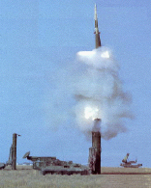
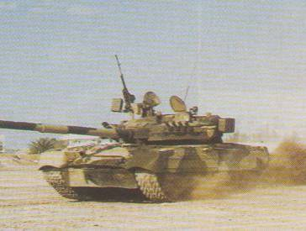
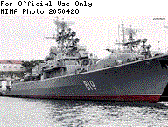
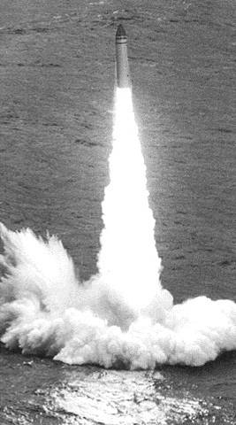

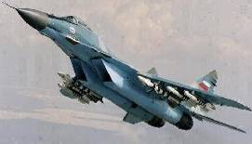
(U) Traditional Missions
(U) Arms Control
(U) Indications and Warning
(U) Monitoring Foreign Military Forces
Text and Graphics are UNCLASSIFIED
UNCLASSIFIED

Slide 11
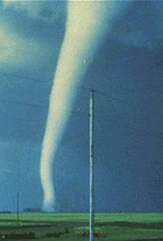

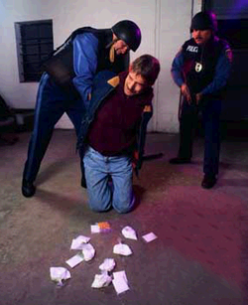


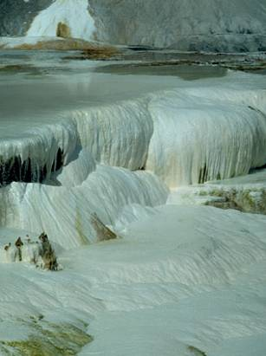
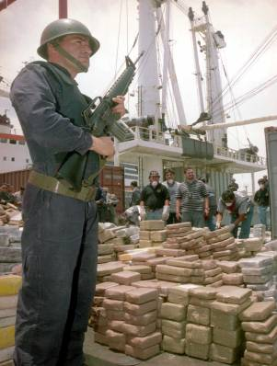
(U) Evolving Missions
(U) Disaster Relief
(U) Environmental Monitoring
(U) Support to Law Enforcement
Text and Graphics are UNCLASSIFIED
UNCLASSIFIED

Slide 12
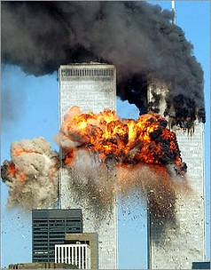
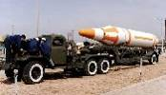

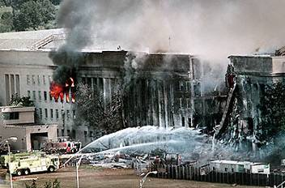
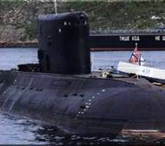


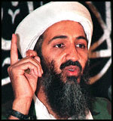
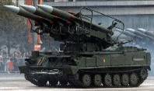
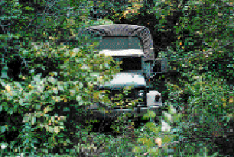
(U) New Challenges
(U) Chemical and Biological Weapons
(U) Counterterrorism
(U) Mobile Targets
(U) Denial and Deception
Text and Graphics are UNCLASSIFIED
UNCLASSIFIED

Slide 13

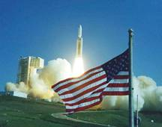




(U) Space Business: Risk and Realities
(U) RISK
(U) Fiscal
(U) Fragility
(U) Launch or
On Orbit Failures
(U) New Challenges
(U) Competing Demands
(U) Advocacy
(U) REALITIES
Graphics are UNCLASSIFIED
UNCLASSIFIED

Slide 14
(U) Summary
(U) Space reconnaissance systems are a major element of our National power
  Empower our Decision-makers
  Empower our Users
  Always in theater – “First In”
(U) Space reconnaissance systems are critical to achieving Information Superiority
  Available continuously, world-wide, in near real time
  Support the full spectrum of operations
UNCLASSIFIED

Slide 15
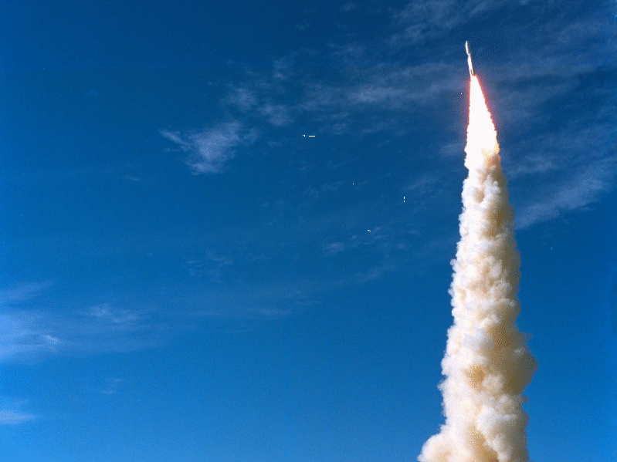
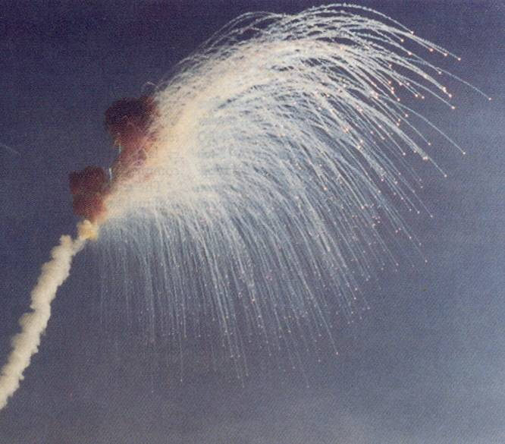
(U) It’s Rocket Science
UNCLASSIFIED
Graphics are UNCLASSIFIED
UNCLASSIFIED

