Slide 1
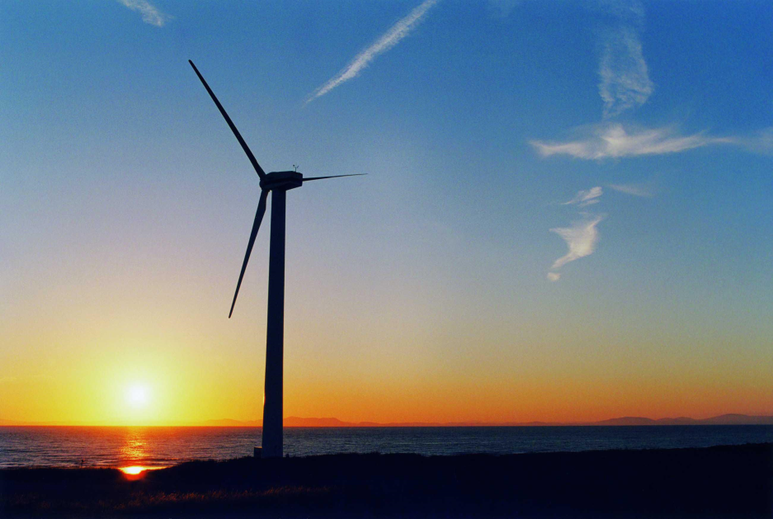
RENEWABLE ENERGY USING HIGH-EFFICIENCY TURBINES
Outline:
Motivation
Problem Statement
Design Constraints
Approach
Technical Challenges
J. Smith, J. Doe, T. Smith and M. Smith
Advisor(s): J. Jones, M. Jones and T. Jones
College of Engineering
Temple University

Slide 2
Abstract
Due to the increasing costs of energy, and the higher demand to move towards green technology, a wind turbine has been installed on top of the Engineering building on Temple University’s Main Campus. The wind turbine has successfully reduced the total cost of electricity for the building, and has also reduced the stress on the power grid. Using wind modeling software, it was determined that the most efficient turbine for the building was a 250Kw rated vertical axis wind turbine. The software also helped in the exact placement of the turbine, which in turn allowed for maximum efficiency and profit. With its current location the wind blows at an average speed of 13.44 mph. This means the turbine produces 49,696KWH per month and saved the University $59,698 a year. A varied amount of energy was stored in a battery storage system that was installed to hold any excess power produced by the system to be used during peak hours of energy consumption. The turbine cuts the total energy usage of the building by 15%, and at this rate will pay for itself in 8.6 years.
(You can make this more visually appealing by using bulleted lists, etc.)
You will skip over this slide during the presentation.

Slide 3
Team Overview
Show team members (names and pictures are good) and team responsibilities (usually done in a chart).
Show your advisors also and list their areas of expertise if you have multiple advisors.

Slide 4
Motivation
Three primary tasks:
Speech Recognition: finally a software-engineered system that is extensible;
Object-Oriented Design: generic signal processing, mathematics, and data structures libraries;
Education: workshops, tutorials, courses, toolkits, Java applets, and a remote job submission facility for debugging and comparing performance.
(Tell us why you selected this project and why it is important. Do this in a creative way to grab our attention.)

Slide 5
Motivation
Talk about the major points in the second page of your problem statement.
Bring out the technical aspects of your problem statement.

Slide 6
Project Overview
Provide a block diagram of your project and explain your basic approach and how the problem has been decomposed into smaller ones.

Slide 7
Technical Design Constraints
List a table showing your 5 technical design constraints. Discuss them (using information from your design document.)

Slide 8
Non-Technical Design Constraints
List a table showing your 5 non-technical design constraints. Discuss them (using information from your design document.)

Slide 9
Approach
A series of 7 slides (maximum) that takes your project apart block by block and discusses in technical detail how you will approach each block.
5 of these slides will typically relate to your technical design constraints, and 2 will related to your non-technical design constraints.
These slides account for the major design content in your project. By the end of these slides you must convince us that your project has significant design content (remember, design not implementation!).
The design content on these slides should relate to your design constraints. For each of your major technical design constraints, you should have a slide that discusses your approach and the corresponding design constraint,. You should convince us that the design will meet your design constraint and that the design constraint was set in a reasonable manner.

Slide 10
Approach

Slide 11
Approach

Slide 12
Approach

Slide 13
Approach

Slide 14
Approach

Slide 15
Approach

Slide 16
Major Technical Challenges and Risks
What are the major technical challenges that you must overcome to be successful?
What are the risks?
What is your risk mitigation plan? (If things don’t go as planned, what are your back up plans?)

Slide 17
Summary
Summarize what you plan to do in SD I and how in three or four bullets.
Summarize what you plan to do in SD II in three to four bullets, pointing out key challenges and major technical risks (including money, equipment, scheduling, approvals).

Slide 18
References
List several key references for your project in APA format.
Do not read this slide during the presentation. It is provided simply as background material for people who will download and read your presentation.

