Slide 1
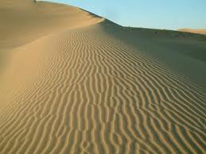
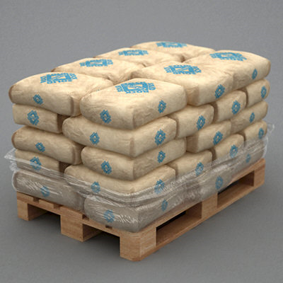
LECTURE 07: EXPERIMENTAL DESIGN AND SUSTAINABLE DESIGNS
Question: How do you establish your “product” is better?
Objectives: Sources of Variability Statistical Significance Statistical Modeling Designing for Variability Sustainability Definition Design Impact
Resources: SRM: Experimental Design Wiki: Sustainable Designs
URL:
Notes:
MS Equation 3.0 was used with settings of: 18, 12, 8, 18, 12.

Slide 2
Experimental Design
See: http://www.socialresearchmethods.net/kb/desexper.php

Slide 3
Sustainable Designs
See: http://en.wikipedia.org/wiki/Sustainable_design

