Slide 1
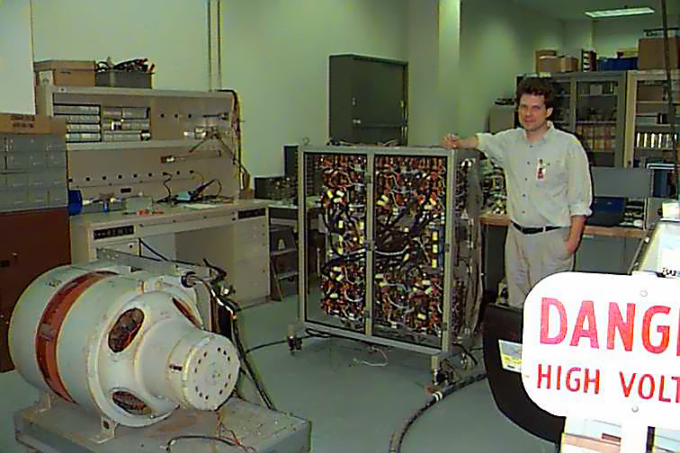
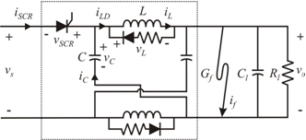
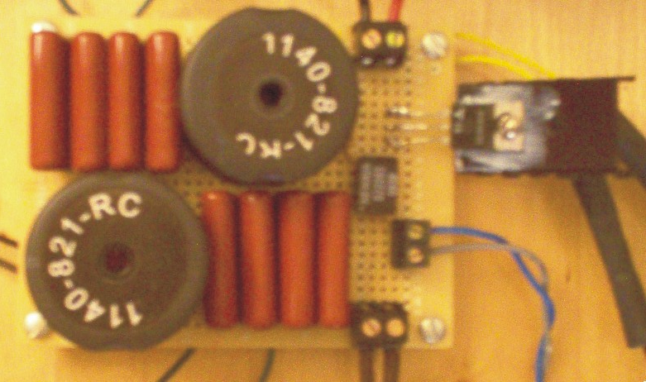
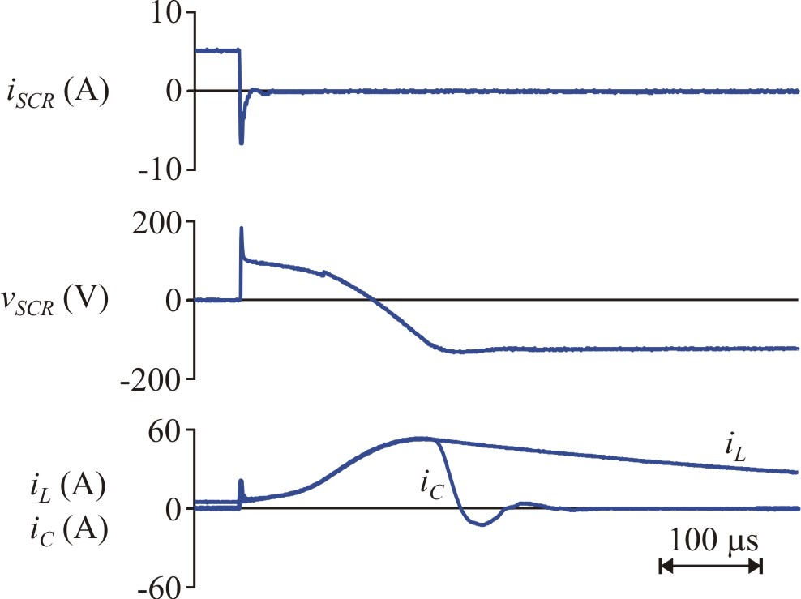
Dr. Keith Corzine: Simulation vs. Reality

Slide 2
Dr. Keith Corzine: Simulation vs. Reality
The transient response is shown below.
Why did the glitch not appear in the simulation?
In this case, the differences were attributable to the use of simplified circuit models for the nonlinear devices.
Simulations always differ from implementations.
It is important to understand the reasons for those differences.

Slide 3
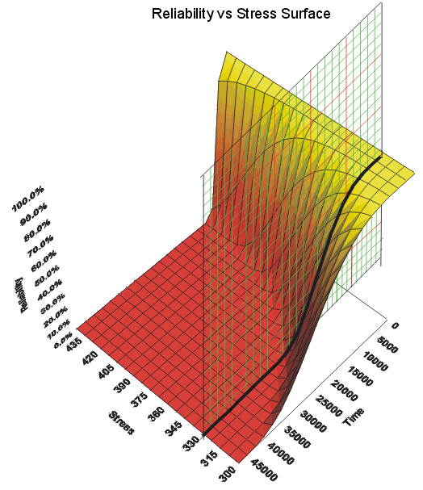
LECTURE 05: ACCELERATED LIFE TESTING
Question: How do you determine the mean time between failures for your “product”?
Objectives:
Life Testing
Accelerated Life Testing
Statistical Models
Resources:
Weibull: ALTA
NIST: Life Testing
URL:
Notes:
MS Equation 3.0 was used with settings of: 18, 12, 8, 18, 12.

Slide 4
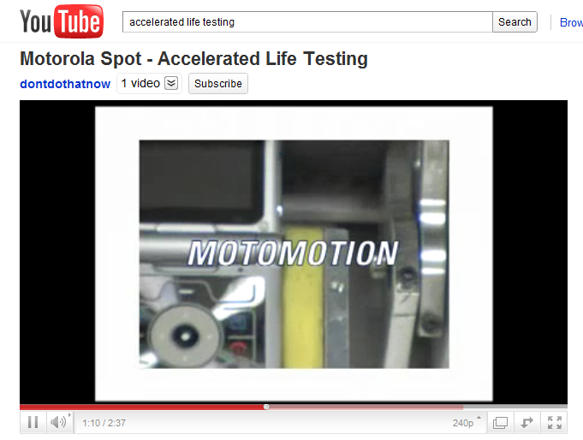
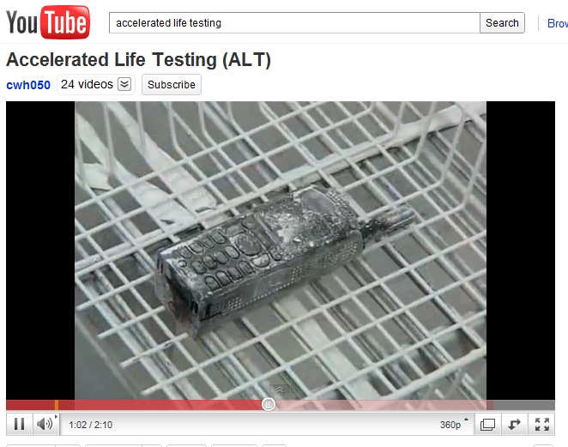
Let’s Start With The Basics…

Slide 5
What is Accelerated Life Testing?
Traditional life data analysis involves analyzing times-to-failure data (of a product, system or component) obtained under normal operating conditions in order to quantify the life characteristics of the product, system or component.
In many situations, and for many reasons, such life data (or times-to-failure data) is very difficult, if not impossible, to obtain.
Accelerated life testing involves acceleration of failures with the single purpose of quantification of the life characteristics of the product at normal use conditions.
More specifically, accelerated life testing can be divided into two areas: qualitative accelerated testing and quantitative accelerated life testing.

Slide 6
Qualitative Accelerated Life Testing
Qualitative tests are tests that yield failure information (or failure modes) only.
Common names:
elephant tests
torture tests
Highly Accelerated Life Tests (HALT)
shake and bake tests
Qualitative tests are performed on small samples with the specimens subjected to a single severe level of stress, to a number of stresses or to a time-varying stress.
Qualitative tests are used primarily to reveal probable failure modes.

Slide 7
Qualitative Accelerated Life Testing (cont.)
Qualitative tests are not designed to yield life data that can be used in subsequent quantitative accelerated life data analysis.
They do provide valuable information as to the types and level of stresses one may wish to employ during a subsequent quantitative test.
Benefits and Drawbacks of Qualitative Tests:
Benefit: Increase reliability by revealing probable failure modes.
Benefit: Provide valuable feedback in designing quantitative tests and in may cases they are a precursor to a quantitative test.
Drawback: What is the reliability of the product at normal use conditions?

Slide 8
Quantitative Accelerated Life Testing
Designed to quantify the life characteristics of the product, component or system under normal use conditions and thereby provide reliability information.
Reliability information can include the determination of the probability of failure of the product under use conditions, mean life under use conditions and projected returns and warranty costs.
It can also be used to assist in the performance of risk assessments, design comparisons, etc.
Quantitative accelerated life testing can take the form of usage rate acceleration or overstress acceleration.

Slide 9
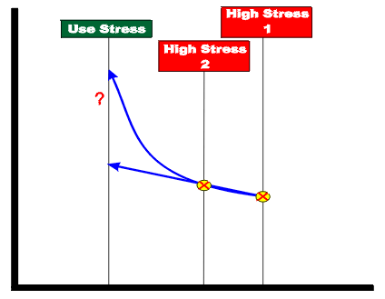
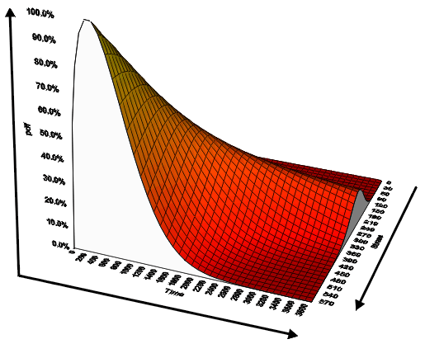
Quantitative Accelerated Life Testing (cont.)
For all life tests, some time-to-failure information (or time-to-an-event) for the product is required. Why?
Two methods of acceleration, usage rate acceleration and overstress acceleration, have been devised to obtain times-to-failure data at an accelerated pace.

Slide 10
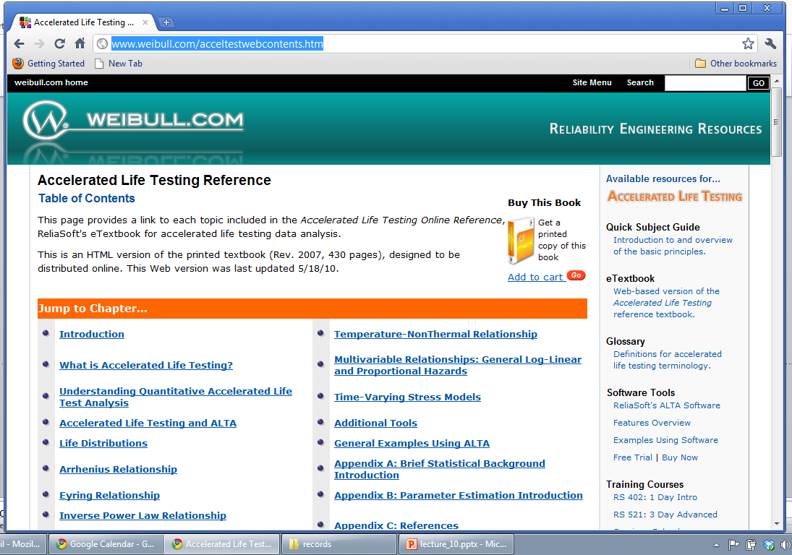
Details

Slide 11
Summary
Many of your projects make claims about reliability, durability, low maintenance, etc.
You must demonstrate how your design has been developed to address these constraints.
Over-engineering is not an acceptable solution.
This is an excellent resource:
http://www.weibull.com/acceltestwebcontents.htm

