Slide 1
The majority of these slides were developed by Professor Jeff Brown, Welcome to FIN/LIR 434: Employee Benefits

Slide 2
Definition of Employee Benefits
Narrow
Employer provided benefits for:
Death
Accident
Sickness
Retirement
Unemployment
Broadest
All benefits and services, other than wages, provided to employees

Slide 3
Five Traditional Categories of Employee Benefits
Legally required social insurance programs
Social Security, Workers’ Compensation
Payments for private insurance and retirement plans
Medical, disability, life insurance
Payments for time not worked
Vacations, parental leave, sabbaticals
Extra cash payments to employees
Educational expenses, suggestion awards
Cost of services to employees
Subsidized cafeterias, adoption assistance, parking

Slide 4
Significance of Employee Benefits - continued
Estimated total employer cost in 1995: $1.5 trillion or 41.8% of payroll
Estimated value for 1929: 3% of payroll
Estimated value for 1965: 21.5% of payroll
In addition, employee payroll deductions equaled 13.1% of payroll in 1995

Slide 5
Examples of Employee Benefits?

Slide 6
5 Traditional Categories
Legally required social insurance
Payments for private insurance and retirement plans
Payments for time not worked
Extra cash payments to employees
Cost of services to employees

Slide 7
Is this Course Relevant?
In 2004, for every dollar paid in wages, employers spent another 40 cents on benefits
Employee benefits are a major force in determining employee retention / happiness
Government provided benefits (e.g., Social Security and Medicare) are by far the largest expenditure of the federal budget
Government tax subsidies for privately provided benefits amount to hundreds of billions of dollars
It is in the news nearly every day

Slide 8
Introduction to Employee Benefits
By the end of this (brief) lecture, you should be able to:
Give a very brief and incomplete history of how employee benefits have developed in US
Name the three most important factors influencing employee benefits
Explain the significance of employee benefits to companies, individuals and the economy

Slide 9
U.S. Benefits “History”
1636: Plymouth settlers’ military pension
1797: Gallatin Glasswork’s profit sharing plan
1875: American Express – first US private employer pension
1902: First workers’ comp law
1911: First group life plan
1935: Social Security Act
1966: Medicare & Medicaid
1974: ERISA
2003: Rx Drugs Added to Medicare Program
2006: Pension Protection Act

Slide 10
What are Employee Benefits? The Broad View
“All benefits and services, other than direct wages, provided to employees”
Insurance against accident, illness, disability, unemployment, death
Retirement savings and income
Vacations and holidays
Tuition assistance, fitness centers, even massages!

Slide 11
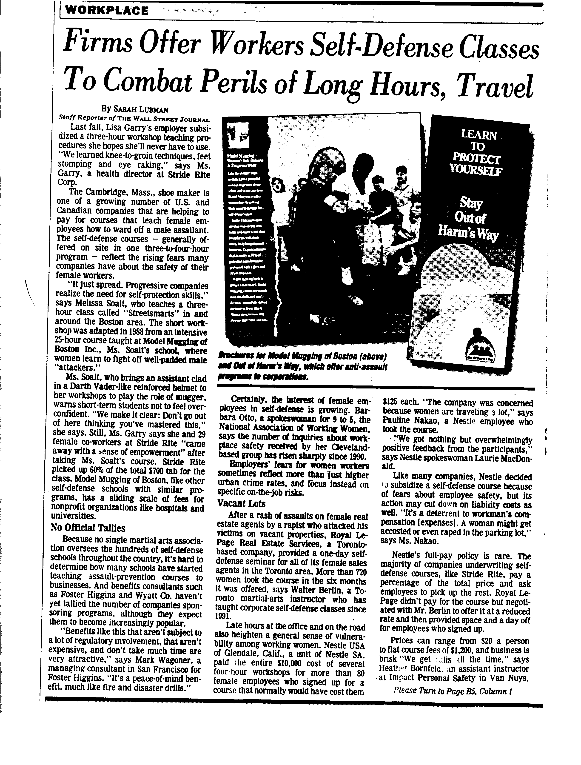

Slide 12
Three Most Important Factors Influencing Employee Benefits
Self-Interest of Decision Makers
Taxation
Demographics

Slide 13
Self-Interest of Decision Makers
What are each of these groups after?
Shareholders
Company Executives
Employees
Unions
Congress and other Policy Makers

Slide 14
Taxation
Tax laws determine which benefits receive favorable tax treatment, and which do not.
Congress has decided to provide favorable tax treatment to:
Pensions, health insurance, dental work, & more
Taxes can influence:
Whether to offer a particular benefit
The form that benefit will take

Slide 15
Changing Demographics
Gender and the workplace
Longevity
Age Distribution
Parenting Roles
Household Composition

Slide 16
How Costly Are Benefits?
In 2004, for every dollar paid in wages and salaries to civilian workers in the U.S., employers spent another 40 cents on benefits
Source: EBRI databook on Employee Benefits Chapter 3
If add in employee payroll deductions, total expenditures on benefits exceed 50 cents per dollar spent on wages and salaries
Ballpark – the U.S. spends $1.5-$2 trillion dollars per year on benefits (roughly equal to GDP of U.K. or Germany)

Slide 17
Total Compensation Costs (Civilian Workers 2004)
Component | Cost per Hour worked | Percent of Total | % Increase since 1995
Total | $24.95 | 100% | +36%
Wages / Salaries | $17.71 | 71% | +35%
Paid leave (vacations, sick) | $1.66 | 7% | +36%
Suppl. Pay (shift pay, bonuses) | $0.60 | 2% | +70%
Insurance (life, health, disability) | $1.93 | 8% | +67%
Pensions | $0.99 | 4% | +39%
Legally required (SS, Medicare, Unempl., WC) | $2.01 | 8% | +26%

Slide 18
A Sampling of Current Issues
Reform of the PBGC
“Automatic enrollment” in 401(k) plans
Social Security reform
Company stock in 401(k) plans
Mismanagement of 401(k) plan assets
Accounting treatment for stock options
Age discrimination in conversion to cash balance plans
Tax reform commission – treatment of fringe benefits

Slide 19
Current Issues, continued
Rising health care costs
The uninsured
Same sex domestic partner benefits
DNA testing
Medicare Rx drug coverage
Importing Rx drugs from Canada
Mental health parity
Rx coverage of birth control devices
Long-Term Care Insurance

Slide 20
WSJ: Ten Ways Employers Benefit from Benefits Plans
Pension piggy banks
Inducements for downsizing
Low cost retiree health coverage
Savings from Medicare
Cheaper than salaries
Benefit plans as profit centers
Payroll savings from pretax plans
Low cost loans
Joys of 401(k)s for employers
Deducting dividends

