Slide 1
LECTURE 01: Introduction to Algorithms and Basic Linux Computing
Topics:
The Login Environment Processes and Shells
The Bash Shell The Command Line (Very Basic)
.profile and .bashrc Customization
Resources:
Syllabus
Lynda.com: YouTube:
Ubuntu Installation The Linux Desktop
Login Resources Introduction to Linux
Environment Variables Customizing the Environment
The Command Prompt Unix and Shells

Slide 2
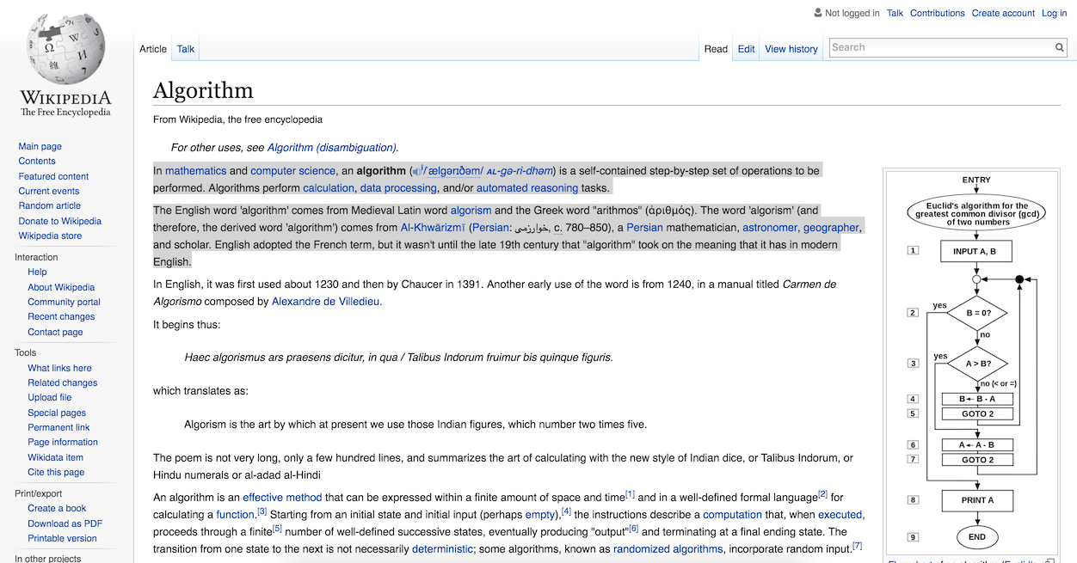
What Is An Algorithm?
Wikipedia: “In mathematics and computer science, an algorithm is a self-contained step-by-step set of operations to be performed.”
Algorithms perform calculation, data processing, and/or automated reasoning tasks.
The English word 'algorithm' comes from Medieval Latin word algorism and the Greek word "arithmos" (ἀριθμός).
Khan Academy: “A set of steps to accomplish a task.”
Typical algorithms might be your strategy for beating traffic when you drive to work, or how you get out of bed and prepare for school each morning.
We use computer to implement algorithms that are too computationally complex to do manually.
Programming is more about algorithms than languages and syntax.

Slide 3
What Is A Functional Mapping?
A functional mapping is a mathematical function that expresses a relationship between inputs and output (e.g., converts data to labels).
Some mappings are deterministic (e.g., they produce the same result each time an input sequence is applied).
Some mappings are stochastic (e.g., they can produce different outcomes for the same input).
In this microcourse, we will focus on algorithms that learn mappings between images and numbers.
An image is a picture stored pixel by pixel (e.g., jpeg, png, gif).
Each pixel can be represented by three colors (e.g., rgb) or a single grayscale value (represented numerically using the range [0,255]).

Slide 4
Machine Learning: Automatically Learning Mappings
In supervised learning, we provide the machine with lots of examples of input data and the associated labels (e.g., answers).
Labels often come from expert knowledge (e.g., a human expert reviews the data).
Data labeled by humans is expensive to develop and difficult to interpret.
Unsupervised learning is a type of machine learning algorithm used to draw inferences from datasets consisting of input data without labeled responses.
The most common unsupervised learning method is cluster analysis, which is used for exploratory data analysis to find hidden patterns or grouping in data.

Slide 5
Big Data: Machines Need Data to Learn Mappings
Big data is a term for data sets that are so large or complex that traditional data processing applications are inadequate to deal with them.
There are so many variables to learn in a real-world problem involving human inference that almost any data set is too small.
Big data and machine learning are used to automatically learn, or discover, relationships between data.
Only with vast amounts of data do true underlying relationships emerge.
Complex machine learning systems are able to “memorize” patterns in small data sets, but are unable to generalize well to new or previously unseen datasets.

Slide 6
Computation Plays A Vital Role
High performance machine learning systems use large Linux compute clusters to learn (e.g., Amazon AWS, Microsoft Azure).
Algorithms are often optimized to run on low-cost high performance chips known as a Graphics Processing Unit (GPU).
Algorithms run in parallel (on multiple CPUs simultaneously) because training is expensive.
In this course, you will use a Linux compute cluster located at neuronix.nedcdata.org (at Temple University).
This cluster consists of 5 compute nodes with 128 general purpose cores, 4 GPUs, over 20T of disk space, and 1T of physical memory, at a total system cost of $30K.

Slide 7
Summary
This microcourse will teach you the basics of how to design and implement a functional mapping for real-world data.
Algorithms are everywhere today, even when you shop online. Machine learning and big data play an integral role in the development of these algorithms.
Linux computing clusters are used to train, optimize and evaluate algorithms.
Therefore, in this microcourse, you will learn the basics of Linux-based distributed parallel computing in addition to learning about algorithms, big data and machine learning.

