Slide 1
LECTURE 04: Functional Mappings and Neural Networks
Topics:
What is a function? What is a mapping? What types of functions can we learn?
How do we learn functions from data?
Resources:
Function Definition
Mapping Definition
Artificial Neural Network
The Neural Network Zoo

Slide 2
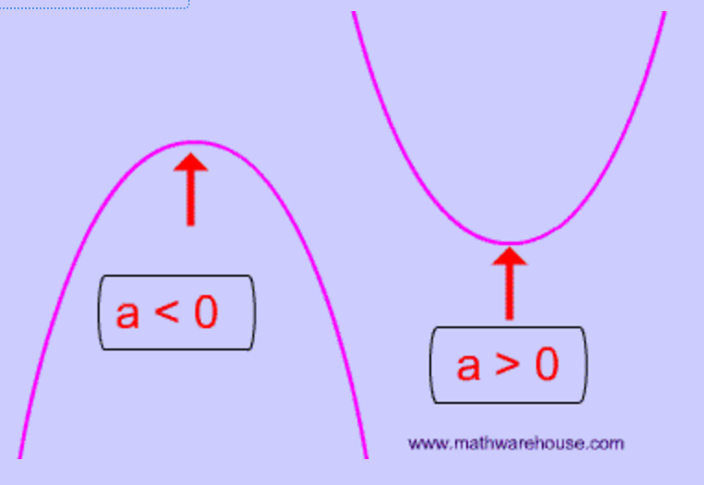
What Is A Function?
Equation of a line: y = mx + b
Equation of a parabola: y = ax² + bx + c
How do we estimate the equation of a line from two points?
m = slope = (y₂-y₁) / (x₂-x₁)
b = y intercept:
y₁ = m(x₁) + b
b = y₁ – m(x₁)
check:
b = y₂ – m(x₂)
How do we estimate the equation of a line from three points or more (hint: mean square error or regression?

Slide 3
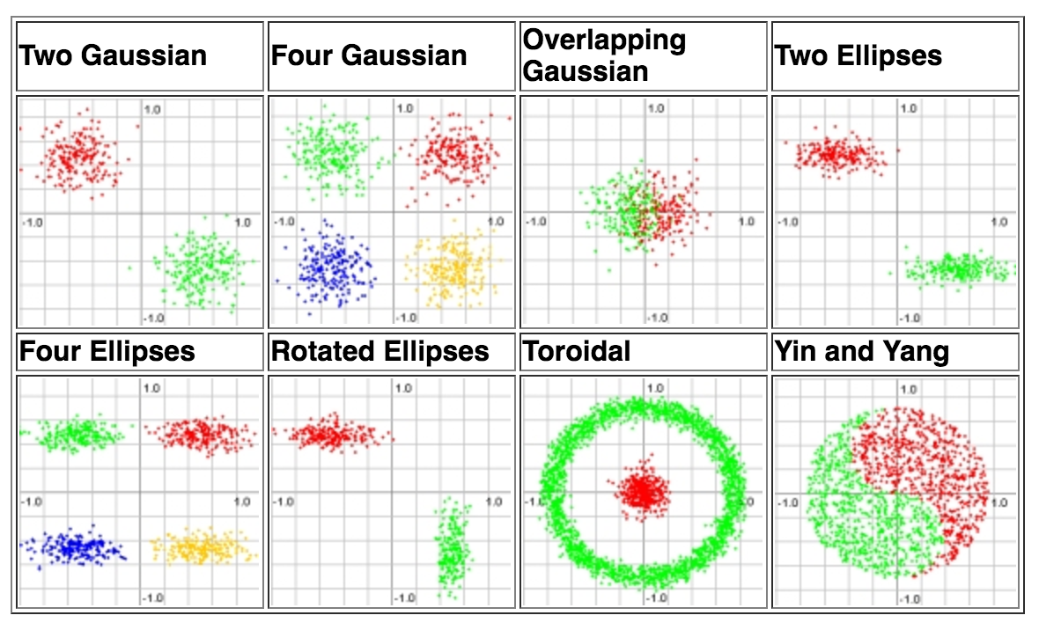
What Is A Functional Mapping?
Emulating human performance can be a complicated process involving highly nonlinear functions.
Example: Equal Loudness Curves
Your perception of loudness varies with frequency.
Perceived loudness also changes depending on the intensity.
Classifying data can be easy:
But generalization can be difficult:

Slide 4
How Do We Minimize An Objective Function?
Most modern learning algorithms use a variant of gradient descent in which we iteratively search for a maximum (or minimum) in a function:
The algorithmic details vary from implementation to implementation, but most approaches are based on derivatives (slopes).

Slide 5
Ideal Search Spaces Are Convex
If the search space for a solution is convex, gradient descent or hill-climbing will find an optimal solution.
This is one reason solutions that minimize the mean square error are popular.
However, real world problems involve optimization in very high dimensional spaces that are extremely complex.
To simplify things, we often try to “regularize” the problem:

Slide 6
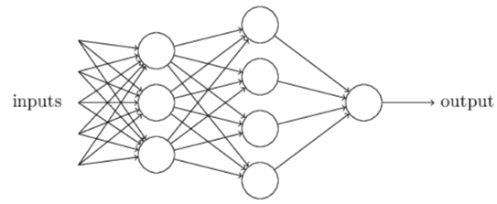
Neural Networks
Artificial neural networks (ANNs) are algorithms modeled after how the human brain operates.
ANNs today perform a number of functions including feature extraction, signal modeling and language or domain modeling.
Neural networks are comprised of nodes, which combine the inputs from the data with a set of coefficients or weights and determine whether the signal will progress further through the network.

Slide 7
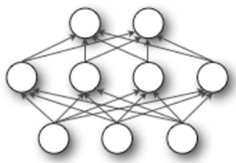
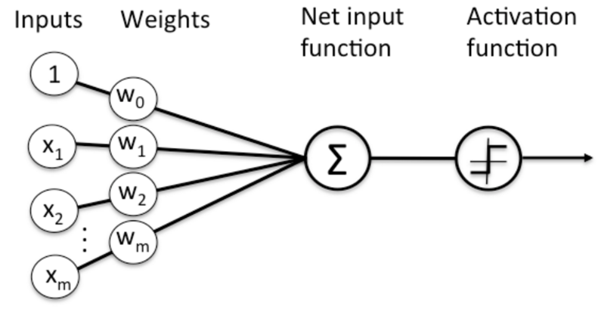
Nodes in Neural Networks
The products between the inputs $x_{n}$ and the weight $ω_{n}$ are summed in the node and the result is passed to the node’s activation function, which determines whether the node will fire.
Perceptrons are the most fundamental and simplest models of neurons.
Node Diagram

Slide 8
Perceptrons
Perceptrons are very simple. They take several binary inputs and generate a single binary output.
Given a set of inputs $x_{1}, x_{2}, x_{3}$, and a set of corresponding weights $ω_{1},ω_{2}$, $ω_{3},$the neuron’s output is given by:
$$output=\left\{\begin{aligned}0 if \sum_{j}{ω_{j}x_{j}≤threshold} \\ 1 if \sum_{j}{ω_{j}x_{j}>threshold}\end{aligned}\right.$$
To simplify, $x$ and $ω$ can be seen as vectors and the threshold is presented as a bias b, where $bias≡−threshold$
$$x_{1}$$
$$ω_{1}$$
$$output=\left\{\begin{aligned}0 if ω∙x+b ≤0 \\ 1 if ω∙x+b >0\end{aligned}\right.$$
$$ω_{2}$$
$$x_{2}$$
$$output$$
$$ω_{3}$$
$$x_{3}$$

Slide 9
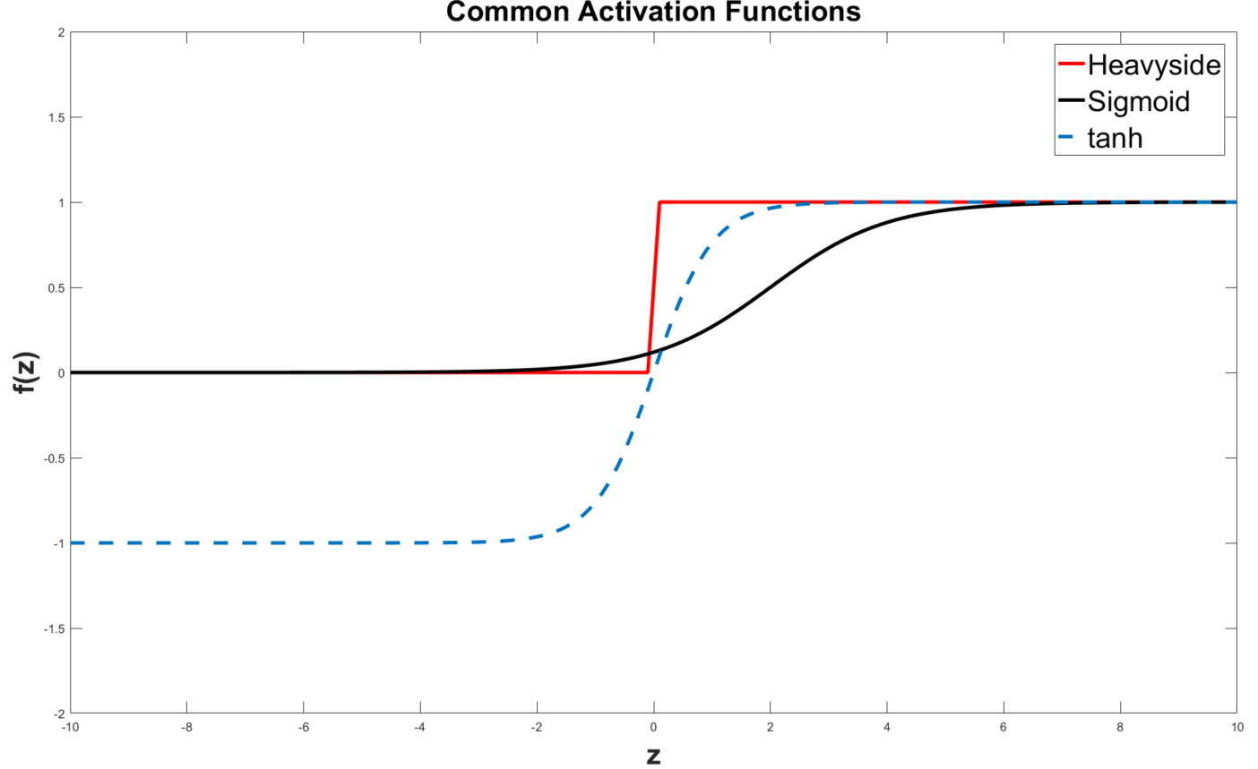
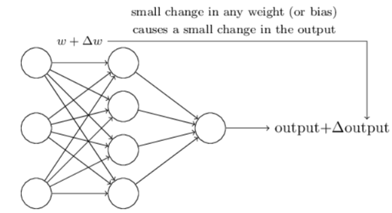
Sigmoid Neurons
Learning algorithms involve the adjustment of the weights and bias
If the neuron model used is the perceptron, a small change in a weight or bias can cause output to completely flip (being a binary model), and the flip can cause a change in the behavior of the entire network
A new type of artificial neuron, a sigmoid neuron, is commonly used to overcome this issue
In this case, the output is given by $σ\left(z\right)≡ \frac{1}{1+e^{z}}$, where $z=ω∙x+b$
This means, the activation function is a logistic function. Other common activation function is the tanh function, given by $tanh\left(z\right)=\frac{{e^{z}−e}^{−z}}{e^{z}+e^{−z}}$

Slide 10
There Are Many Types Of Neural Networks

Slide 11
Summary
The ability to learn complex mappings from data can be a powerful way to predict and classify data, and can lead to a better understanding of underlying dependencies.
This type of learning, however, requires iterative algorithms that are computationally expensive.
Gradient descent is a popular way to find good solutions.
A neural network attempts to emulate properties observed in the human brain: a simple computational element is used that emulates the basic properties of a neuron. By combining large numbers of these nodes in various topologies, we can solve complex engineering and scientific problems.
There are many types of neural networks in use today. In our previous class, you ran a network based on logistic regression.

