Slide 1
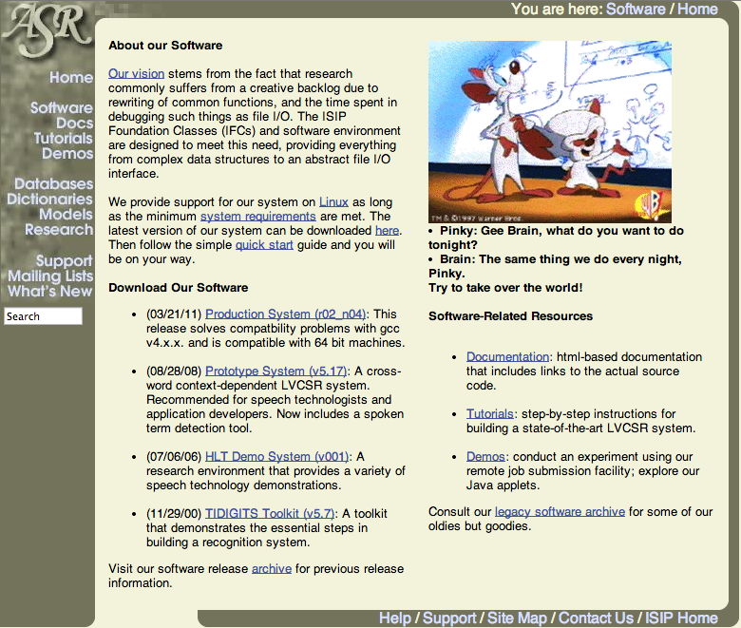
Institute for Signal and Information Processing (www.isip.piconepress.com)

