Slide 1
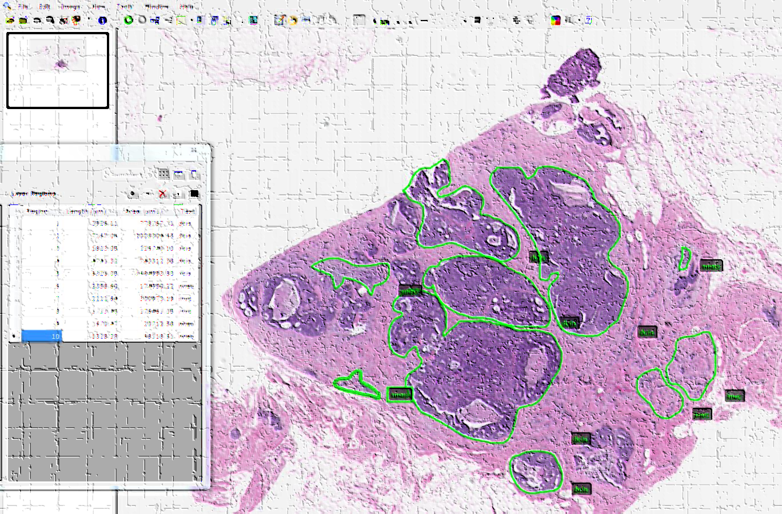
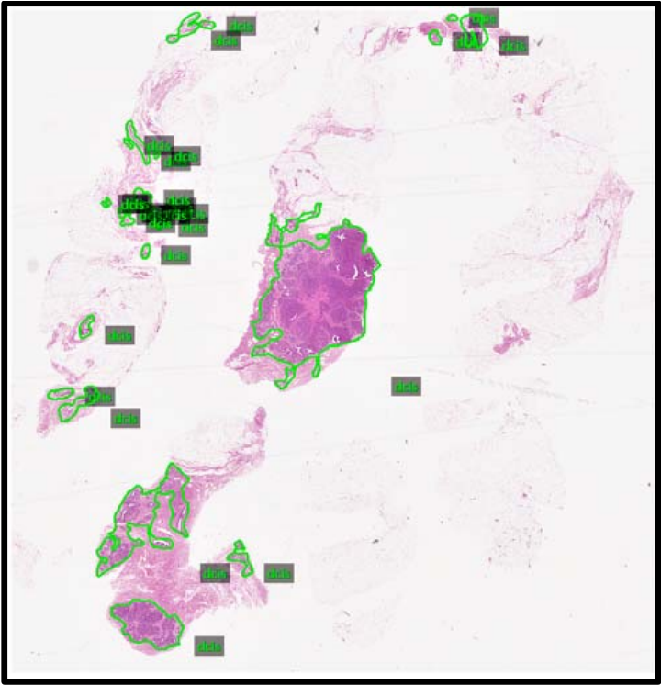
NSF DPATH CCRI Community Research Consortium
Digitizing Pathology Together

