Slide 1
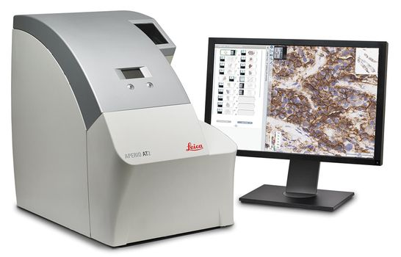
Leica Aperio AT2 – Digital Scanner at Temple University Hospital

