Slide 1
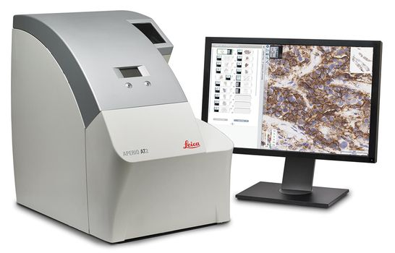
Fig.1 – Leica Aperio AT2

Slide 2
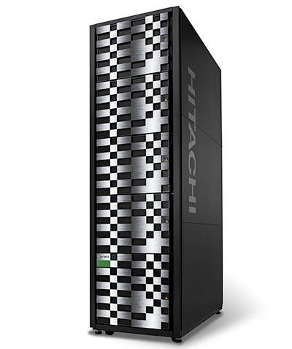
Fig.2 – Hitachi VSP G600

