Slide 1
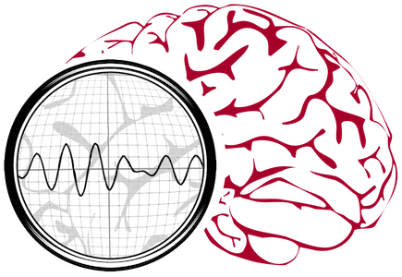
Neural Engineering Data Consortium
Data and Analytics
that Drive Innovation in Healthcare
info@nedcdata.org
www.nedcdata.org

Slide 2
Real-time analytics improve the quality and efficiency of healthcare

Slide 3
Real-time analytics improve the quality and efficiency of healthcare
AutoEEGTM: A clinical decision support tool for pre-scanning EEGs
Enable clinical neurologists to increase billing by decreasing time spent analyzing EEGs
Allow pharma companies to measure neural changes during drug trials
Allow neurologists to order and bill for substantially more long-term monitoring tests

Slide 4
Real-time analytics improve the quality and efficiency of healthcare
AutoEEGTM: A clinical decision support tool for pre-scanning EEGs
Enable clinical neurologists to increase billing by decreasing time spent analyzing EEGs
Allow pharma companies to measure neural changes during drug trials
Allow neurologists to order and bill for substantially more long-term monitoring tests

Slide 5
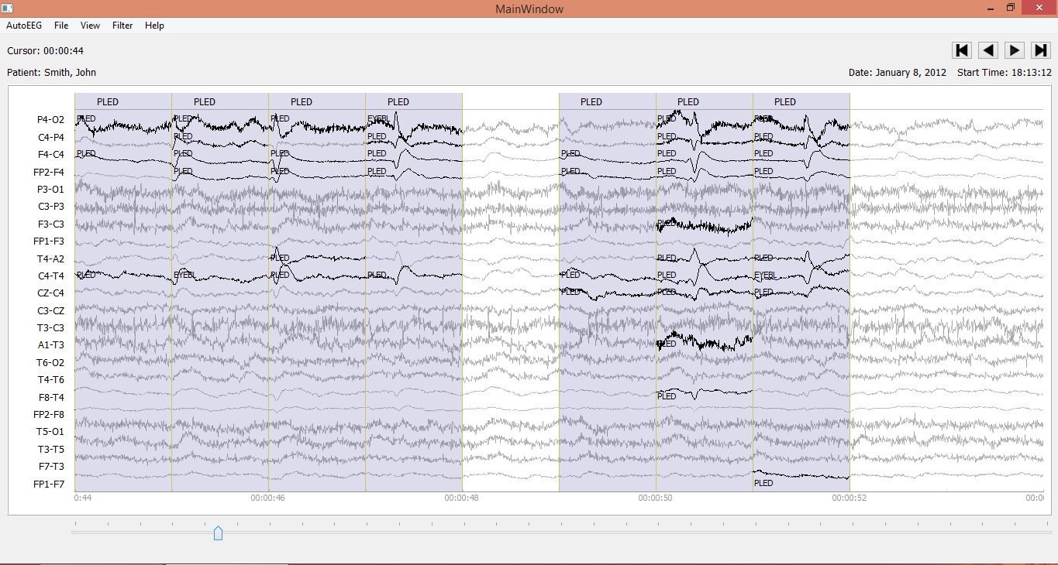
Powerful machine learning technology delivers unprecedented performance on clinical data

Slide 6
Powerful machine learning technology delivers unprecedented performance on clinical data
95% accuracy identifying relevant events with less than 5% false alarms

Slide 7
Powerful machine learning technology delivers unprecedented performance on clinical data
95% accuracy identifying relevant events with less than 5% false alarms
A multi-level architecture featuring an integration of deep learning and sequential pattern recognition

Slide 8
Powerful machine learning technology delivers unprecedented performance on clinical data
95% accuracy identifying relevant events with less than 5% false alarms
A multi-level architecture featuring an integration of deep learning and sequential pattern recognition
Emerging markets beyond traditional EEG clinical applications include concussion, sleep disorders and Alzheimer’s disease.

Slide 9
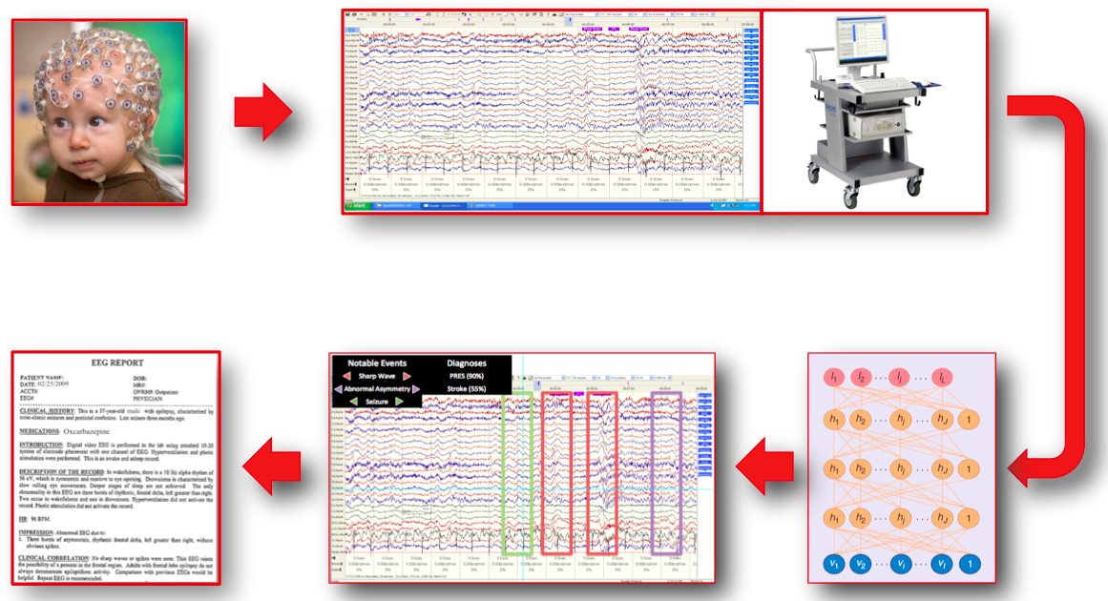
EEG …

Slide 10
Deep Learning Analytics…

Slide 11
Automatically Marked EEG…

Slide 12
Automatic Reports

Slide 13
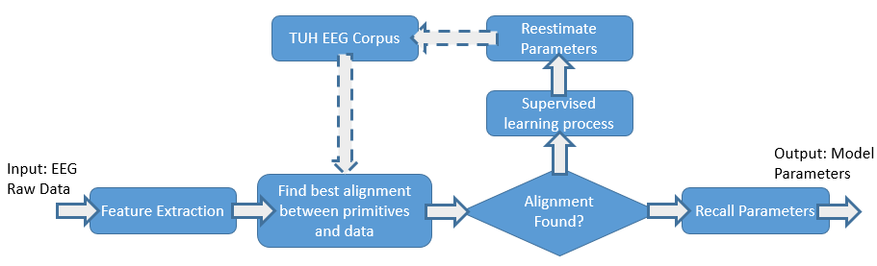
Semi-supervised deep learning trained on the world’s largest clinical EEG data corpus

Slide 14
Semi-supervised deep learning trained on the world’s largest clinical EEG data corpus

Slide 15




Sponsored by…
Temple University
Office of Research

Slide 16
Transforming healthcare through big data analytics

Slide 17
Industry
PI
Research Questions
Funding Agencies
Neural Engineering Data
Consortium
Fees
Funded
PI
Unfunded
PI
Data
Data Design
Results
Funded
PI
Unfunded
PI
Data Generation
Results Scoring
Funded
PI
Unfunded
PI

Slide 18
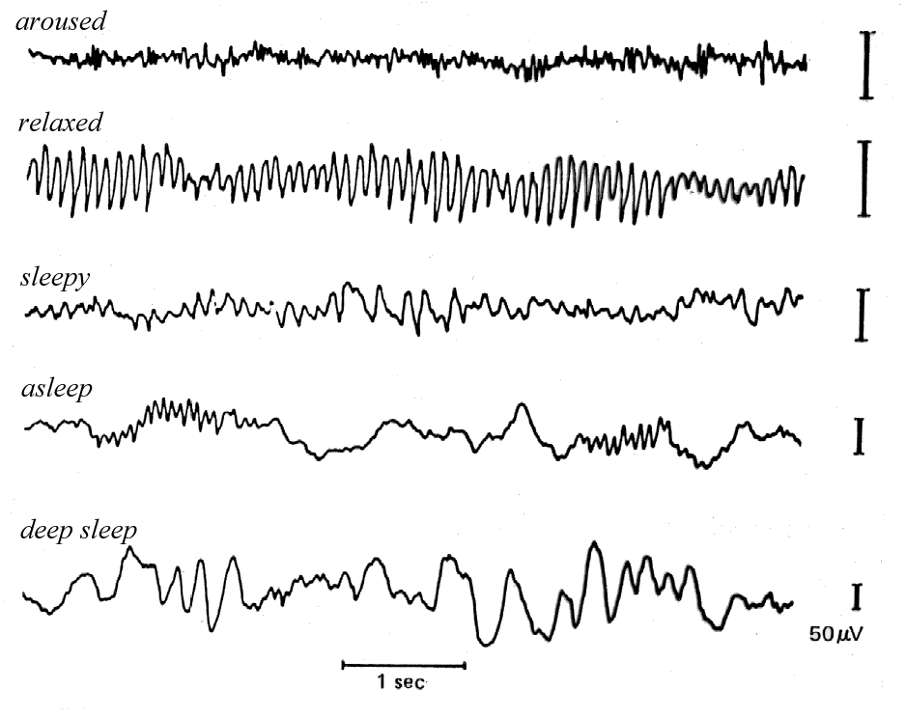
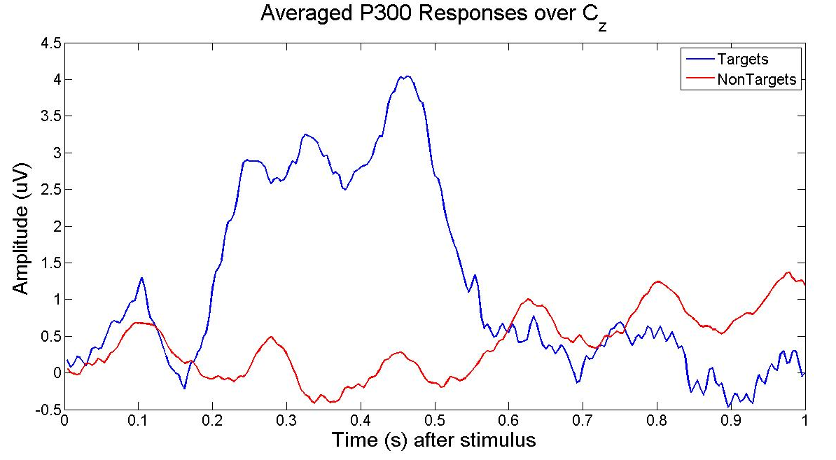
EEG

Slide 19
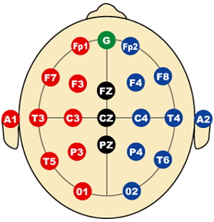
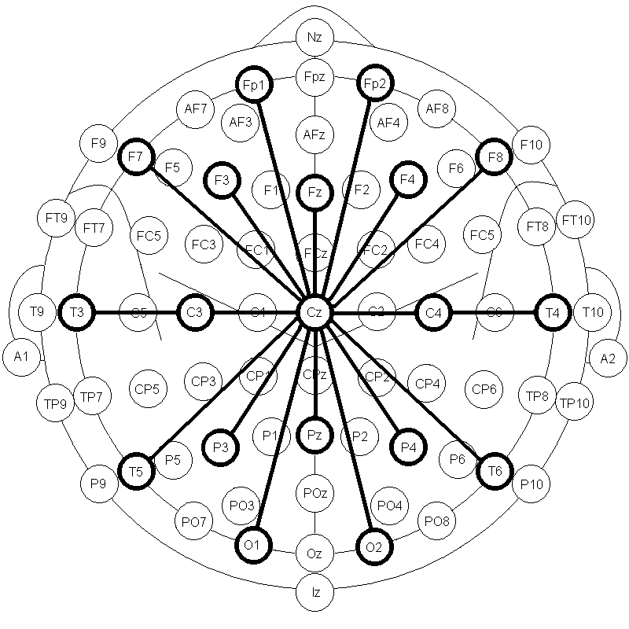
10-20 EEG System

Slide 20
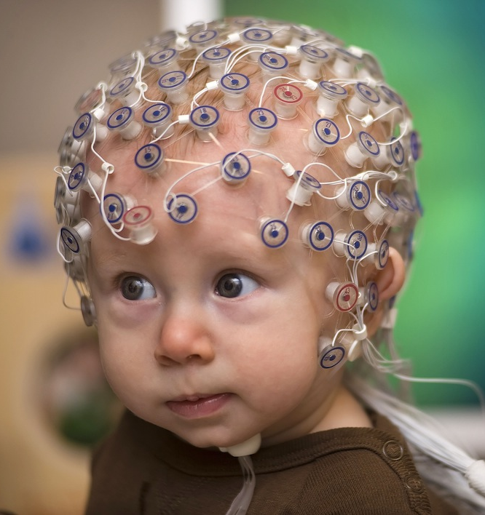
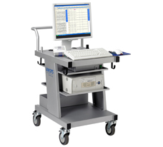
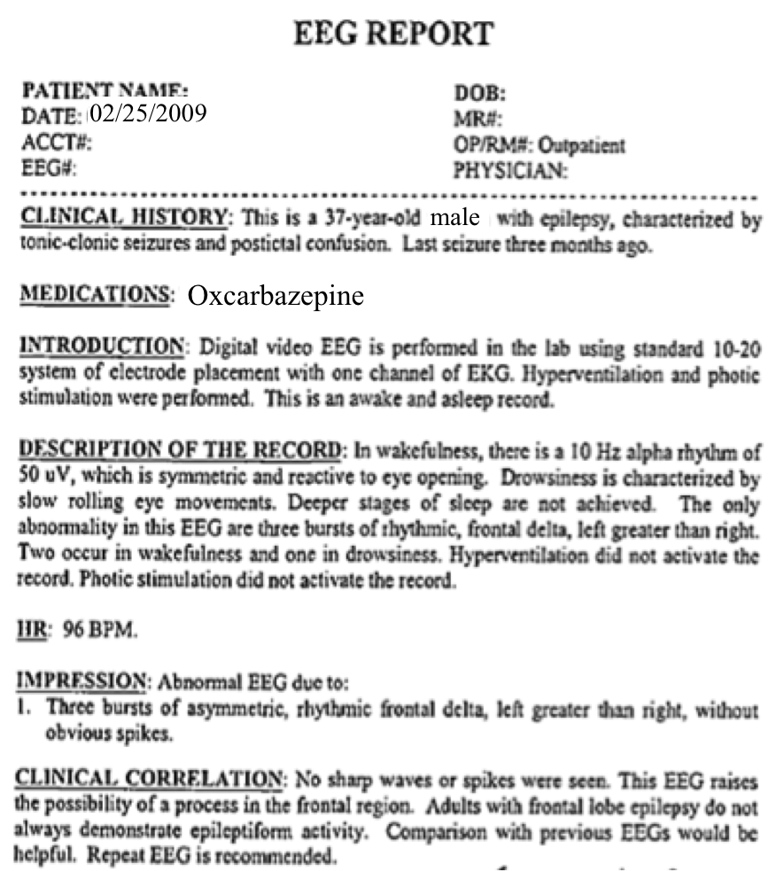
The Clinical Process
  A technician administers a 30−minute recording session.
  An EEG specialist (neurologist) interprets the EEG.
  An EEG report is generated with the diagnosis.
  Patient is billed once the report is coded and signed off.

Slide 21
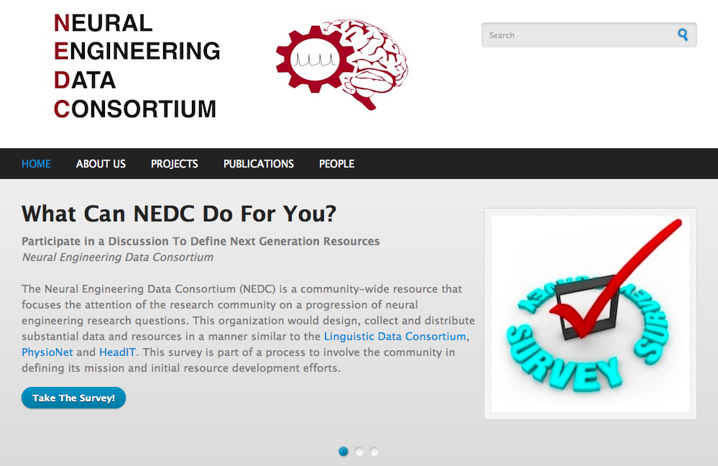

Slide 22
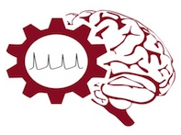
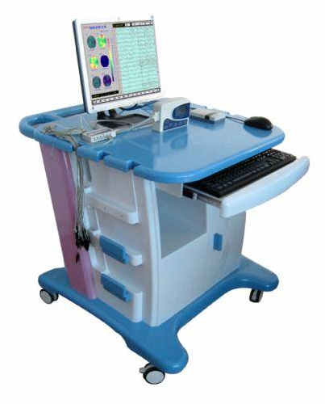
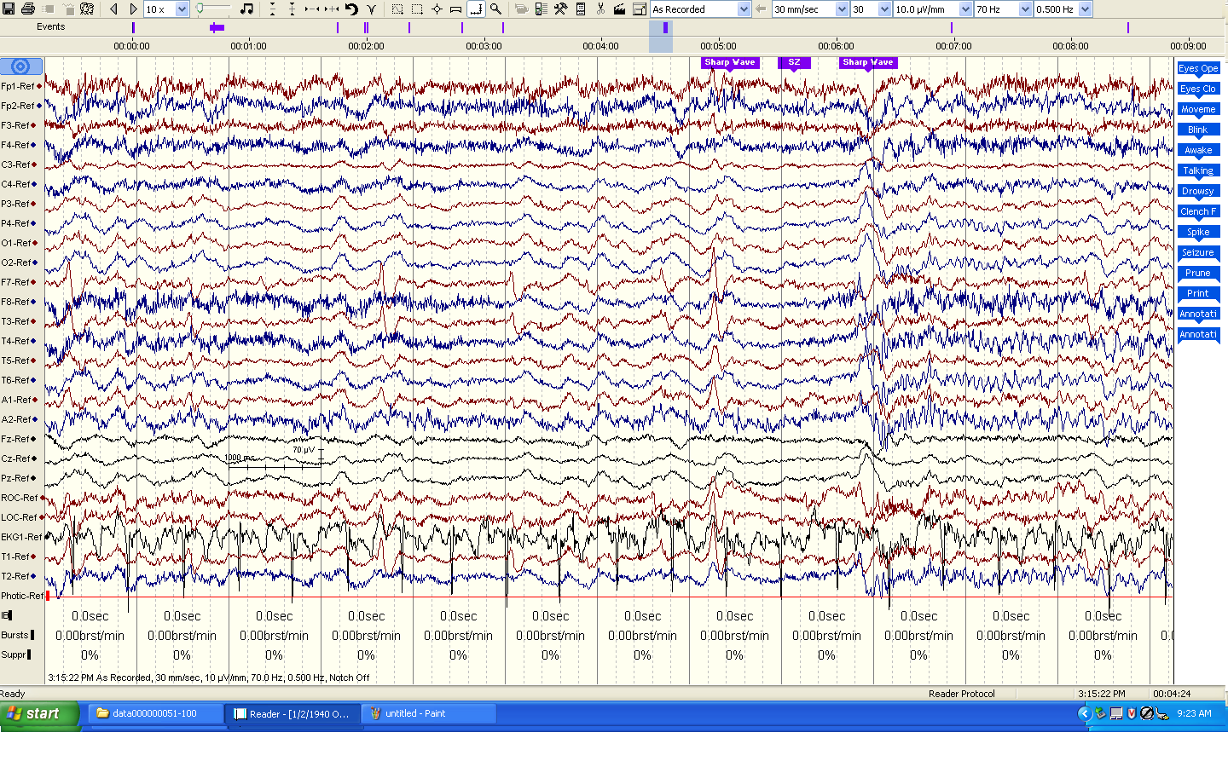
The Temple University Hospital EEG Corpus
Synopsis: The world’s largest publicly available EEG corpus consisting of 20,000+ EEGs collected
from 15,000 patients, collected over 12 years. Includes physician’s diagnoses and patient medical
histories. Number of channels varies from 24 to 36. Signal data distributed in an EDF format.
Impact:
  Sufficient data to support application of state of the art machine learning algorithms
  Patient medical histories, particularly drug treatments, supports statistical analysis of correlations between signals and treatments
  Historical archive also supports investigation of EEG changes over time for a given patient
  Enables the development of real-time monitoring
Database Overview:
  21,000+ EEGs collected at Temple University Hospital from 2002 to 2013 (an ongoing process)
  Recordings vary from 24 to 36 channels of signal data sampled at 250 Hz
  Patients range in age from 18 to 90 with an average of 1.4 EEGs per patient
  Data includes a test report generated by a technician, an impedance report and a physician’s report; data from 2009 forward inlcudes ICD-9 codes
  A total of 1.8 TBytes of data
  Personal information
  has been redacted
  Clinical history and medication history are included
  Physician notes are captured in three fields: description, impression and correlation fields.

Slide 23
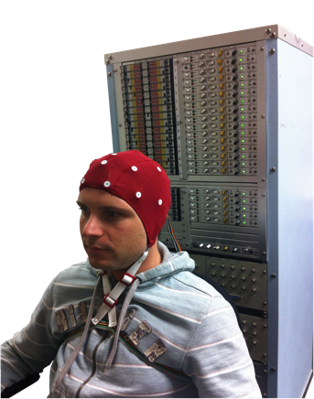
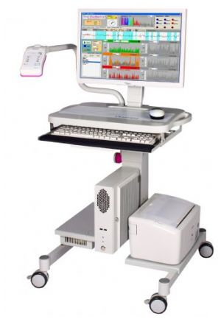
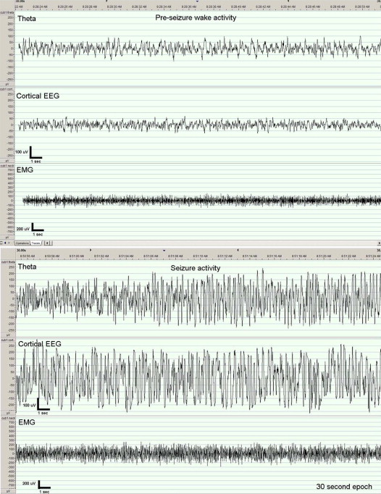
The Neural Engineering Data Consortium
Mission: To focus the research community on a progression of research questions and to
generate massive data sets used to address those questions. To broaden participation by making
data available to research groups who have significant expertise but lack capacity for data generation.
Impact:
  Big data resources enables application of state of the art machine-learning algorithms
  A common evaluation paradigm ensures consistent progress towards long-term research goals
  Publicly available data and performance baselines eliminate specious claims
  Technology can leverage advances in data collection to produce more robust solutions
Expertise:
  Experimental design and instrumentation of bioengineering-related data collection
  Signal processing and noise reduction
  Preprocessing and preparation of data for distribution and research experimentation
  Automatic labeling, alignment and sorting of data
  Metadata extraction for enhancing machine learning applications for the data
  Statistical modeling, mining and automated interpretation of big data
  To learn more, visit www.nedcdata.org

Slide 24
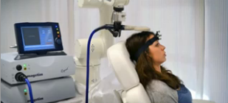
Automated Interpretation of EEGs
Goals: (1) To assist healthcare professionals in interpreting electroencephalography (EEG) tests,
thereby improving the quality and efficiency of a physician’s diagnostic capabilities; (2) Provide
a real-time alerting capability that addresses a critical gap in long-term monitoring technology.
Impact:
  Patients and technicians will receive immediate feedback rather than waiting days or weeks for results
  Physicians receive decision-making support that reduces their time spent interpreting EEGs
  Medical students can be trained with the system and use search tools make it easy to view patient histories and comparable conditions in other patients
  Uniform diagnostic techniques can be developed
Milestones:
  Develop an enhanced set of features based on temporal and spectral measures (1Q’2014)
  Statistical modeling of time-varying data sources in bioengineering using deep learning (2Q’2014)
  Label events at an accuracy of 95% measured on the held-out data from the TUH EEG Corpus (3Q’2014)
  Predict diagnoses with an F-score (a weighted average of precision and recall) of 0.95 (4Q’2014)
  Demonstrate a clinically-relevant system and assess the impact on physician workflow (4Q’2014)

Slide 25
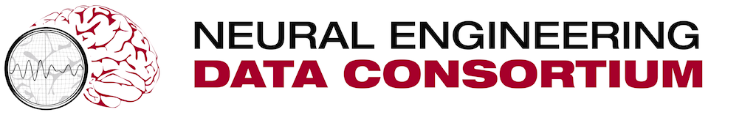
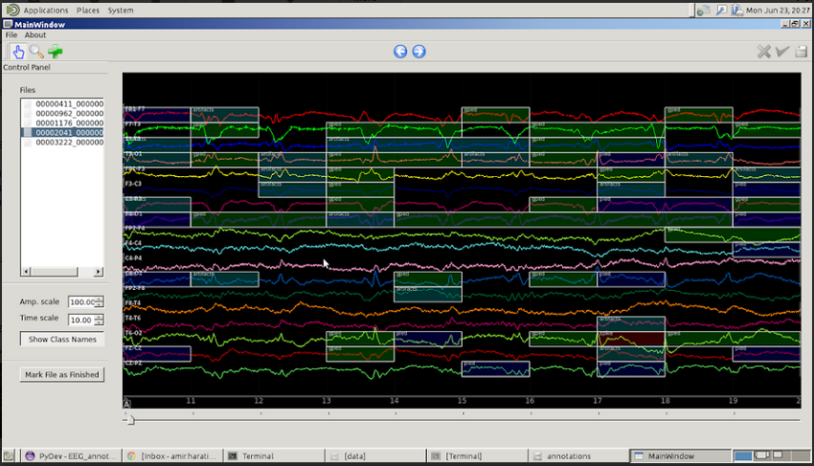
Big Data Approaches to EEG Analysis
Clinical, Basic, and Applied Science
Iyad Obeid, PhD – Dept. of Electrical and Computer Engineering
Our goal
Using big biomedical data to drive discovery and hypothesis formation
Understanding, decoding, detecting neural function
Our method
Created massive EEG corpus from archived hospital medical records
Matched physician reports for each EEG
Data-driven machine learning
TUH-EEG data corpus
~25,000 sessions
~14,000 unique patients
Ten year span of records
Average of 1.75 sessions / patient
Ages 2 – 90+
Real-world data variability
Our assets
TUH-EEG Database
Active relationship with Temple Hospital
Machine learning expertise
Biomedical signal processing expertise
Our infrastructure
Neural engineering data consortium
TU high performance computing center

Slide 26
Annotated Data

