Slide 1
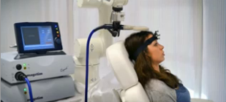
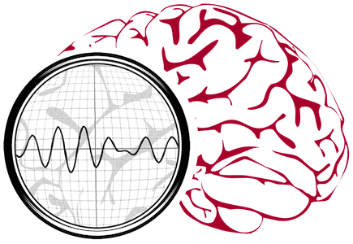
Neural Engineering Data Consortium
1801 North Broad Street
401 Conwell Hall
Philadelphia, Pennsylvania 19122-6027
Data and Analytics
that Drive Innovation in Healthcare
Transforming healthcare through big data analytics
Temple Ventures
http://www.nedcdata.org
info@nedcdata.org
Our core expertise is the development of high performance data analytics that integrate information automatically derived from biomedical signal and image data with knowledge representations derived from electronic medical records. This enables a new generation of clinical tools that enhance and accelerate decision-making. We operate in a customer-centric mode and focus on problems with significant clinical impact.
1947 North 12th Street
Philadelphia, Pennsylvania 19122
The Neural Engineering Data Consortium
Tel: 215-204-9033
Fax: 215-204-5960
Notes:
To change this brochure, replace our sample content with your own. Or, if you'd rather start from a clean slate, press the New Slide button on the Home tab to insert a new page. Now enter your text and pictures in the empty placeholders. To change the logo to your own, select the picture “replace with LOGO” and choose Change Picture on the Picture Tools Format tab.
And did you notice we made fold marks for you? They are really light, but if you don’t like them showing on your brochure, select and delete them before you print.

Slide 2
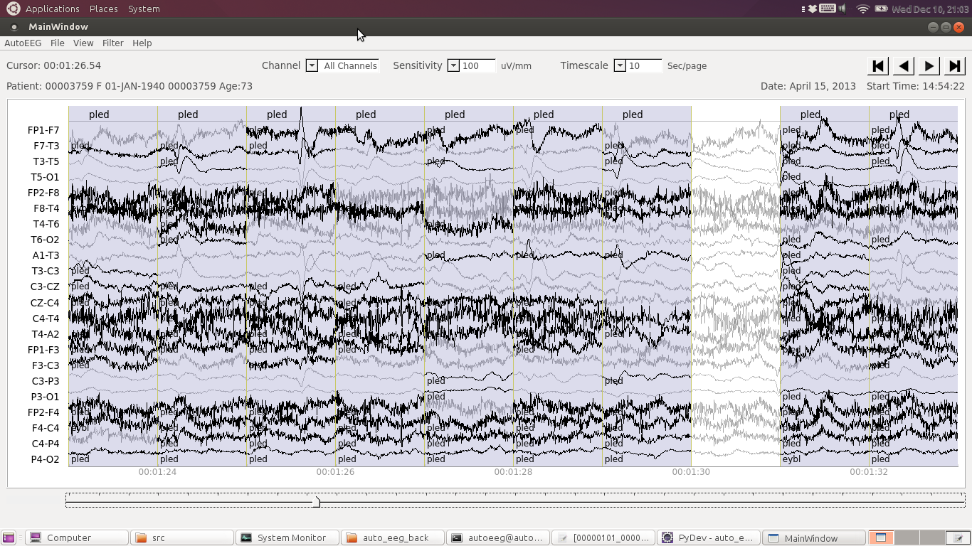
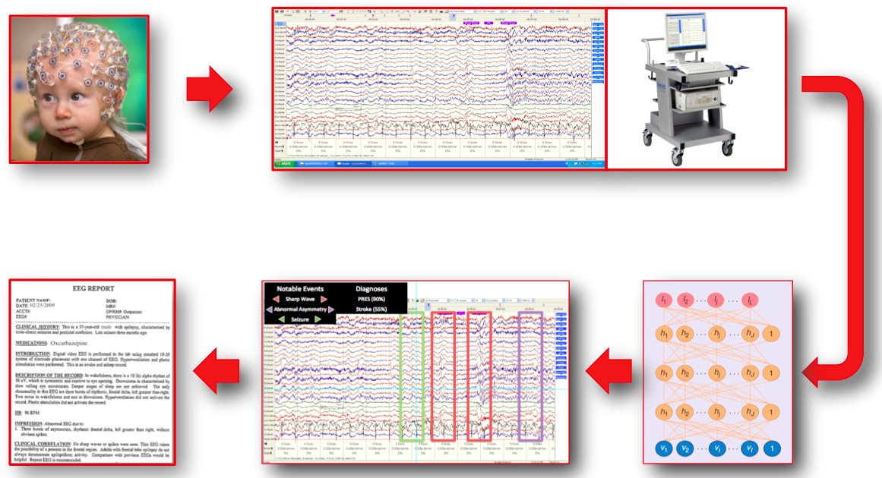
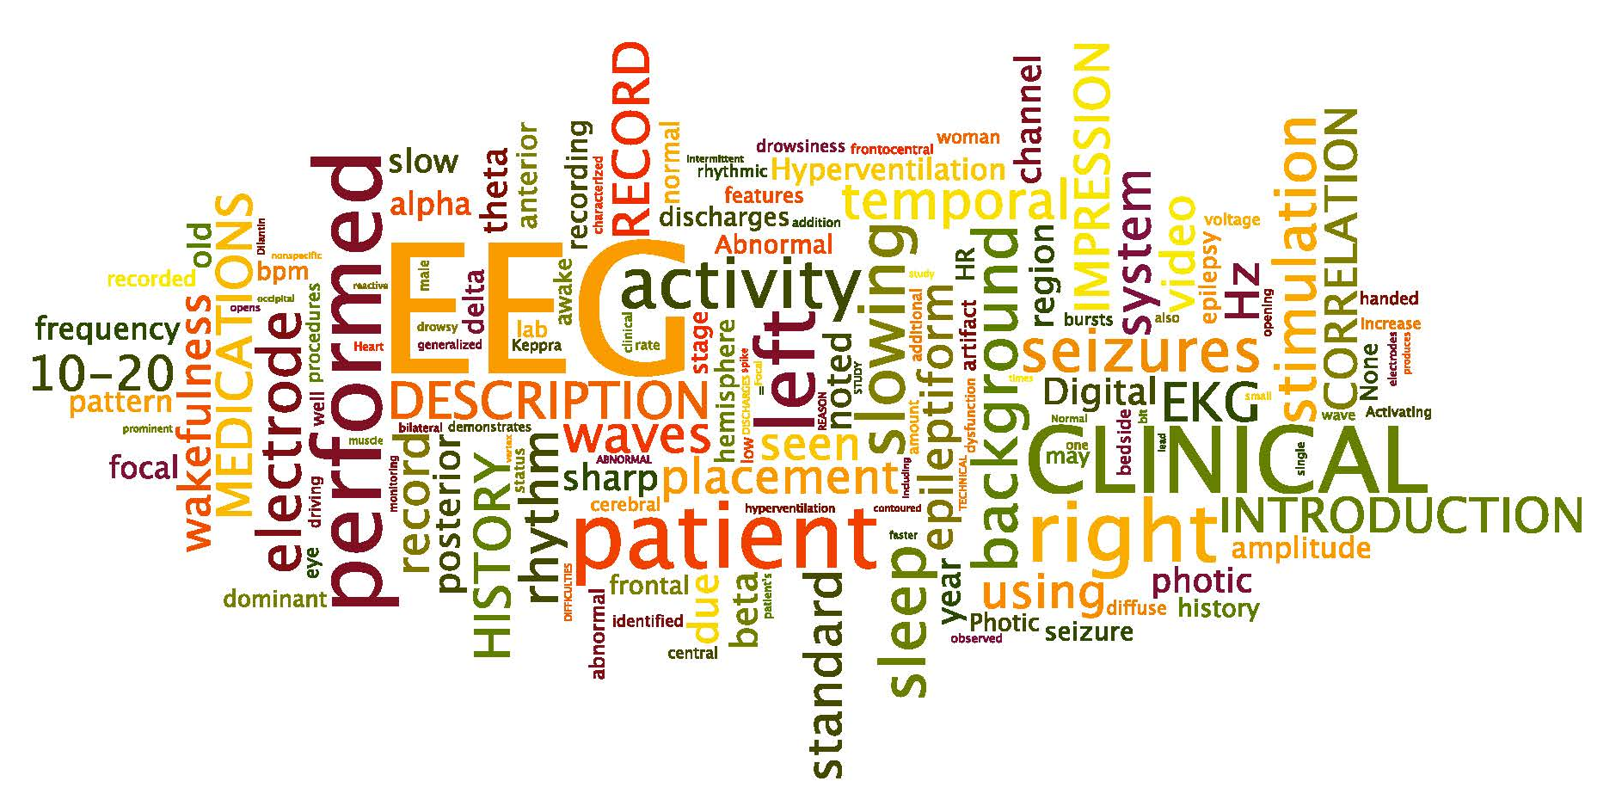
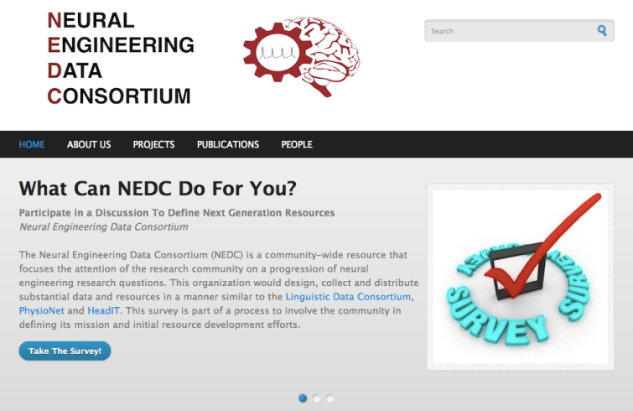
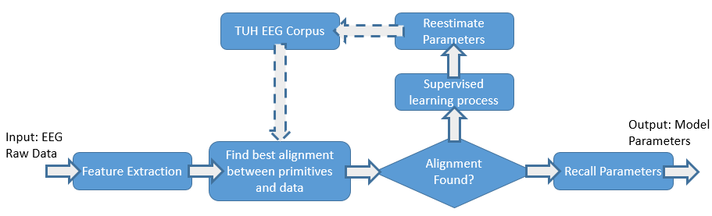
Real-time analytics improve the quality and efficiency of healthcare
Big data resources enable advancements in clinical technology
Unprecedented levels of performance on clinical EEG data
The TUH EEG Corpus is the world’s largest publicly released EEG corpus. It is enabling a new generation of EEG analytics such as AutoEEGTM.
The Neural Engineering Data Consortium (NEDC) focuses on the advancement of science by developing big data resources.
AutoEEGTM: A clinical decision support tool that automatically scans EEGs and identifies regions of interest, enabling real-time alerts for critical events such as seizures. Benefits include:
Decreases the time spent analyzing an EEG, thereby increasing productivity;
Increases capacity for conducting long-term monitoring and ambulatory testing;
Enables cross-platform decision support tools for portable devices such as tablets.
95% accuracy identifying relevant events with less than 5% false alarms.
A multi-level architecture featuring an integration of deep learning and sequential pattern recognition.
Builds on over 30 years of success processing a wide range of biological signals and images.
Emerging markets beyond traditional EEG clinical applications include traumatic brain injury and Alzheimer’s disease.
For further information
Dr. Iyad Obeid, Director
The Neural Engineering Data Consortium
1947 North 12th Street
Philadelphia, Pennsylvania 19122
Tel: 215-204-9033
Email: iobeid@temple.edu
Notes:
To change this brochure, replace our sample content with your own. Or, if you'd rather start from a clean slate, press the New Slide button on the Home tab to insert a new page. Now enter your text and pictures in the empty placeholders. To change the logo to your own, select the picture “replace with LOGO” and choose Change Picture on the Picture Tools Format tab.
And did you notice we made fold marks for you? They are really light, but if you don’t like them showing on your brochure, select and delete them before you print.

