Slide 1
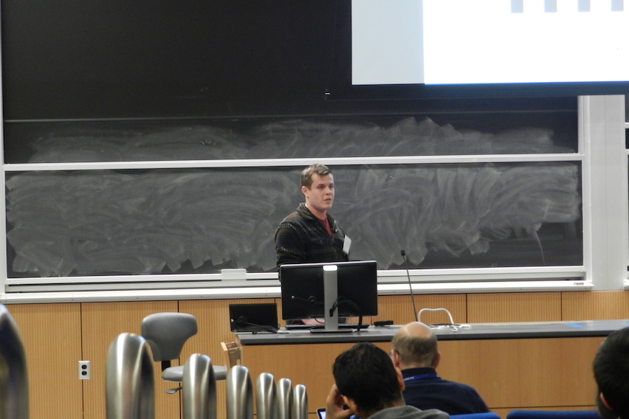
This is an example of a perfectly sized box.

