Slide 1
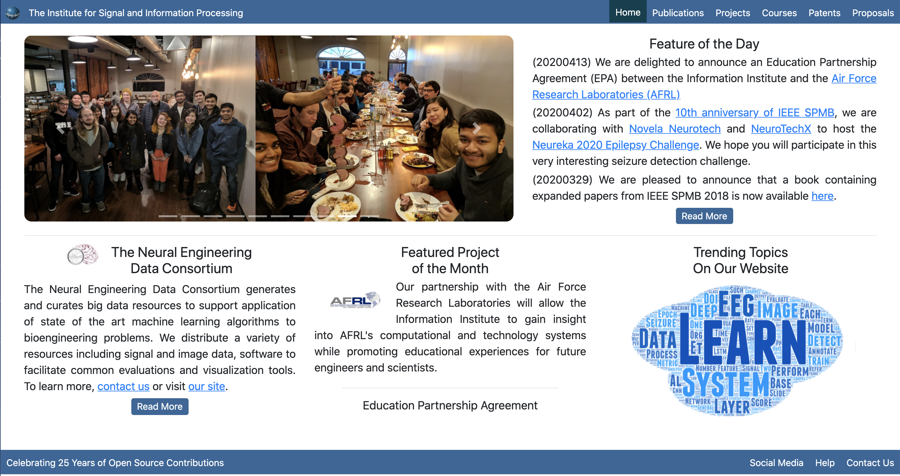
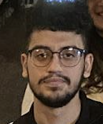
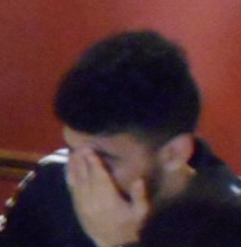
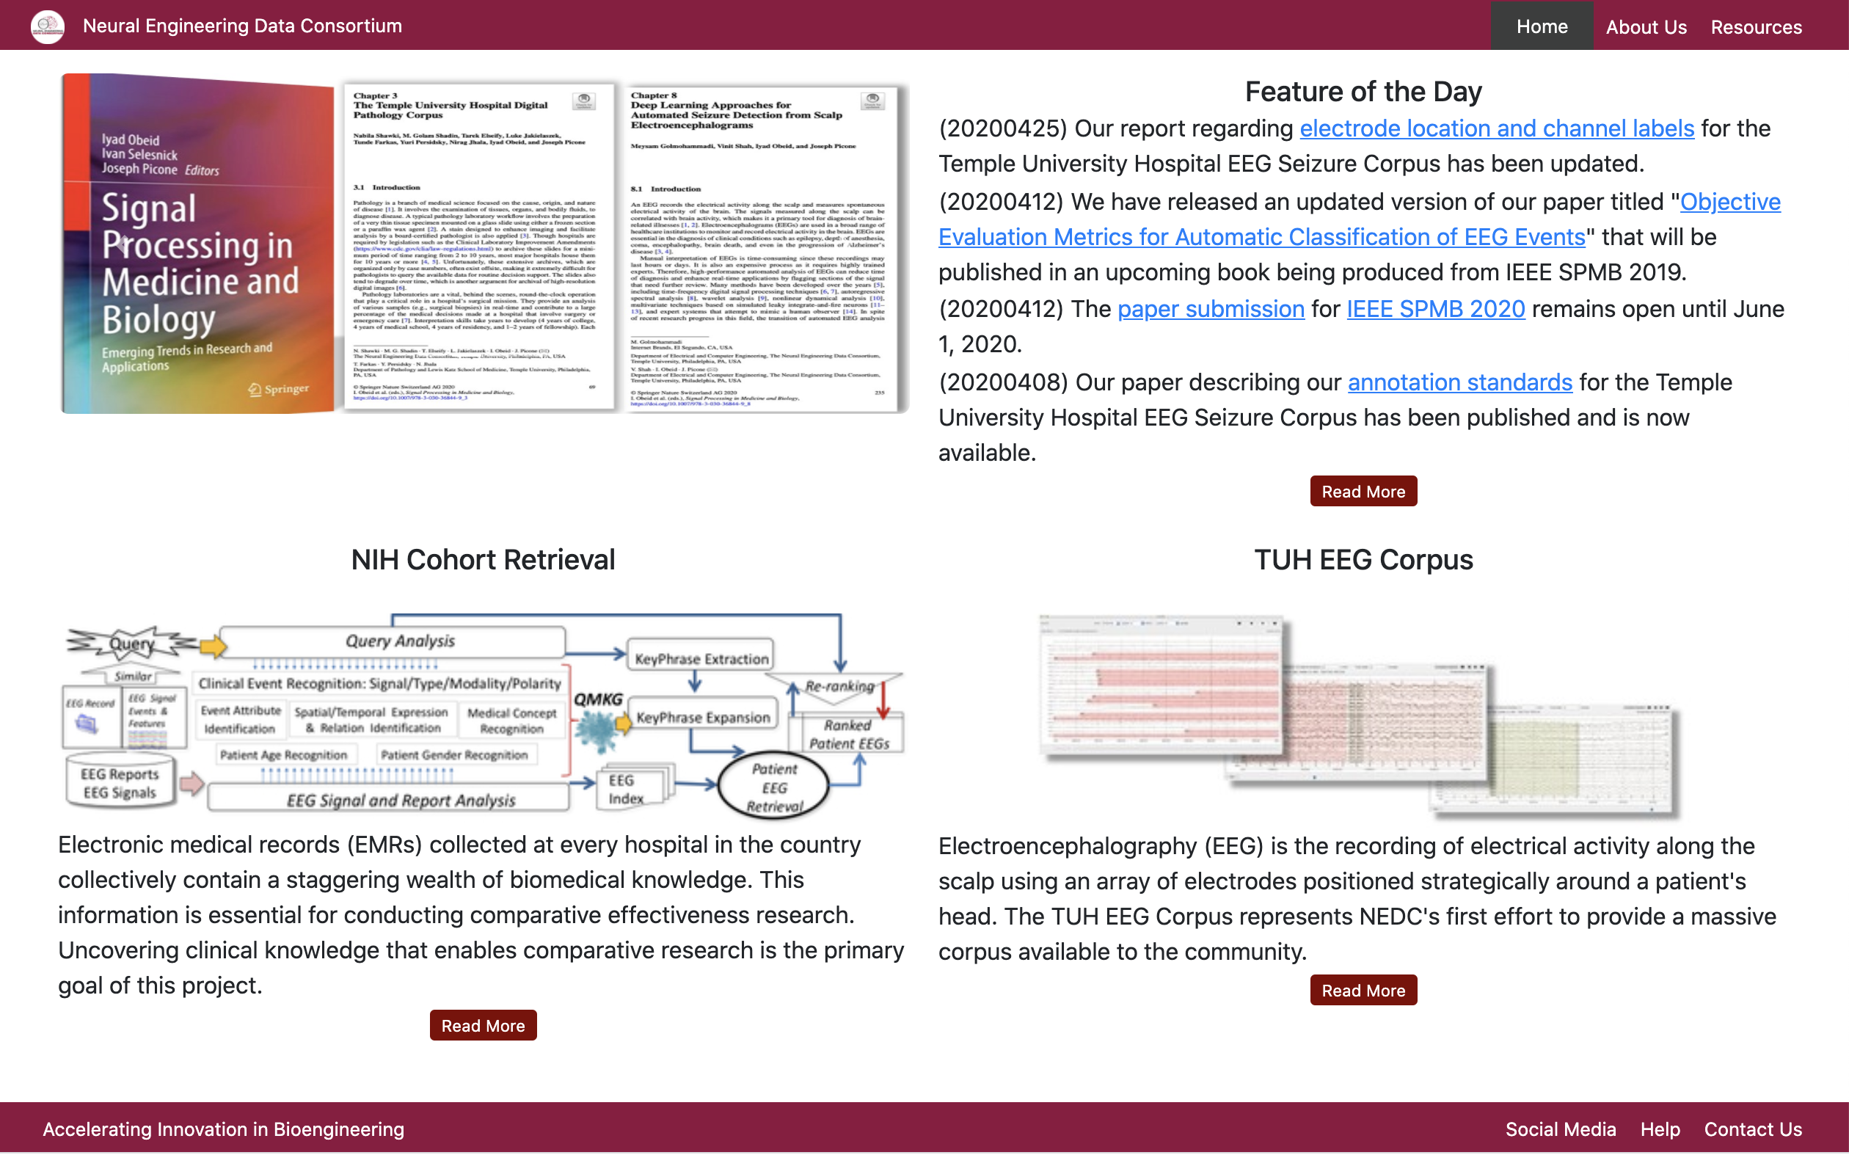
The ISIP/NEDC Web Site
Bootstrap, TensorFlow and PyTorch
Deep Learning Toolkits and Demos
Tarek,
I wish we could have gotten to know each other better, but I appreciate all of your hard work for this group. I wish you the best of luck in your future.
-Sam
Hi Tarek,
It was a pleasure getting to know you and a crazy coincidence that I met you for the first time before we even knew we were in the same lab together. I wish you all the best and I know you're going to accomplish great things!
-Saf Rahman
Tarek,
Thanks for making us all look so good! Good luck in all your future endeavors and don’t forget to visit!
--Iyad Obeid
Hi Tarek,
You are the nicest person in the lab that I’ve known. You’re talent too of course. Good luck with your future journey and I hope you find a cat that is as nice as you are soon.
- Thao Cap
Tarek,
I did not get to know you too well; however I think we both can remember and get a nice laugh out of the many times I scared the life out of you at the tech center to the point where you almost fell out of the chair. I wish you the best and good luck in Wisconsin.
- Ahmad Hamid
Before a software review
Hey Tarek
You’re the coolest CS major I know. You were great to have around the lab, so chill to talk to and wise with code. Goodluck with your future endeavors and with Wisconsin,
-Matthew Miranda
You write software that’s almost as nice as you are;
Congrats on finishing school and thanks for
always being a friendly face in the office.
- Isabel Hunt
After a software review
Tarek, You will be missed. Stay humble yet cool ! I wish you best luck with your future endeavors even though you don't need it ;)
-Vinit
Hey Tarek,
Thanks a lot for the mentorship in the web team. Those media blasts, new websites, and cluster diagrams will really, really miss you! Haha Really, it’s humbling to know how you started with no help knowing nothing. It’s inspiring; I will continue to embrace the unknown with an eager, determined mind. Best of wishes Budd. - Julien Simons
You make CS majors look competent. That’s the nicest thing I can say honestly. In all seriousness, thanks for all your contributions in the lab and it was fun hanging with you. Good luck with everything out there and hope you find it nice in Wisconsin.
P.S.
-Shmyrde Jean-Paul
Tarek,
You are a credit to the field of Computer Science ☺
We will miss you!
It would be weird going to the lab when they open it and not working with you on some crazy problem which you would solve eventually. Thanks for being the friend on whom we could rely. I wish you all the best on your next journey!
- Nabila
Tarek! I don’t know why everyone is using fonts that are hard to read so I’ll take one for the team. I wish I got to know you better but appreciate that you always looked out for everyone in lab. Best of luck in Wisconsin, I think they have good cheese there!
-Saiyeda
May 2020

