Slide 1
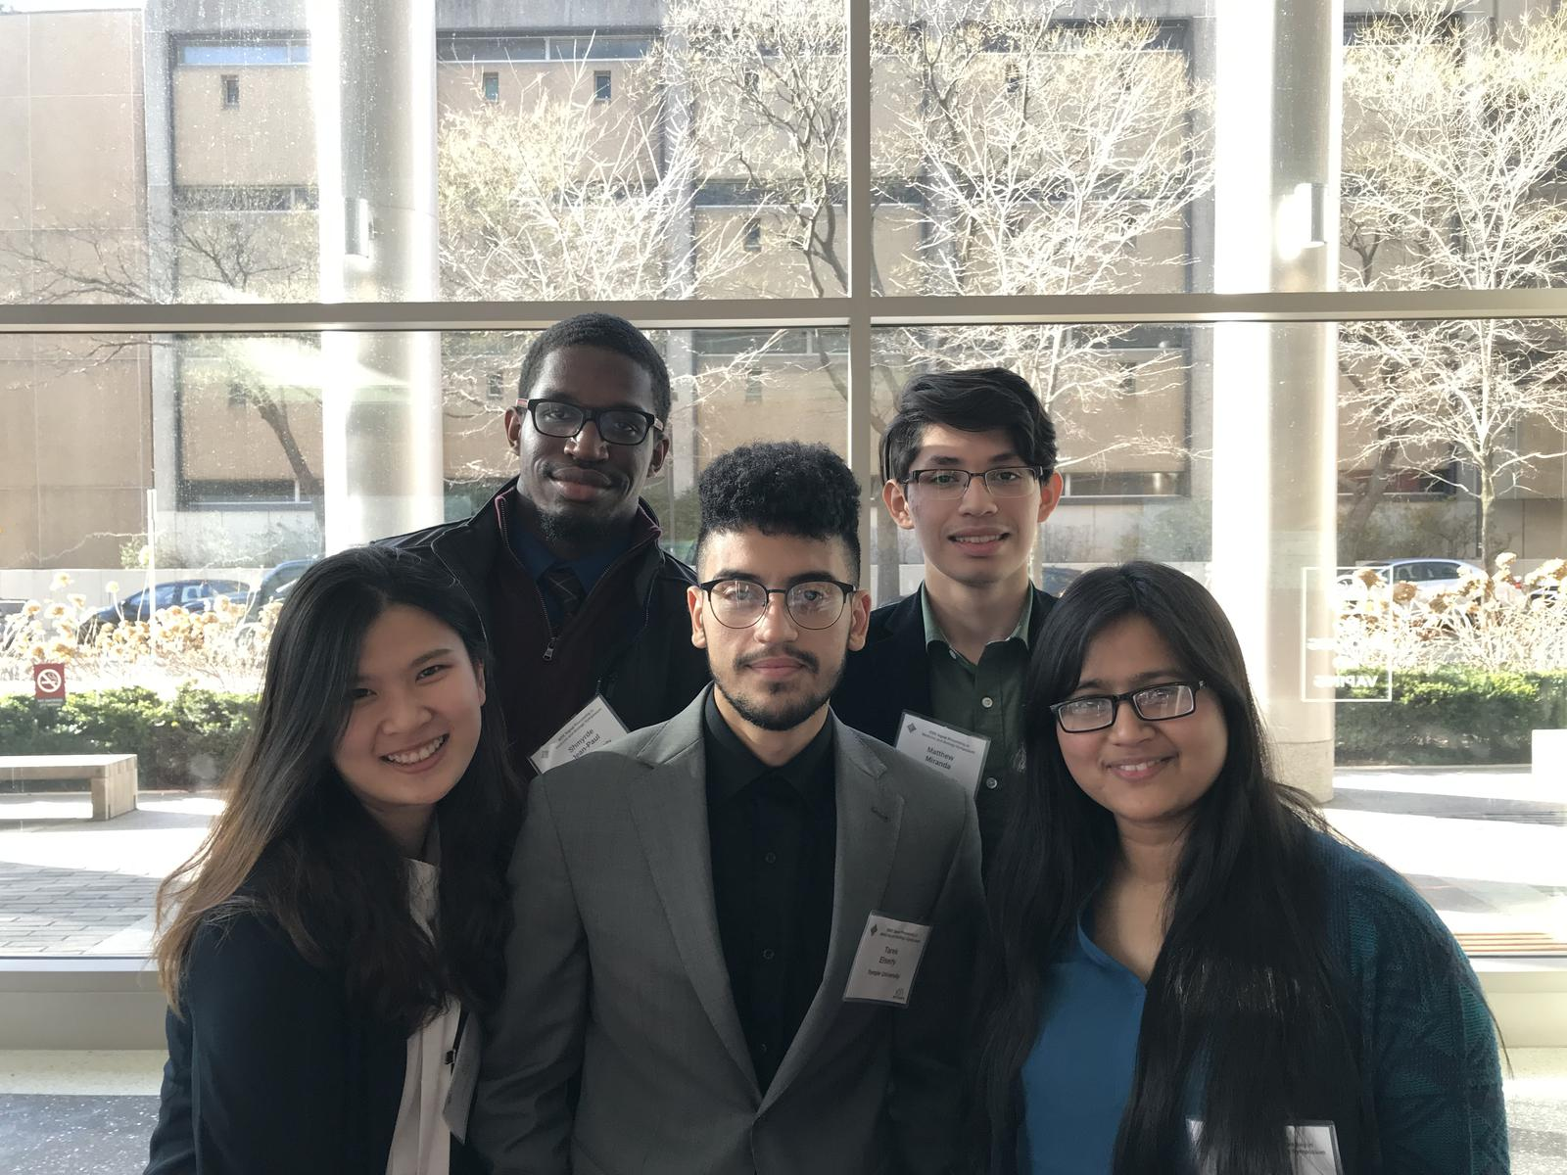
Good luck on your League journey and get whatever highest rank ☺
I appreciate the jokes and time that we had and hope that you will do great at work. Try not to get in trouble with HR :D
-Thao
The Neuronix Cluster
The ISIP Machine Learning Demo
Anonymous Rsync
Shmyrde!
Warmest congratulations on your graduation. I appreciate what you've done for the group by managing the cluster. You played a vital and important part in our group, and you did a fantastic job undertaking your mission. Congratulations on your graduation and best wishes for the future.
-Meysam
Shmyrde,
You are one of those students that I can honestly say I will never forget ;)
We appreciate all the great contributions you made to the group. Many of those capabilities have become standard parts of our environment. Hopefully we will someday soon finish IMLD ☺
Shmyrde!
Well this has been fun! Thanks for all your hard work going all the way back to the days with Victor. We’re going to miss your know-how and dry sense of humor. Our door is always open – come visit any time.
--Iyad
Dear Shmyrde,
I don’t know what I will miss the most, the joy you brought to the group just by being yourself or your dedication toward making our lives easier by taking care of the cluster.
Wish you all the best!
- Nabila
Shmyrde,
Congratulations on graduating!
I always admired your patient against all the tickets that we used to send to nedchelp. Thank you for helping us to run our programs easily!
Wish you success in your future life!
- Vahid
Shmyrde,
Congratulations on graduating! I wish you the best of luck and know that your intellect will take you far in life.
- Lynn
May 2021

