Slide 1
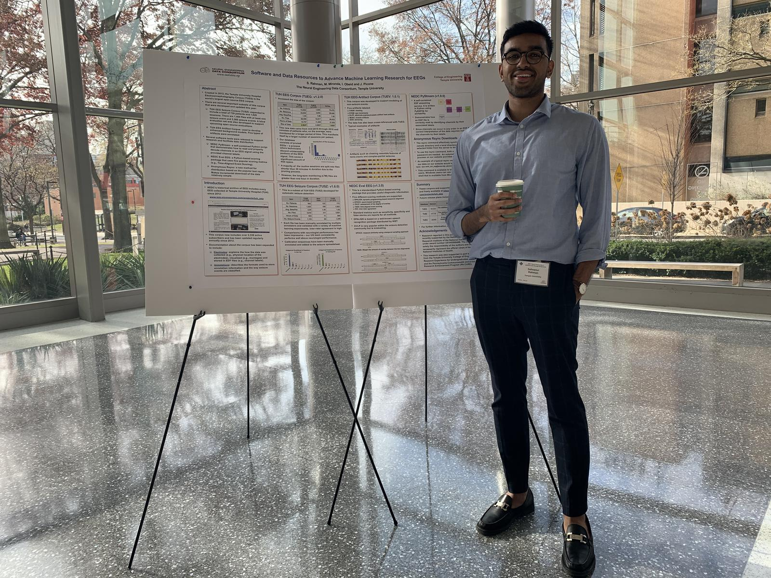
The TUH EEG Seizure Detection Corpus (v1.5.3)
The Temple University Artifact Corpus
The TUH EEG Annotation Team
Sup Saf,
Man, we had a lot of fun times in the lab, from talking about random stuff (which is what I primarily did) or just doing lab work. It was fun being around you and I wish you the best in all you decide to do. Thanks for being a cool guy.
-Shmyrde
Saf!
Congratulations on your graduation and best wishes for your next adventure! Keep on growing. Keep adding to the goodness and beauty in the world. Keep developing those unique dreams and talents that make you who you are!
-Meysam
Saf,
I can almost forgive you for all those late weekly reports because of your excellent contributions to the annotation team. That team has been one of the bright spots in our lab over the years. You did an excellent job leading it and producing some very valuable corpora. Good luck as you embark on another exciting chapter in your life.
Saf!
Congrats on making it to the finish line! We’re grateful for all your hard work and dedication. Good luck out there.
--Iyad
Dear Saf,
I enjoyed working with you on releasing databases. We are going to miss presence in the group. Best of luck on your future endeavors!
- Nabila
Saf,
Congratulations on graduating! Wishing you the best of luck in the future.
-Sarah
Saf,
Congratulations on graduating!
Your pretty job in the management of EEG corpus annotation will be always honored by researchers all over the globe.
Wish you success!
- Vahid
Saf,
Congrats on graduating. Wishing you the best of luck on your next adventure.
-Sidney
May 2021

