Slide 1
Creating a Culture for
Scholarly and Systematic Innovation in Engineering Education
Highlights from the Report
Original Presentation & Report Authors:
Leah H. Jamieson Jack R. Lohmann
Purdue University Georgia Tech
Modified and Presented by:
Gary A. Gabriele
Villanova University
Notes:
Jack
Intro + slides 1-6: 10 minutes

Slide 2

a fundamental question
How can we create an environment in which many exciting, engaging, and empowering engineering educational innovations can flourish and make a significant difference in educating future engineers?
Notes:
Leah - 30 seconds

Slide 3
Charles Vest, President of National Academy of Engineering
“As we think of the challenges ahead, it is important to remember that students are driven by passion, curiosity, engagement, and dreams. Although we cannot know exactly what they should be taught, we can focus on the environment in which they learn and the forces, ideas, inspirations, and empowering situations to which they are exposed.
In the long run, making universities and engineering schools exciting, creative, adventurous, rigorous, demanding, and empowering milieus is more important than specifying curricular details.”

Slide 4
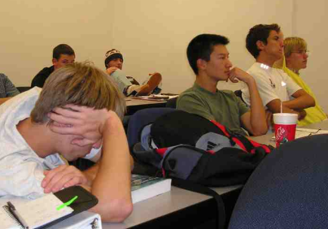
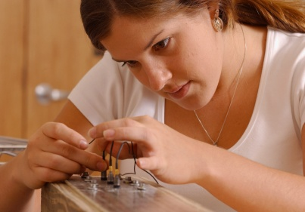
a foundational premise
How we teach is as important as what we teach
Pedagogy cannot make up for a lack of content — but inattention to pedagogy can seriously compromise learning
High-quality learning environments are the result of attention to both content and how people learn
Notes:
Jack - 30 seconds

Slide 5
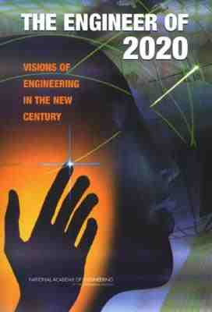
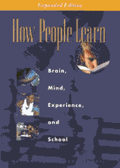
the focus of the report
This report is NOT about preparing the “next generation” engineer or about what we know about learning per se. Rather, it connects these two bodies of knowledge.
This report is about engineering learning.
Notes:
Leah - 30 seconds

Slide 6

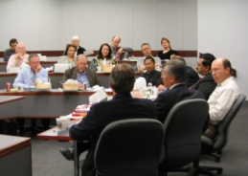
the purpose of the Phase 1 report
…to catalyze a conversation on creating and sustaining a vibrant engineering academic culture for scholarly and systematic educational innovation — just as we have for technological innovation — to ensure that the U.S. engineering profession has the right people with the right talent for a global society.
Two-phase project :
Phase 1 ─ A report for conversation
Phase 2 ─ Contributions from the broader engineering community and final report
Notes:
Jack - 2 minutes

Slide 7
who, what, and how
Most reports emphasize “what” needs to change (e.g., topics to cover, experiences to offer);
“who” should drive the change and “how” have not been as fully discussed — but largely determine how quickly and how well change occurs and how it is sustained.
Notes:
Leah - 2 minutes

Slide 8
“how” the landscape of
educational innovation looks today
How do we bridge the divide?
(Engineering) education researchers
Engineering education practitioners
Notes:
Jack - 1 minute

Slide 9
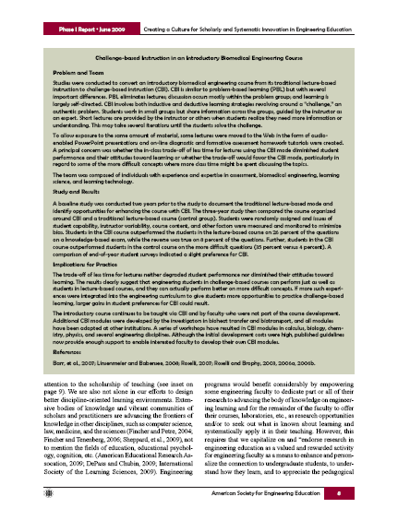
a proposed model
Educational Practice
which help improve
identifies and motivates
Answers
Insights
Questions
Ideas
that results in
which lead to
“Challenge-based Instruction in an Introductory Biomedical Engineering Course”
(p. 8)
Educational Research
Notes:
Leah - 1 minute

Slide 10
building capacity and connecting the communities
  Engineering education innovation depends on a vibrant community of scholars and practitioners
  working in collaboration
  to advance the frontiers of
  knowledge and practice…and it also depends on support –
  Adequate fiscal resources
  Appropriate facilities
  Reputable journals
  Highly-regarded conferences
  Prestigious recognitions
Educational Practice
Answers
Insights
Questions
Ideas
Educational Research
Notes:
Leah - 1 minute

Slide 11
“who” should drive change?
Engineering education depends on many stakeholders:
faculty and students (often their parents)
staff and academic administrators
alumni and employers
governing boards and taxpayers, etc
Engineering faculty and administrators are key; they:
determine the content of the engineering program,
decide how it is delivered, and
shape the environment in which it is offered
Directly or indirectly, engineering faculty and administrators are responsible for the quality of the educational experience
Notes:
Jack - 30 seconds

Slide 12

encouraging, supporting, and empowering faculty
It’s the reward system.
Nah, duh!
No doubt, we need to continue to assure evaluation processes are transparent and they do reward educational innovation.
However, the proposed model has many of the same metrics commonly used to evaluate faculty success in scholarly and systematic technological innovation.
Notes:
Jack - 1 minute

Slide 13
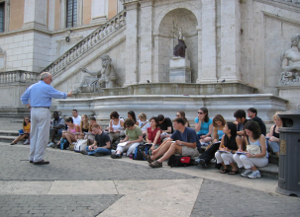
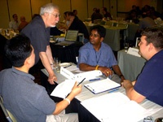
beyond rewards — the educational role of faculty
The role of faculty members is not to impart knowledge — it is to design learning environments that support the process of knowledge acquisition
We need to –
  strengthen career-long professional development
  create supportive environments
  form broader collaborations
Notes:
Leah - 1 minute

Slide 14
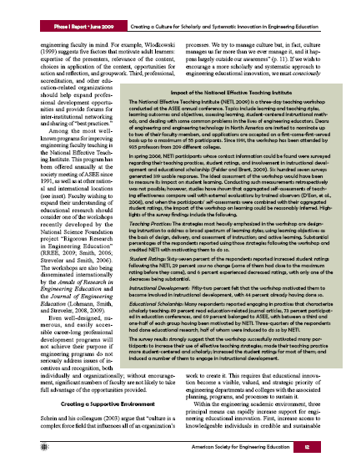
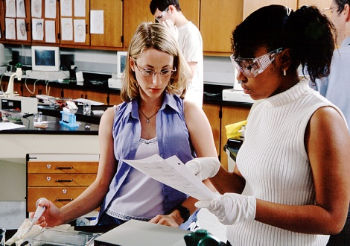
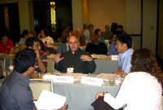
career-long professional development
Clearly, faculty should be well prepared
for their educational responsibilities.
Doctoral students should graduate knowing something about how people learn.
Faculty should be supported to continue their development as educators and educational innovators.
National Effective Teaching Institute
Workshops on conducting rigorous research in engineering education
(p. 12)
Notes:
Jack - 1 minute

Slide 15
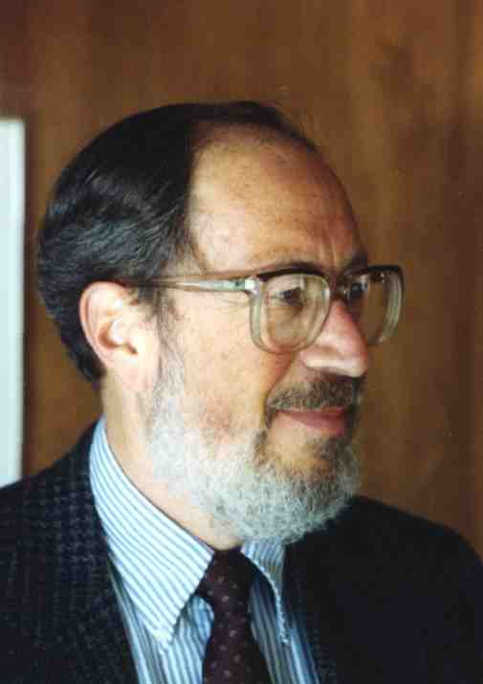
create supportive environments
“Culture manages us more than we manage it, and it happens largely outside our awareness”
Edgar H. Schein Organizational Psychologist
We need to work consciously to make engineering education innovation
a visible, valued, and strategic priority with the associated planning, programs, and processes to sustain it
We need to –
increase access to knowledgeable persons in educational R&D units
provide resources to initiate, experiment, and implement innovations
ensure recruiting, hiring, and evaluation processes are supportive
Notes:
Leah - 1 minute

Slide 16
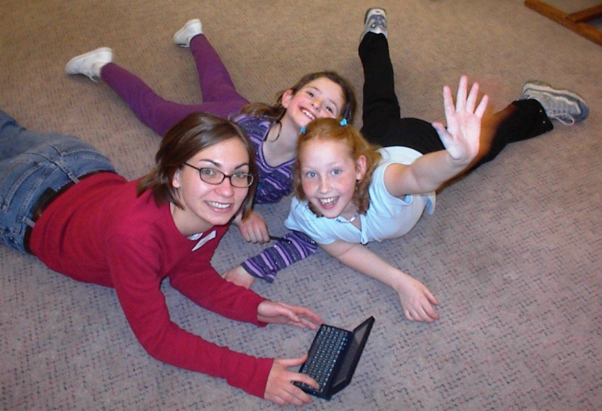
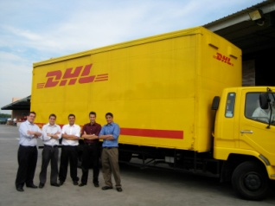
form broader collaborations
Engineering education innovation is about designing engineering learning environments. It requires, at the least, engineering and education expertise, i.e., it is a cross-disciplinary endeavor.
Our innovations should include –
  students
  learning scientists
  learning technologists
  employers
  pre-college teachers
  etc.
Notes:
Jack - 30 seconds

Slide 17


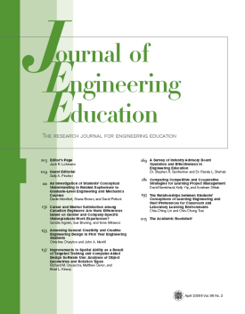
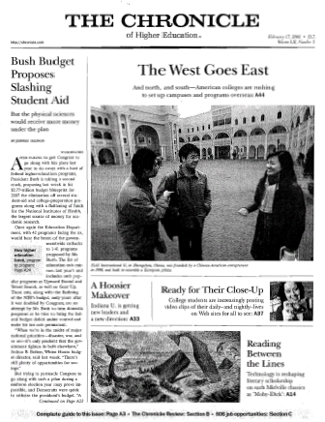

integrating “what” we know about engineering
with “what” we know about learning
An examination of recent literature, program announcements, conference themes, etc. make clear that a considerable amount of attention is being directed at making our engineering programs more –
engaging
relevant
welcoming
Notes:
Leah - 1 minute

Slide 18
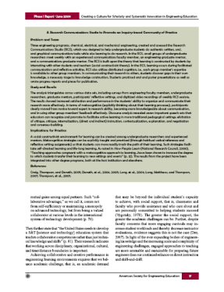
engaging learning environments
Both students and faculty need to move from this…
Moving students from novice to competent practitioners is not a one way movement.
It requires continuing
back-and-forth movements from general principles to problem particularities
as student builds sophisticated skills
through various experiences.
Educating Engineers, 2009
…to this
“A Research Communications Studio to Promote an Inquiry-based Community of Practice” (p. 17)
Notes:
Jack - 1 minute

Slide 19
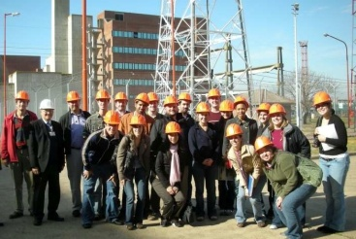
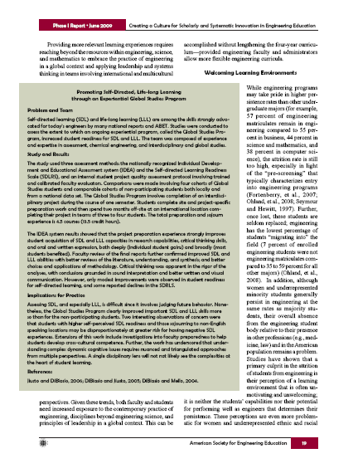
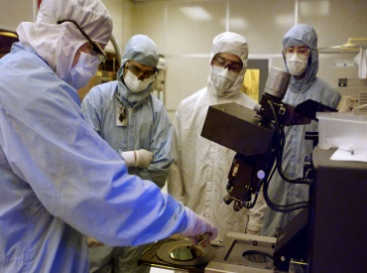
relevant learning environments
Opportunities for more relevant experiential learning can integrate the fundamental components of engineering education.
Engineering programs should assure both the curriculum (both formal and informal) and the faculty are well prepared to offer multiple opportunities over time to experience “real world” engineering .
“Promoting Self-Directed, Life-Long Learning through an Experiential Global Studies Program”
(p. 19)
Notes:
Leah - 1 minute

Slide 20
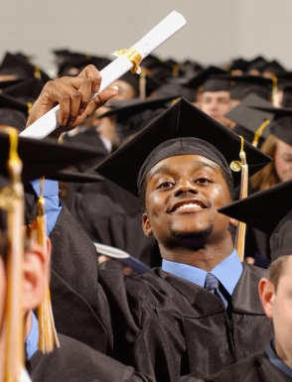
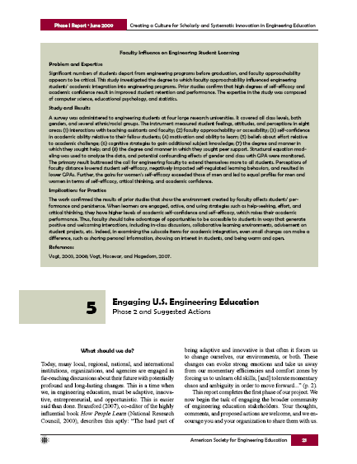
welcoming learning environments
Studies show repeatedly that the most effective way to improve persistence is to improve the quality of the engineering learning experience (it is neither the students’ capabilities nor their potential for performing as an engineer that determines persistence).
Often a root cause in the mismatch between students and faculty and their perceptions of the learning environment is a lack of knowledge about how people learn.
“Faculty Influence on Engineering Student Learning” (p. 21)
Notes:
Jack - 1 minute

Slide 21
the hard part
“The hard part of being adaptive and innovative is that often it forces us to change ourselves, our environments, or both. These changes can evoke strong emotions and take us away from our momentary efficiencies and comfort zones by forcing us to unlearn old skills, [and] tolerate momentary chaos and ambiguity in order to move forward.”
John Bransford
Co-editor, How People Learn
Notes:
Leah - 30 seconds

Slide 22
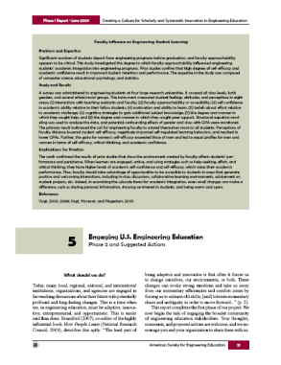
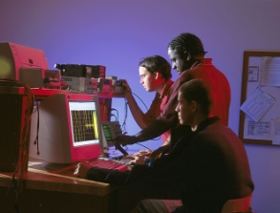
phase 2 — engaging the engineering community
Taking action with those ready to move forward with some suggested actions to get started (pp. 21-26)
Feedback from the broader engineering community, i.e., catalyzing the conversation:
  Project Web site for the community-at-large at www.asee.org open for comments from
  June 23, 2009 to March 1, 2010
  Sample of engineering programs and engineering education-related organizations
  The feedback will be synthesized and incorporated into a (Phase 2) final report issued next year.
Notes:
Leah - 30 seconds on actions
Jack - 30 seconds on feedback and phase 2

Slide 23
Recommendations for Engineering Faculty, Chairs and Deans
Link engineering education practice and research
Support and recognize educational innovation
Prepare future faculty
Integrate the curriculum
Promote learning through entrepreneurship
Educate the global engineer
Develop leaders
Promote learning through service
Enhance faculty experience
How does this help ECEDHA?

Slide 24
Thank you.

Slide 25

Your turn!
An Opportunity to
Share Your Thoughts
Sarah A. Rajala
Mississippi State University
ASEE President 2008-09
Notes:
Jack
Intro + slides 1-6: 10 minutes

Slide 26
help launch the next phase by focusing on 3 questions
How can you, your home organization, or other organizations,
including ASEE, act on the report’s ideas?
1. [Who] How can more engineering faculty engage in scholarly and systematic innovation in engineering education?
2. [How] How can innovation as a cycle of educational practice and research be practiced more effectively?
3. [What] What can we do to make engineering programs more engaging, relevant, or welcoming based on what we know about learning?

Slide 27
“think - pair - share”
Think:
  Pick one of the 3 questions.
  For 3-4 minutes, think and write your response on the card.
Pair:
  Turn to your neighbor, introduce yourself.
  For 8-10 minutes, talk about your responses.
Share:
  Moderators circulating through the room will ask audience participants to share their responses.
  We’ll collect the index cards at the end of the session.

Slide 28
facilitators
Karl Smith, Purdue University
Cindy Atman, University of Washington
Larry Shuman, University of Pittsburgh
Sheri Sheppard, Stanford University
Gary Gabriele, Villanova University
Aditya Johri, Virginia Tech
Donna Llewellyn, Georgia Tech
Norman Fortenberry, NAE CASEE

Slide 29
your turn!
Instructions:
  Pick a question and write the number of an index card.
  Write up to three suggested actions - legibly!
  Identify who could or should address them (you, your home organization, ASEE, others).
Questions:
[Who] How can more engineering faculty engage in scholarly and systematic innovation in engineering education?
[How] How can innovation as a cycle of educational practice and research be practiced more effectively?
[What] What can we do to make engineering programs more engaging, relevant, or welcoming based on what we know about learning?

Slide 30
The Path Forward
J. P. Mohsen
University of Louisville
ASEE President 2009-2010
Notes:
Jack
Intro + slides 1-6: 10 minutes

Slide 31
Thank you!
Please drop your cards in the boxes by the doors.
Come to the follow-up panel session 2312 10:30-noon.
Contribute your thoughts on the project Web page at www.asee.org.
The site will be open for comments from June 23, 2009 until March 1, 2010.
Notes:
Jack
Intro + slides 1-6: 10 minutes

