Slide 1
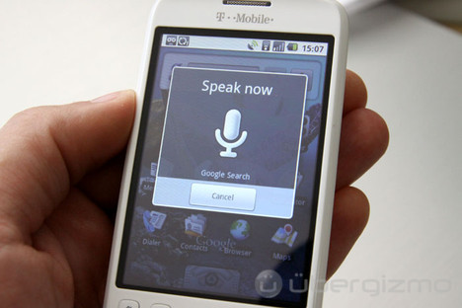
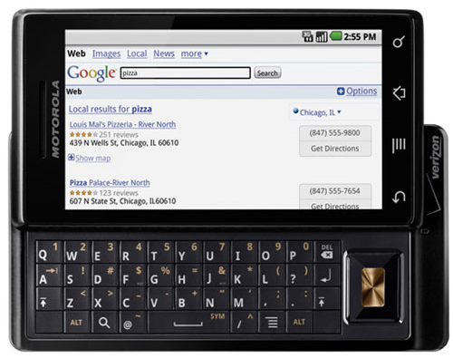
Nonparametric-Bayesian approach for automatic generation of subword units- Initial study
Amir Harati
Institute for Signal and Information Processing
Temple University
Philadelphia, Pennsylvania, USA

Slide 2
Motivation
Acoustical mismatch in the lexicon can reduce the performance of the system.
For many languages we don’t have sufficient resources.
Recognition of other signal (e.g. gestures.)
Number of subword units is unknown and should grows by data; so this problem naturally fits in the nonparametric framework.
Each unit (at least for HMM based recognizers) is assumed to be stationary (piece wise constant.) so can be modeled with a single state of an HMM (for segmentation).

Slide 3
Problem
Input: speech waveform, utterance level transcription.
Output: subword units, lexicon
General approaches: Several approaches have been proposed during the last two decades that differs in different stages but the process generally can be decomposed into three sections:
Segmentation.
Clustering.
Lexicon building.
The first two steps are subword unit building and the last is the dictionary generation. Some algorithms do all three steps jointly.
Segmentation generally is accomplished using different dynamic programming methods.
Clustering is accomplished using K-means or other heuristic methods.
For segmentation different methods use different criteria such as change in spectrum etc.

Slide 4
Proposal
Using HDP-HMM for segmentation.
Segments can be in word boundaries. How to deal with them? Should we allow multiple word entries?
Should we segment a whole utterance or each word?
Using DPM for clustering.
How many units? How to control it?
Generating the lexicon will be accomplished separately.
After generating the lexicon, we can use EM and forced alignment to resegment the speech and re-cluster the segments and subsequently regenerate a lexicon until convergence.
One of the major problem is word segmentation.
Can we use a forced alignment using xwrds models?
There is another approach in the literature (explained later.).
How many pronunciation per word should be existed?
Simplest answer: all
Another way: To force all instances of a word have equal number of segments (too restrictive)
First cluster all instances and then segment over the center of these clusters.
Prune the dictionary later using forced alignment.
How to deal with speaker variations?
It is OK? (possibly many units)
Using adaption or something like that?

Slide 5
Plan
TIMIT and RM has been used in other works. It seems starting from TIMIT would be more beneficial, specially because we can compare with performance of handily phoneme labeled system. It is also can be used to find word boundaries so we can compare with other algorithms that find word boundaries automatically.
We can try many different settings feature extractions; but since almost all works used 10 msec frame rate with 25 msec windows and 39 MFCC features we should start from here.
Each step of the experiment will be done in a separate sub-experiment. For example, feature extraction would be exp000, Initial segmentation using HDP-HMM exp001 etc. In this way, we can try many different settings for different steps without recalculating other steps.
Outline is as follow:
Feature extraction.
Baseline experiment using phoneme based system (both CI and CD)
Generating word boundaries information using both time alignment information and forced alignment using CD models.
Segmentation of utterances using HDP-HMM.
Cluster all segments obtained in pervious step using DPM, and generate initial subword inventory.
Generate a lexicon:
Using word boundaries obtained from time information.
Using word boundaries obtained from forced alignment.
Using the method described in (G. Goussard and T. Niesler , PRASA 2010)
Since some of the discovered units will be spanning word boundaries , we can have multiple word entries in the lexicon.
Depending on number of multi word entries we can prune the dictionary in a later step using a score similar to (M. Bacchiani et al ICASSP 96)

Slide 6
Next Step
Depending on the results there are several other things that we can do in the next step:
Using different frame rate/ window length.
Estimate hyper parameters using a held out set. The algorithm is not sensitive to these hyper parameters generally but this could help to tune the algorithm.
After Generating the lexicon we can use methods similar to (Bacchiani et al, speech communication 1999) to resegment the audio using the new lexicon and Viterbi (and forced alignment) and cluster the new segments and regenerate a new lexicon. In this case new segments are not generated using HDP-HMM but clustering can yet be accomplished using DPM.
If number of pronunciation per word was too high, we can first group all instances of each word in one group and cluster them first and generate subword units for these clusters.
At the initial experiments we just run CI models, after getting acceptable results we can run CD experiments. We have to design proper questions for the tree in this case.
DPM clustering can be replaced with HDP. In this case, all instances of a word place in one group but all groups share the same underlying clusters. (I expect this result in a better inventory.)

Slide 7
Lexicon generation in (G. Goussard and T. Niesler , PRASA 2010)
Initial pronunciation dictionary: Either flat assignment of acoustic clusters (subword units) in an utterance to words in that utterance or assign proportional to word’s length.
Intermediate pronunciation dictionary: Use an HMM to align words and acoustic clusters. In this case, we use a left-right HMM with skip in which each state is presenting a word. For each state of HMM, there is a probability distribution that describe how likely is for that state to associate with each acoustic cluster. The probability that cluster c_{i} is associated with word w_{j} is :
In this case, the right hand side of the equation is obtained by accumulating the counts from all the corpus.
Final pronunciation dictionary: prune the dictionary using forced alignment to reduce the number of pronunciation.

Slide 8
References
Bacchiani M., Ostendorf, M., Sagisaka, Y., Paliwal, K., 1996. Design of a speech recognition system based on non-uniform segmental units. In: Proceedings of the Interna-tional Conference on Acoustics, Speech and Signal Pro-cessing, Vol. 1, pp. 443-446.
Bacchiani M. and Ostendorf M., 1999, “Joint lexicon, acoustic unit inventory and model design,” Speech Communication, vol.29, pp.99–114.
Goussard G., Niesler T., 2010, “Automatic discovery of subword units and Pronunciations for automatic speech recognition using TIMIT” , Proceedings of the twenty-first annual symposium of the Pattern Recognition Association of South Africa (PRASA), Stellenbosch, South Africa.
Huijbregts, M., McLaren, M., & Leeuwen, D. V. (2011). UNSUPERVISED ACOUSTIC SUB-WORD UNIT DETECTION FOR QUERY-BY-EXAMPLE SPOKEN TERM DETECTION. Language and Speech, pp. 4436-4439.
Paliwal, K.K., 1990. Lexicon building methods for an acoustic sub-word based speech recognizer. In: Proceedings of the International Conference on Acoustics, Speech and Signal Processing, Vol. 2, pp. 729-732.
Singh R., Raj B., and Stern R.M. , 2002, “Automatic generation of subword units for speech recognition systems,” IEEE Transactions on Speech and Audio Processing, vol.10, no.2, pp.89–99.
Varadarajan B., Khudanpur S., and Dupoux E.,2008 , “Unsupervised learning of acoustic sub-word units,” in proceedings of HLT’08, Columbus, Ohio, pp. pp.165-168.
Varadarajan B.,Khudanpur S., 2008, "Automatically learning speaker-independent acoustic subword units", in Proc. INTERSPEECH, pp 1333-1336.

