Slide 1
Peer Mentoring
Android Mobile Application
March 2016
Daniel Douglas, Emilie Doyle, Claire Durand, Rachel King
Dr. Joseph Picone

Slide 2
Purpose
Provide a mentor-matching service
Enhance mentor and mentee network
Provide effective mentoring relationships
Alleviate administrative burden
Notes:
Claire

Slide 3
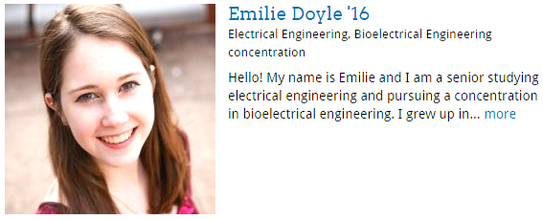
Audience and Users
Temple Honors Peer Mentorship Program
Temple College of Engineering Mentorship Program
Student Users
Mentors & mentees
Administrative Users
Superuser & admin
Notes:
Claire

Slide 4
Functions
Students (Mentors and Mentees) Can:
S earch for mentors based on key attributes
Request a ‘match’ with a mentor
Edit Personal Information
Admins Can:
Search for mentors
Manage students users
Add new mentors and mentees
Notes:
Based on our Preliminary User Testing, these are the required use cases… Emilie

Slide 5
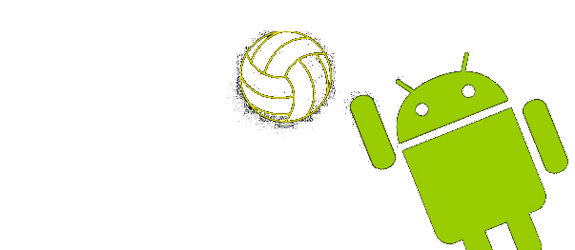
Tools
Notes:
Dan

Slide 6
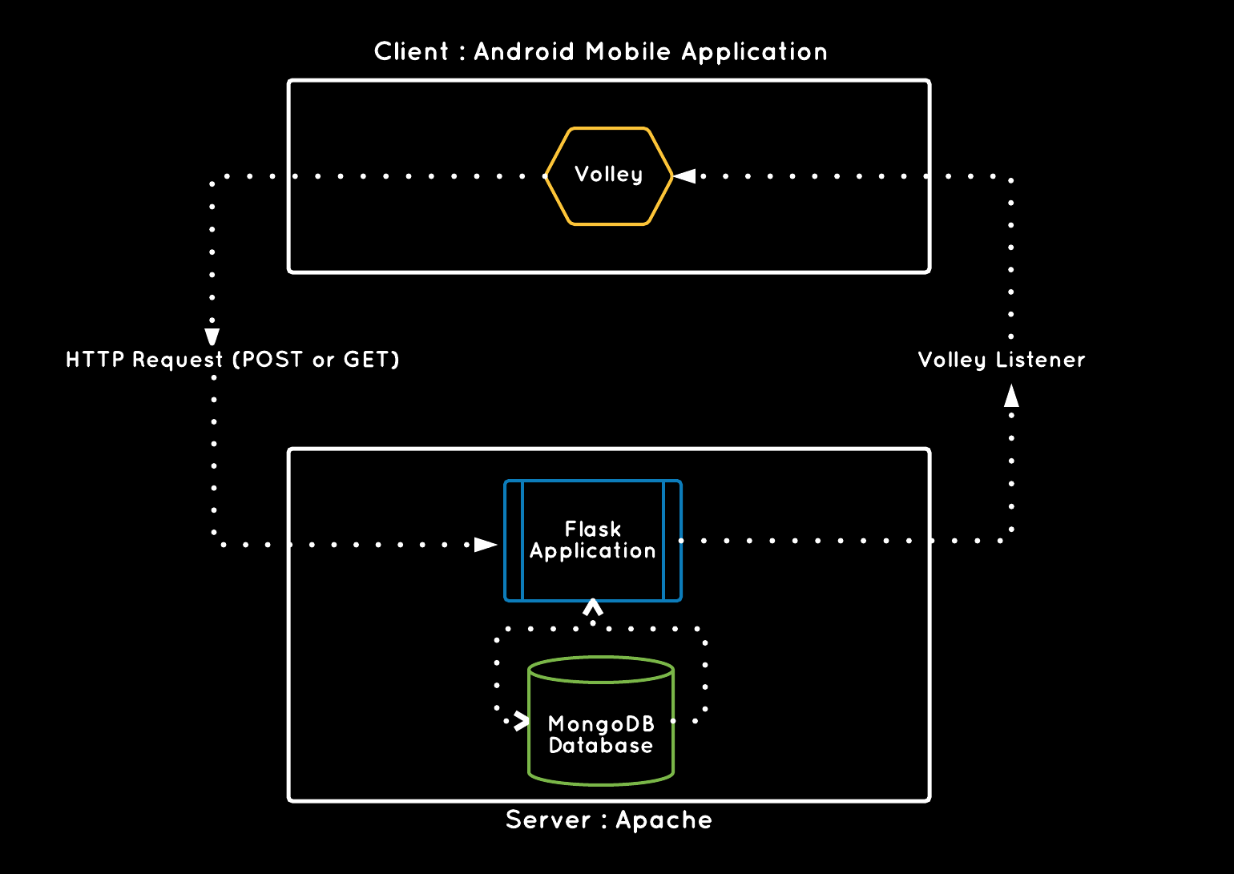
Client:Server Relationship
Database is never directly accessed by client.
Notes:
Rachel

Slide 7
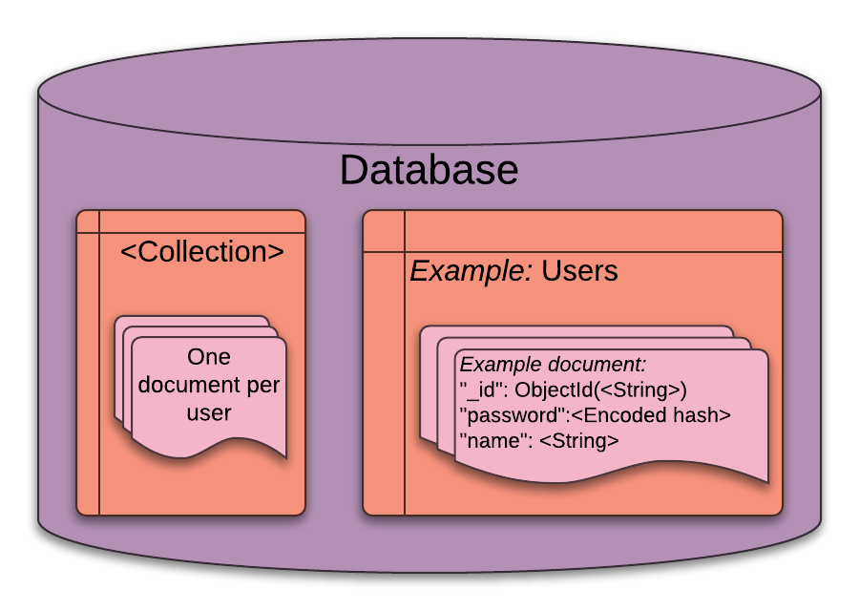
Database Structure
MongoDB is NoSQL and schema-free. We can quickly find the best structure for each data collection.
Notes:
This slide causes me to feel excitement ~Raquel
Dan

Slide 8
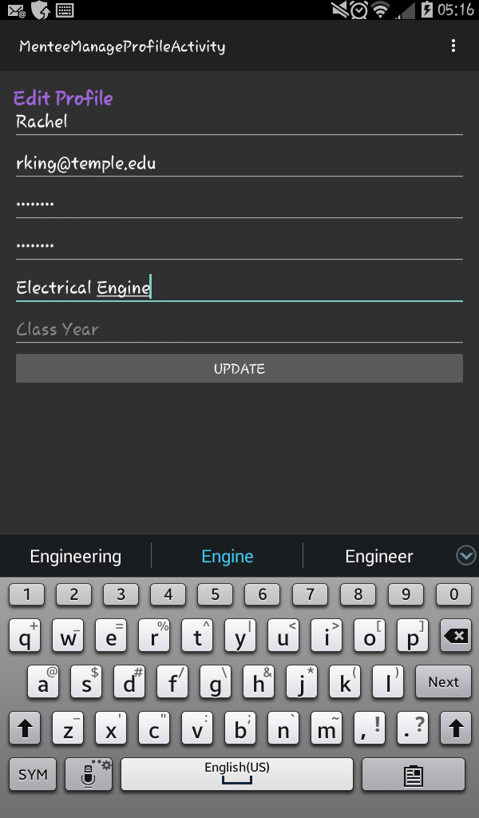
Application Demonstration

Slide 9
Project Management Tools
Agile Development
‘SCRUM’
Cyclical
Iterative
plan sprint
meet
set stories
work
& adjust
create tickets
Notes:
Rachel

Slide 10
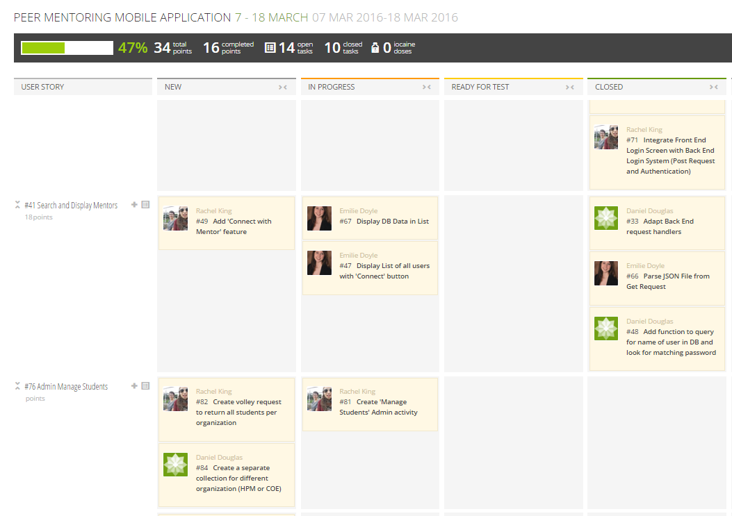
Project Management Tools
Taiga
Agile
Project Libre
Semester Schedule
Requirements Document
Use Cases
Functionality
Notes:
Rachel

Slide 11
Future Work
Match Requests
Admin Management
LDAP Certifications
Client Certificates
Development of Matching Algorithm
Email Notifications
Push Notifications
Backend Data Analytics
Expanded Application Security
And many other possibilities!
Notes:
Emilie

Slide 12
thanks!
Any questions?
You can contact us at
temple-engineering-engr3982-001@googlegroups.com

