Slide 1
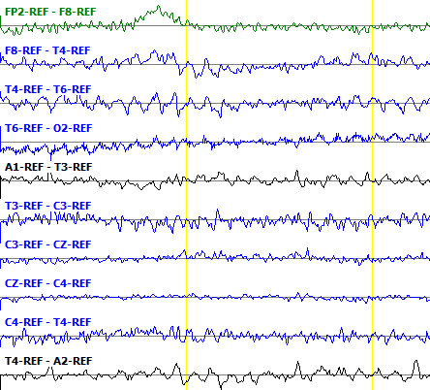
Window = 0.2s
Frame = 0.1s
Frequency Energy
1st Cepstral Coefficient
7th Cepstral Coefficient
Differential Energy

