Slide 1
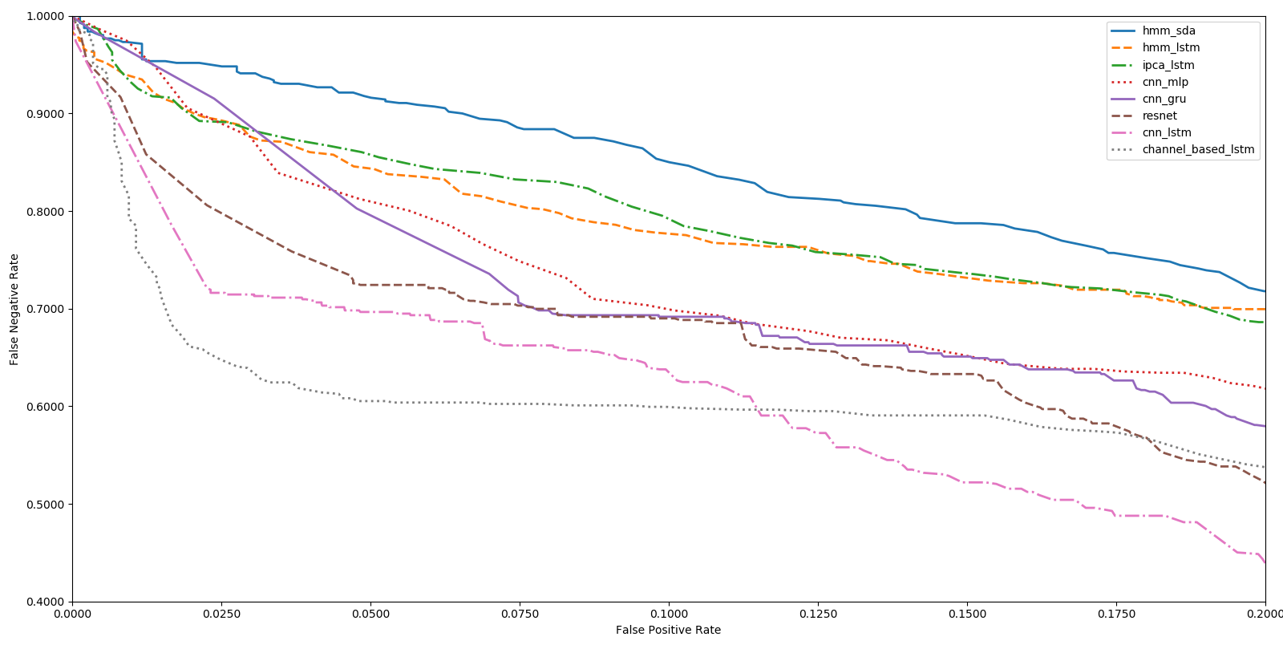
1.00
hmm_sda
hmm_lstm
ipca_lstm
cnn_mlp
cnn_gru
resnet
cnn_lstm
channel_based_lstm
0.90
0.80
0.70
False Negative Rate
0.60
0.50
0.40
0.00
0.025
0.050
0.075
0.100
0.125
0.150
0.175
0.200
False Positive Rate

