Slide 1
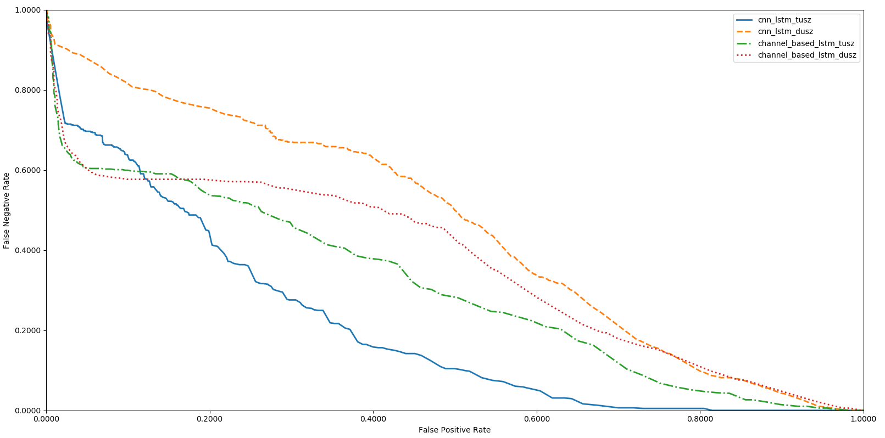
1.00
cnn_lstm_tusz
cnn_lstm_dusz channel_based_lstm_tusz
channel_based_lstm_dusz
0.80
0.60
False Negative Rate
0.40
0.20
0.00
0.00
0.20
0.40
0.60
0.80
1.00
False Positive Rate

