Slide 1
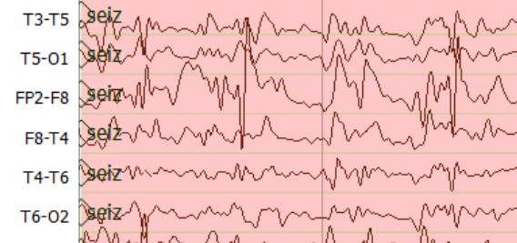
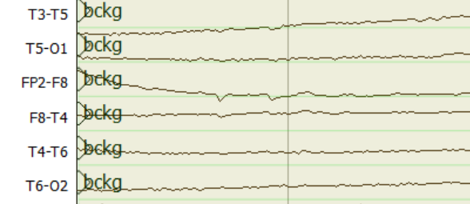
Feature
Extraction
2D-Convolution
2D-Max Pooling
2D-Convolution
2D-Max Pooling
210@22*26*16
210@11*13*16
210@11*13*32
210@5*6*32
210@22*26*1
Time Steps
TUH EEG
Corpus
Channels
Feature Length
1D-Convolution
Flatten
2D-Max Pooling
2D-Convolution
210@16
210@384
210@2*3*64
210@5*6*64
Post Processor
Sequential Modeler
$$o_{t}$$
Output Gate
$$i_{t}$$
Input Gate
Output
$$h_{t}$$
$$c_{t}$$
1D-Max Pooling
$$f_{t}$$
Forget Gate
26@16
Learning Long-Term Dependencies with B- LSTM

