Slide 1
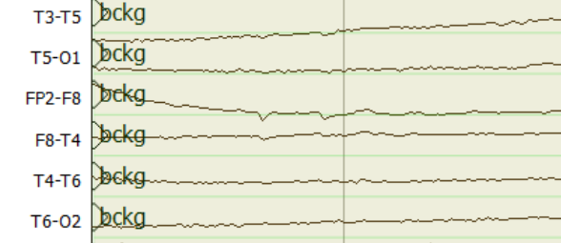
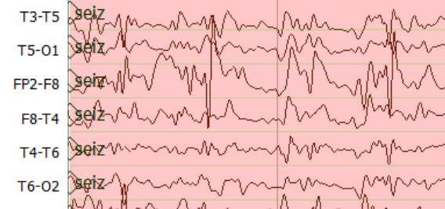
Epoch Posteriors
Sequential Modeler
Sequential Modeler
$$o_{t}$$
Output Gate
Feature Extraction
$$a_{11}$$
$$a_{22}$$
$$a_{33}$$
$$i_{t}$$
Input Gate
$$a_{12}$$
$$a_{23}$$
TUH EEG
$$c_{t}$$
$$h_{t}$$
$$b_{1}(x)$$
$$b_{2}(x)$$
$$b_{3}(x)$$
Corpus
Hidden Markov Models
$$f_{t}$$
Forget Gate
Learning Long-Term Dependencies with LSTM
Post Processor
Output
$$a$$
$$a$$
S1
S2
$$b$$
$$c$$
$$b$$
$$a$$
S3
S4
$$d$$
Epoch Label
Finite State Machine for Language Model

