Slide 1
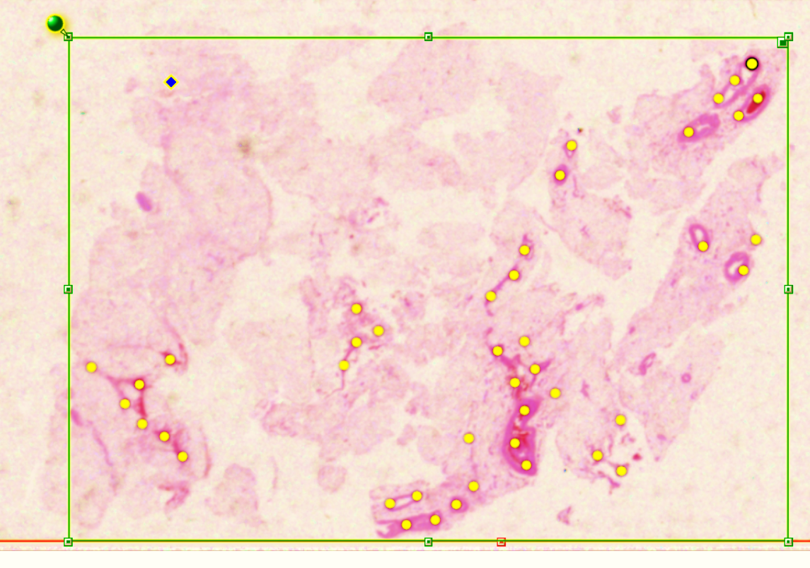
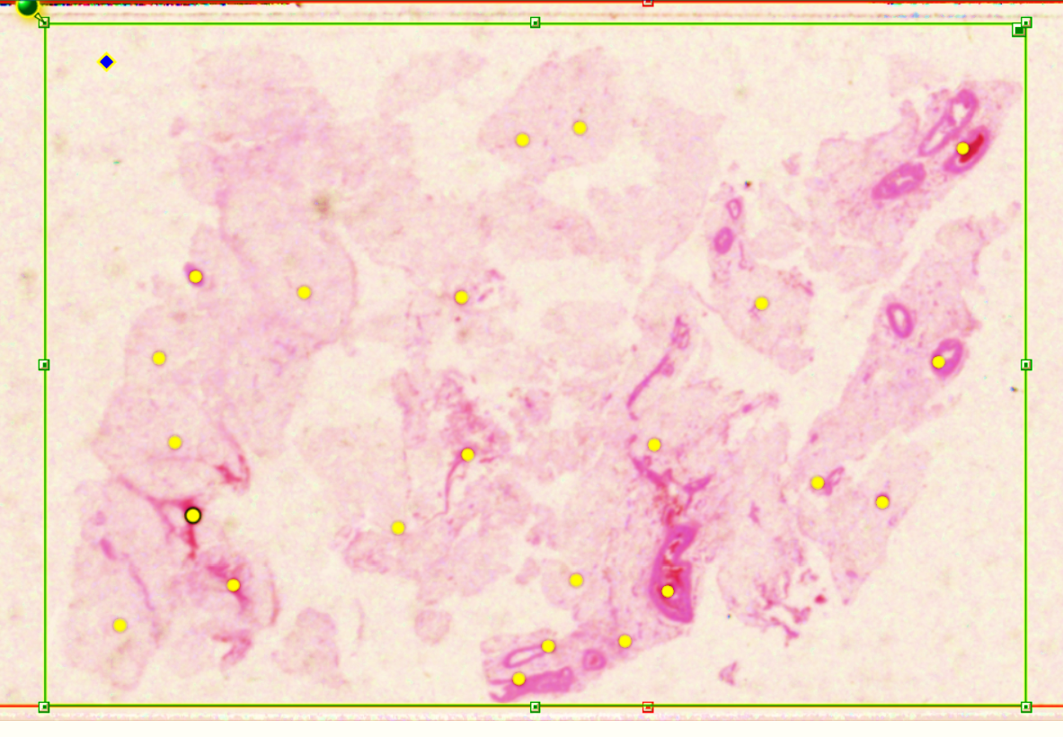
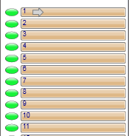
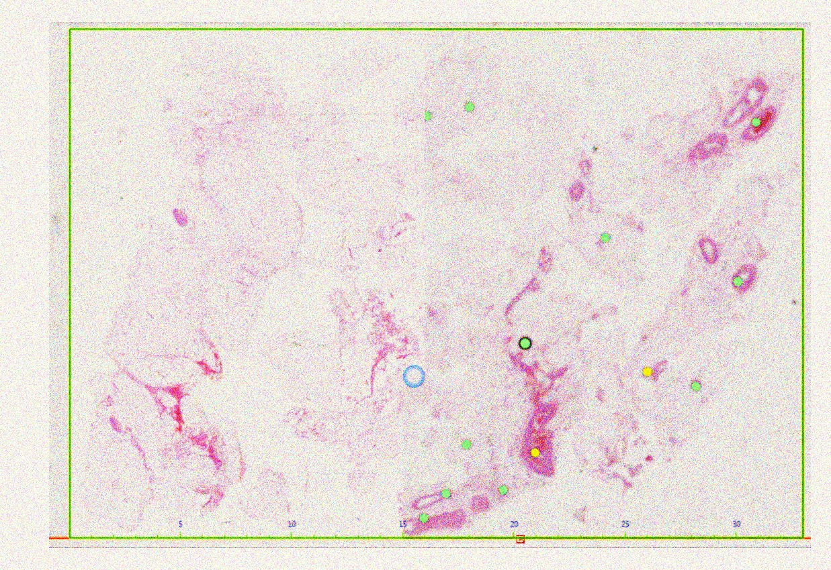
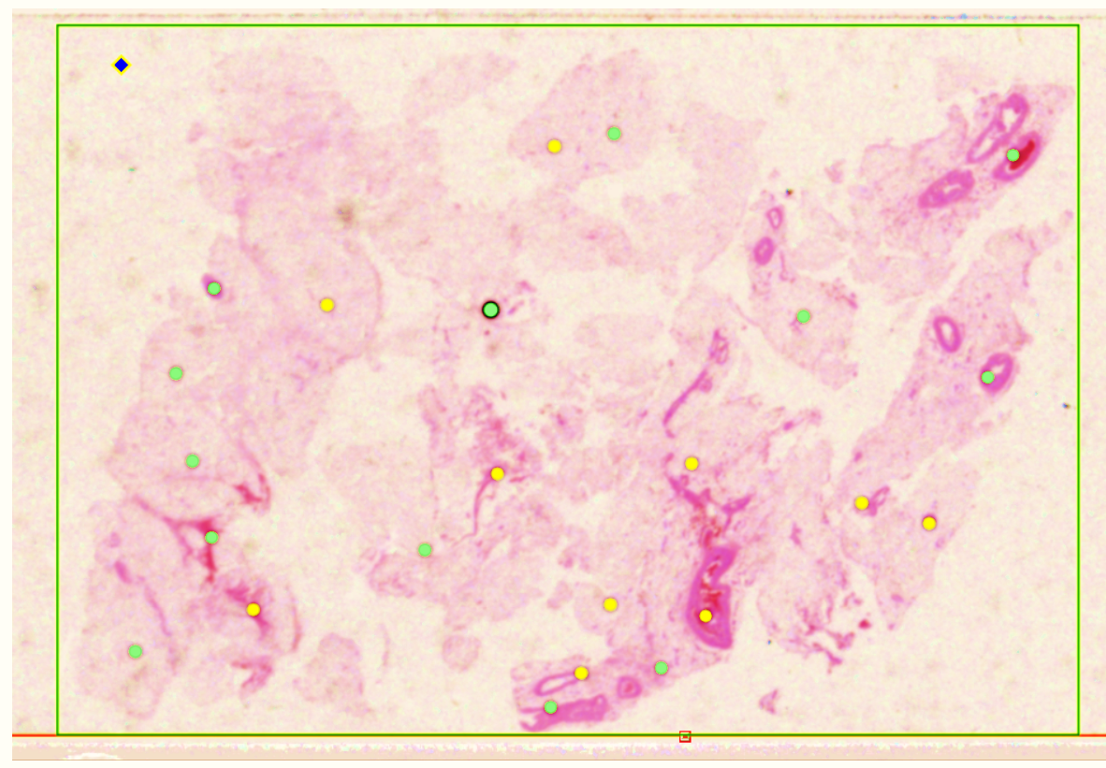
Pre-scan snapshots are taken prior to scanning process.
Focus points are placed on each snapshot to specify the area of the slide to be scanned.
In some cases, focus points must be manually added, and the boundaries are adjusted.
The resulting images are databased using Aperio’s eSM software.
After the pre-scan is adjusted, the slides are scanned at high resolution.

