Slide 1
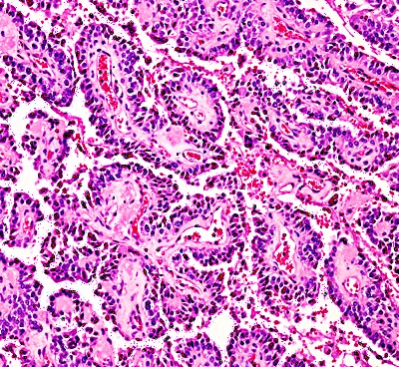
Input Batch
1500@100*100*3
2D-Convolution
1500@49*49*32
2D-Maxpooling
1500@24*24*32
Batch Normalization
1500@24*24*32
2D-Convolution
1500@22*22*64
2D-Maxpooling
1500@11*11*64
Batch Normalization
1500@11*11*64
RGB Channels
Frames
Extracted Window
Dropout
1500@5*5*32
Batch Normalization
1500@5*5*32
2D-Convolution
1500@5*5*32
Batch Normalization
1500@7*7*96
2D-Maxpooling
1500@7*7*96
Batch Normalization
1500@9*9*64
2D-Convolution
1500@9*9*64
Flatten
1500@800
Dense
1500@128
Dense
1500@2
Output
Post Processor

