Slide 1
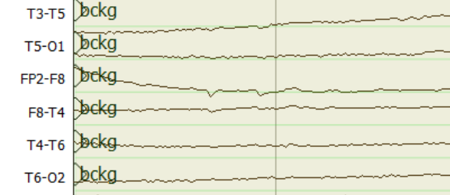
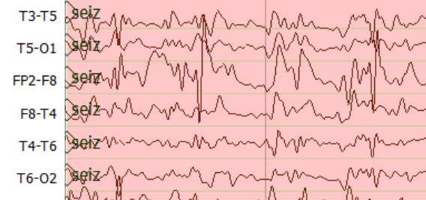
Epoch Posteriors
Sequential Modeler
Temporal and Spatial Context Analysis by Deep Learning
Feature Extraction
$$a_{11}$$
$$a_{22}$$
$$a_{33}$$
$$y$$
$$z$$
$$a_{12}$$
$$a_{23}$$
$$g_{θ′}$$
TUH EEG
$$b_{1}(x)$$
$$b_{2}(x)$$
$$b_{3}(x)$$
$$f_{θ}$$
$L_{H}$(x,z)
Corpus
Hidden Markov Models
$$\tilde{x}$$
$$x$$
Stacked Denoising Autoencoders
Post Processor
Output
$$a$$
$$a$$
S1
S2
$$b$$
$$c$$
$$b$$
$$a$$
S3
S4
Epoch Label
$$d$$
Finite State Machine for Language Model

