Slide 1
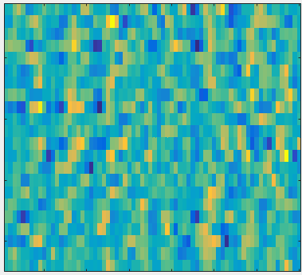
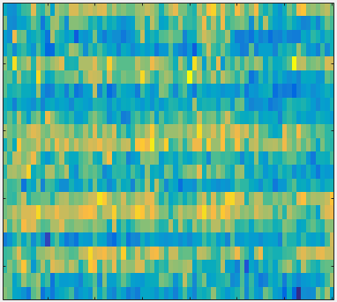
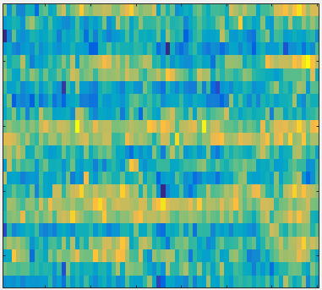
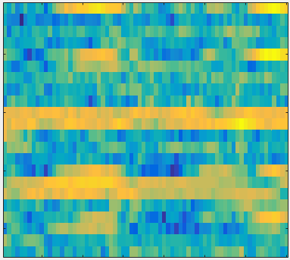
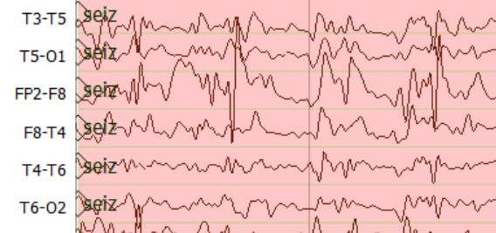
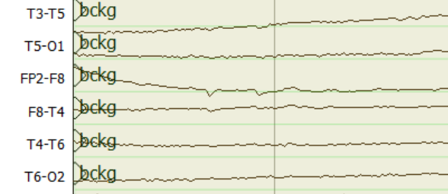
Input Layer
Convolution
Convolution
Max Pooling
Convolution
Convolution
16@70*22
16@68*20
16@34*10
32@34*10
32@32*8
Features
.
.
.
Channels
Time
Flatten
Max Pooling
Convolution
Convolution
Max Pooling
64@7*1
64@14*2
64@16*4
32@16*4
Output
.
.
.

