Slide 1
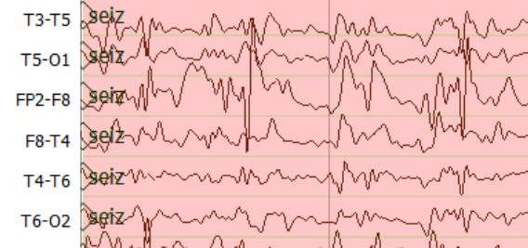
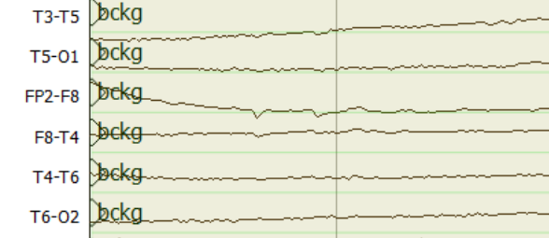
Feature
Extraction
Sequential Modeler
$$o_{t}$$
Output Gate
Time Steps
$$i_{t}$$
Input Gate
Output
Incremental PCA
Time Steps
$$c_{t}$$
$$h_{t}$$
TUH EEG
Channels
Corpus
25 First Principal Components
Feature Length
$$f_{t}$$
Forget Gate
Learning Long-Term Dependencies with LSTM

