Slide 1
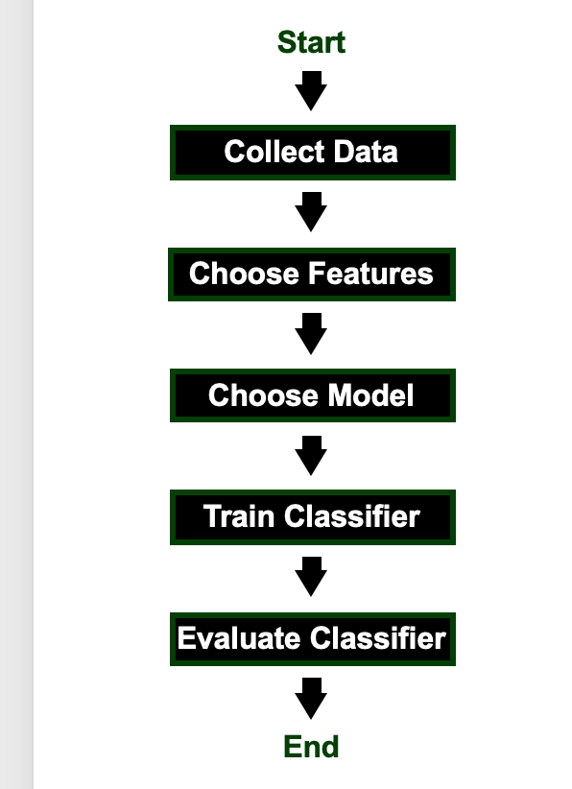

Slide 2
Blind Evaluation
Select Model
Train
Collect Data
Feature Extraction
Validate
Blind Evaluation
Select Model
Train
Collect Data
Feature Extraction
Validate
Blind Evaluation
Select Model
Train
Collect Data
Feature Extraction
Validate

