Slide 1
Blind Evaluation
Select Model
Train
Collect Data
Feature Extraction
Validate
Blind Evaluation
Select Model
Train
Collect Data
Feature Extraction
Validate
Blind Evaluation
Select Model
Train
Collect Data
Feature Extraction
Validate

Slide 2
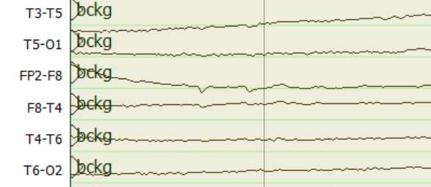
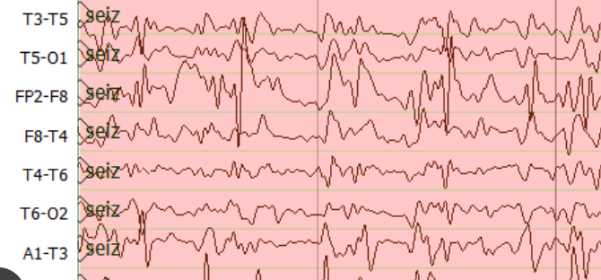
Epoch Posteriors
Sequential Modeler
Temporal and Spatial Context Analysis by Deep Learning
Feature Extraction
$$a_{11}$$
$$a_{22}$$
$$a_{33}$$
$$y$$
$$z$$
$$a_{12}$$
$$g_{θ′}$$
$$a_{23}$$
TUH EEG
$$b_{1}(x)$$
$$b_{2}(x)$$
$$b_{3}(x)$$
$$f_{θ}$$
$L_{H}$(x,z)
Corpus
Hidden Markov Models
$$\tilde{x}$$
$$x$$
Stacked Denoising Autoencoders
Post Processor
Output
$$a$$
$$a$$
S1
S2
$$b$$
$$c$$
$$b$$
$$a$$
S3
S4
$$d$$
Epoch Label
Finite State Machine for Language Model

Slide 3
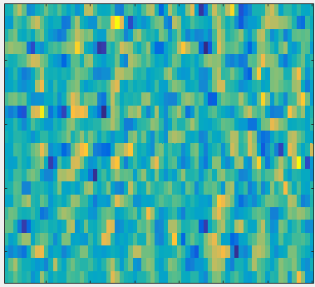
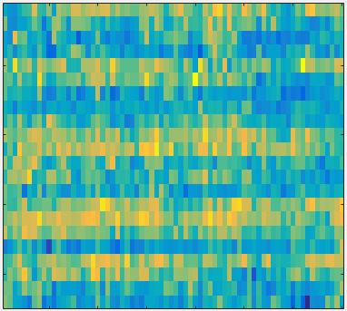
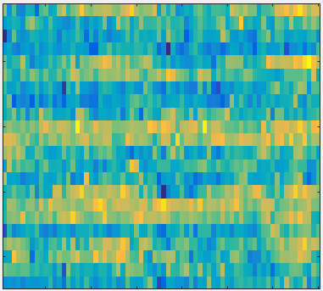
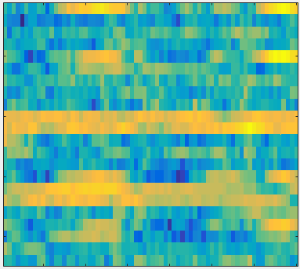
Input Layer
Convolution
Convolution
Max Pooling
Convolution
Convolution
16@70*22
16@68*20
16@34*10
32@34*10
32@32*8
Features
.
.
.
Channels
Time
Flatten
Max Pooling
Convolution
Convolution
Max Pooling
64@7*1
64@14*2
64@16*4
32@16*4
Output
.
.
.

Slide 4
Input
Conv2d
ReLU
ReLU
ReLU
ReLU
Dropout
Dropout
Dropout
Conv2d
Conv2d
Conv2d
ReLU
ReLU
ReLU
Conv2d
Dropout
Dropout
Dropout
ReLU
Conv2d
Conv2d
Conv2d
Dropout
Conv2d
+
+
+
+
Max Pooling2D
Max Pooling2D
ReLU
ReLU
Dropout
Dropout
Flatten
Conv2d
Conv2d
ReLU
ReLU
ReLU
ReLU
Dense
Dropout
Dropout
Dropout
Conv2d
Conv2d
Conv2d
Dropout
Sigmoid
+
+
Predictions

Slide 5
Discriminator
Classification Result
Real World EEGs
CNN
✓
TUH EEG
Corpus
x
Transposed CNN
Noise
Is Discriminator Correct?
Synthetic Generated EEGs
Generator
Update Models

Slide 6
Feature
Extraction
Sequential Modeler
$$o_{t}$$
Output Gate
Time Steps
$$i_{t}$$
Input Gate
Output
Incremental PCA
Time Steps
$$c_{t}$$
$$h_{t}$$
TUH EEG
Channels
Corpus
25 First Principal Components
Feature Length
$$f_{t}$$
Forget Gate
Learning Long-Term Dependencies with LSTM

Slide 7
Feature
Extraction
2D-Convolution
2D-Max Pooling
2D-Convolution
2D-Max Pooling
210@22*26*16
210@11*13*16
210@11*13*32
210@5*6*32
210@22*26*1
Time Steps
TUH EEG
Corpus
Channels
Feature Length
1D-Convolution
Flatten
2D-Max Pooling
2D-Convolution
210@16
210@384
210@2*3*64
210@5*6*64
Post Processor
Sequential Modeler
$$o_{t}$$
Output Gate
$$i_{t}$$
Input Gate
Output
$$h_{t}$$
$$c_{t}$$
1D-Max Pooling
$$f_{t}$$
Forget Gate
26@16
Learning Long-Term Dependencies with B- LSTM

Slide 8
Epoch Posteriors
Sequential Modeler
Sequential Modeler
$$o_{t}$$
Output Gate
Feature Extraction
$$a_{11}$$
$$a_{22}$$
$$a_{33}$$
$$i_{t}$$
Input Gate
$$a_{12}$$
$$a_{23}$$
TUH EEG
$$c_{t}$$
$$h_{t}$$
$$b_{1}(x)$$
$$b_{2}(x)$$
$$b_{3}(x)$$
Corpus
Hidden Markov Models
$$f_{t}$$
Forget Gate
Learning Long-Term Dependencies with LSTM
Post Processor
Output
$$a$$
$$a$$
S1
S2
$$b$$
$$c$$
$$b$$
$$a$$
S3
S4
$$d$$
Epoch Label
Finite State Machine for Language Model

Slide 9
0.91
0.97
0.88
0.77
0.82
0.87
0.61
0.57
0.72
0.99
0.6
Probabilistic filtering (Threshold = 0.75)
0.91
0.97
0.88
0.77
0.82
0.87
0.665
0.99
0.6
Duration filtering (Threshold = 3 Sec.)
0.91
0.97
0.88
0.77
0.82
0.87
0.632
Target aggregation (Margin = 3.54 Sec.)
0.91
0.97
0.88
0.82
0.632
Posterior
Seizure
Posterior
Background
4 Seconds
Time scale

Slide 10
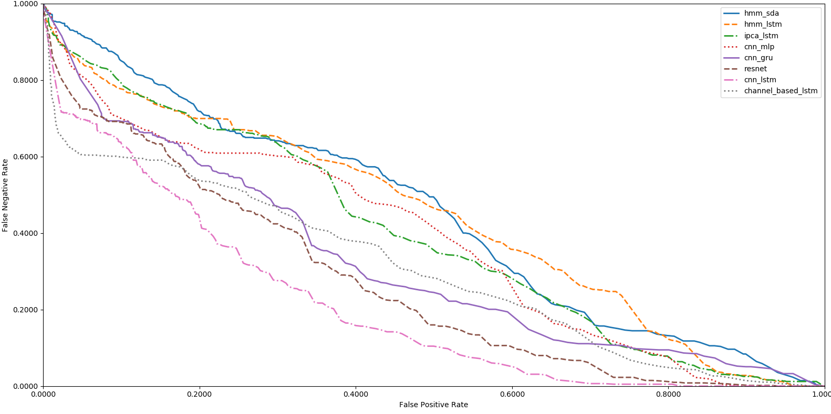

Slide 11
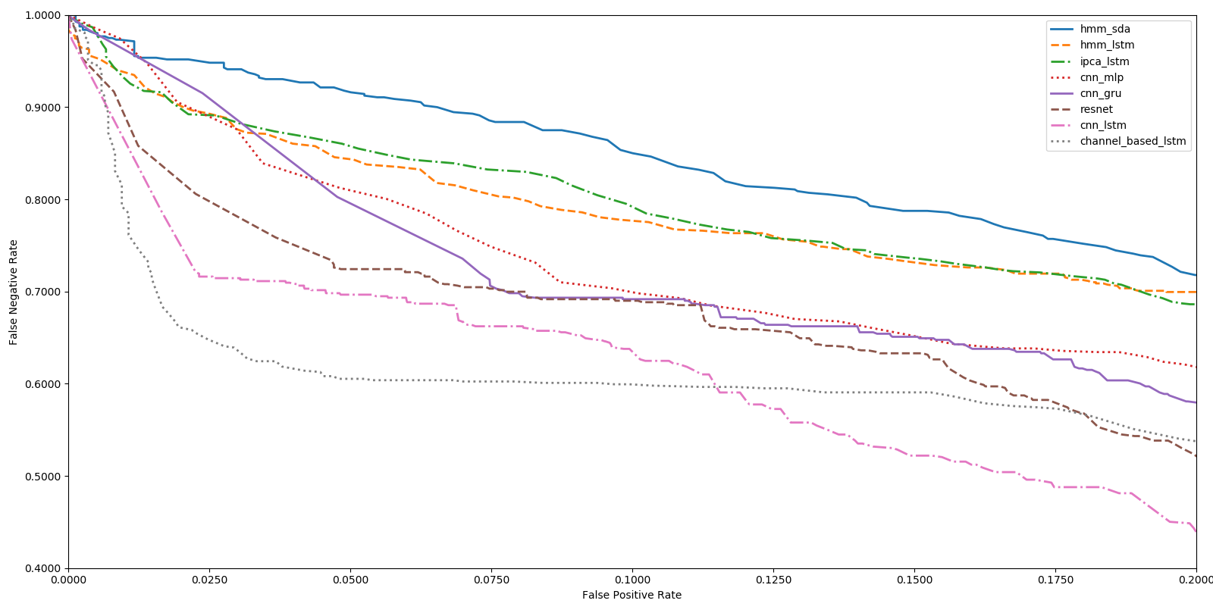

Slide 12
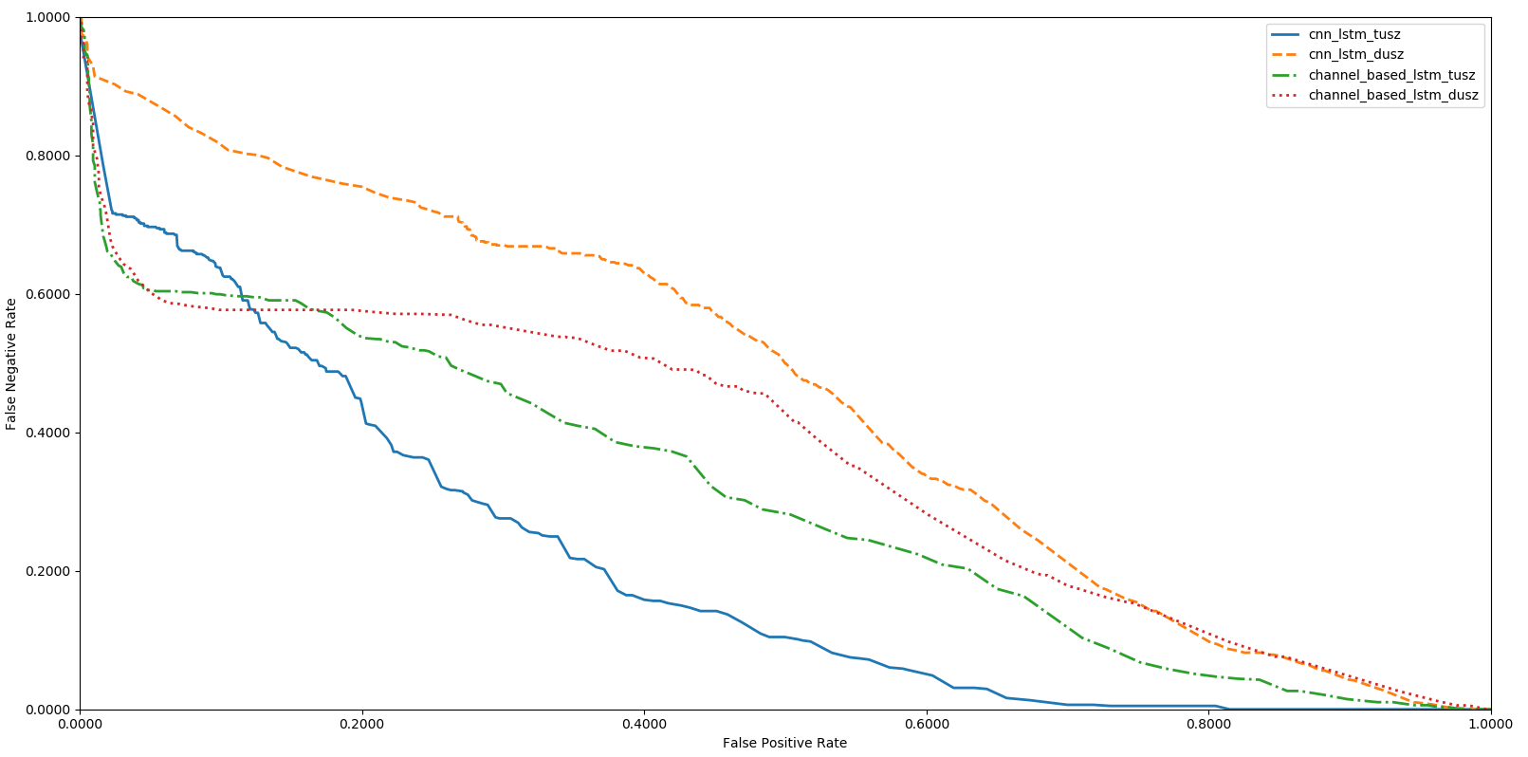

Slide 13
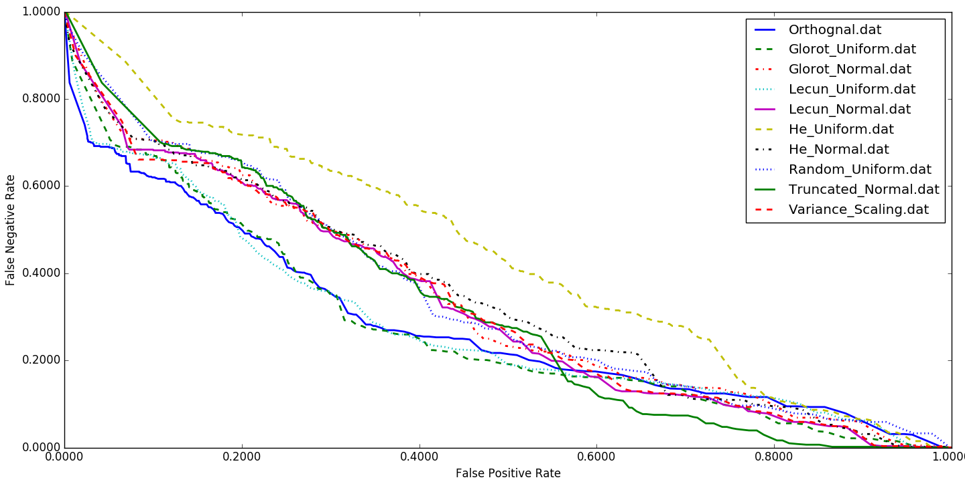

Slide 14
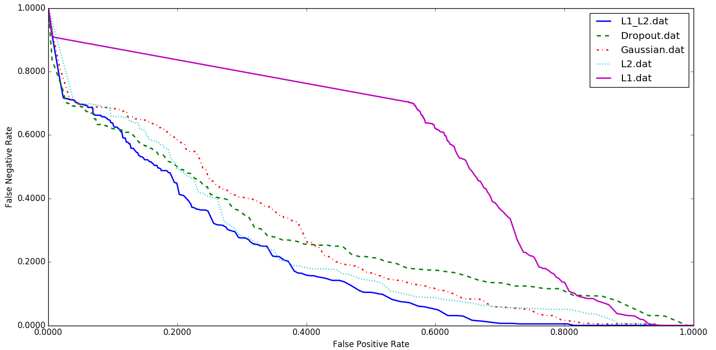

Slide 15
