Slide 1
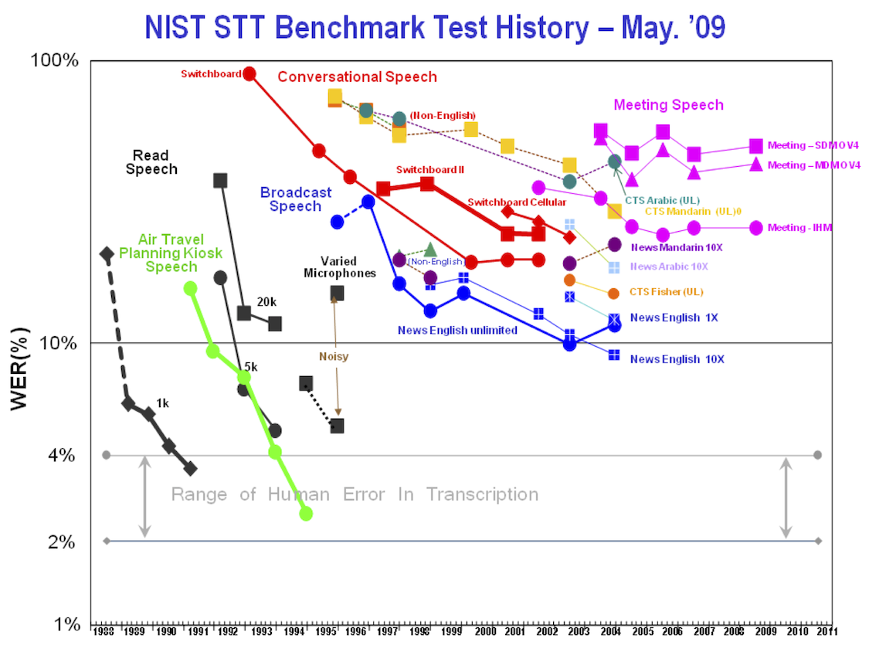
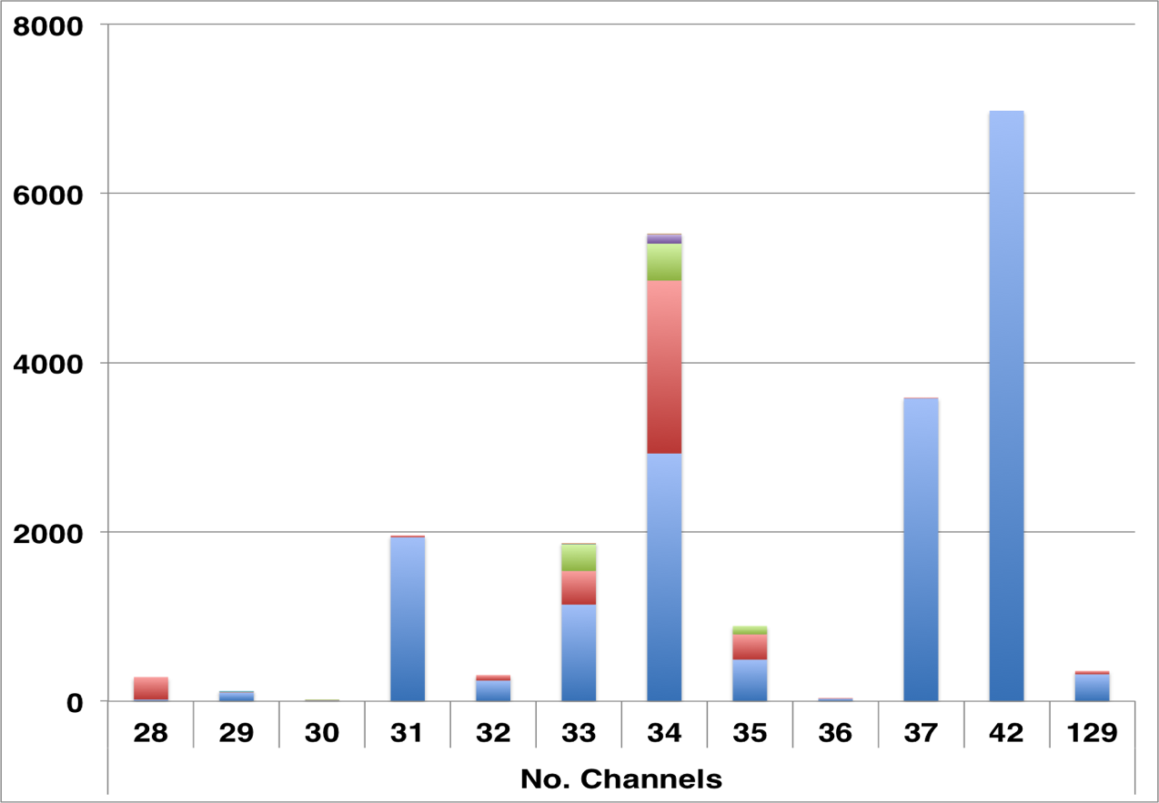
Neural Engineering Data Consortium
Iyad Obeid PhD, Joseph Picone PhD
Temple University, Philadelphia, Pennsylvania
Existing Research & Funding Model
Proposed Research & Funding Model
A Proven Paradigm
Proof-of-Concept EEG Big Data Project
Objective: We present the launch of a neuroscience community-wide resource whose goal is to accelerate research in neural signal processing by creating, curating, and archiving massive neural datasets. A focused collaboration between stakeholders, including researchers, funding agencies, regulators, and industry, can define common problems of broad interest. Pooled resources can then be used to generate massive common datasets for community-wide adoption; best methods for data decoding or processing can be identified using large-scale computing competitions on the common data corpora. This paradigm extends well beyond the basic concept of ‘data sharing’ into a more integrated resource for focusing community attention and funding.
Methods: The Neural Engineering Data Consortium (NEDC) has been launched to meet this role. Based at Temple University and supported by NSF seed funding, the NEDC has recruited a board of directors from academia, industry, federal funding agencies, and government regulators, and is presently soliciting input from the community on goals and priorities. The NEDC is also releasing its first curated corpus to the public: a dataset of approximately 25,000 clinical EEGs with corresponding physician reports taken from the electronic medical record archives.
Results: The NEDC anticipates that its EEG corpus will of interest to neuroscientists, biomedical engineers, machine learning experts, and big data researchers alike. The corpus will be available at www.nedcdata.org.
Conclusion: Community-wide data infrastructure can support neuroscience investigation by focusing attention and by exploiting efficiencies of scale.
Significance: By presenting an alternative to the predominant neuroscience funding paradigm (‘investigator collects data to test own hypothesis’), the NEDC aims to accelerate discovery by having communities of investigators focus on common problems, pool data generation resources, and then compete for data processing tools and methods. The NEDC can also greatly facilitate research by providing a community framework for handling the multitude of legal and privacy concerns when human data is shared between parties.
Data Corpus with ~25,000 Clinical EEG records
Clinical data from Temple University Hospital
De-identified but fully annotated
Demographic data, medical history, presenting complaint, medications all included
24,637 sessions
14,075 unique patients
~3000 new EEGs generated per year
Large spectrum of data formats (channels, montages, sampling rates, etc)
Freely available
Funding Agencies
Money
PI
Data
Industry
Research Question
Methods
PI
Results
Funding Agencies
Research Questions
Money
PI
Data
Research Question
Methods
Neural Engineering Data
Consortium
Fees
Funded
PI
Unfunded
PI
Results
Data
Money
PI
Data
Data Design
Results
Funded
PI
Unfunded
PI
Research Question
Methods
Data Generation
Results
Results Scoring
Funded
PI
Unfunded
PI
There is a fundamental limit to how much data any single lab or group can produce
Each lab uses its own experimental protocols
Results between labs are hard to compare
Communal resources are pooled, allowing NEDC to create massive datasets, orders of magnitude larger than what any individual PI could generate
Data is custom tailored to resolve specific questions of interest to the community
Performance claims are easier to compare
Research community is focused on common problems
Speech processing field
Linguistics Data Consortium (LDC)
Massive common data corpora
Benchmark evaluations
Tiered consortium membership fees
Community resource serving academia and industry
Credited with enabling commercial technology development
Existing Funding Model
Progress
Over $200M spent by NIH & NSF alone on BCI & neural engineering in past decade
Additional investments by DARPA, ONR, others
Over 1700 peer-reviewed journal papers
Limitations
Relatively little commercial technology development
Relatively little translation from academia into industry
Risk of alienating the funding community
Is there a better way to invest resources?
Channel Count Histogram
Clinical EEG data reveals a wide variety of data recording parameters
Comparison to Existing Resources
Repositories
Physionet
Collaborative Research in Computational Neuroscience (CRCNS)
Swartz Center for Computational Neuroscience
NSF Data Sharing Policy
None are “common protocol”
Not just another repository!
Prize-Based Research
Berlin BCI Contest
X-Prize, Netflix, others
Organization
Board of Directors
Operations
Data Design
Data Collection
Data Delivery & IT Support
Acknowledgements
Sponsored by DARPA MTO under the auspices of Dr. Doug Weber through the Contract No. D13AP00065, NSF (Award 1305190), Temple University’s College of Engineering and Office of the Senior Vice-Provost for Research.
Get Involved
Download and use the data
Take the survey
Join the user group
www.nedcdata.org
info@nedcdata.org

