Slide 1
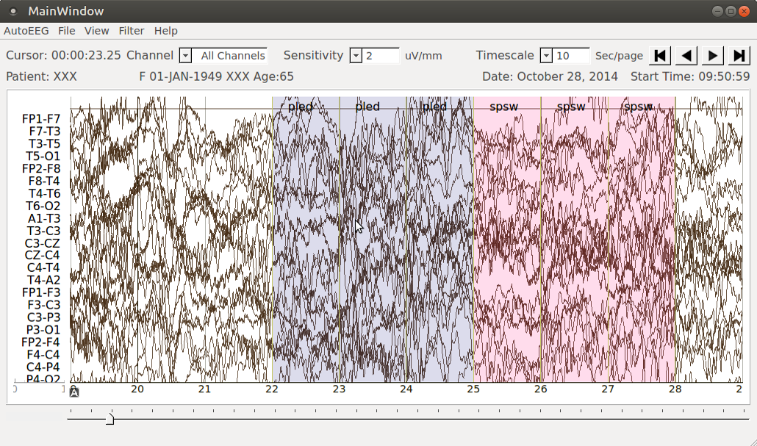
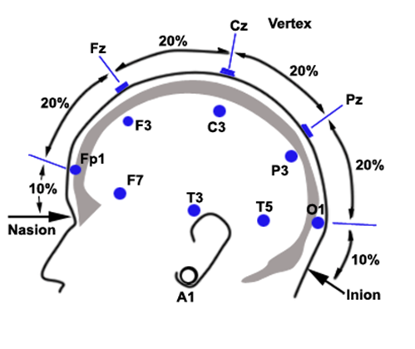
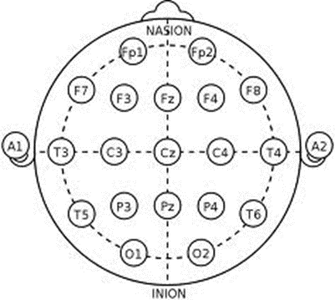
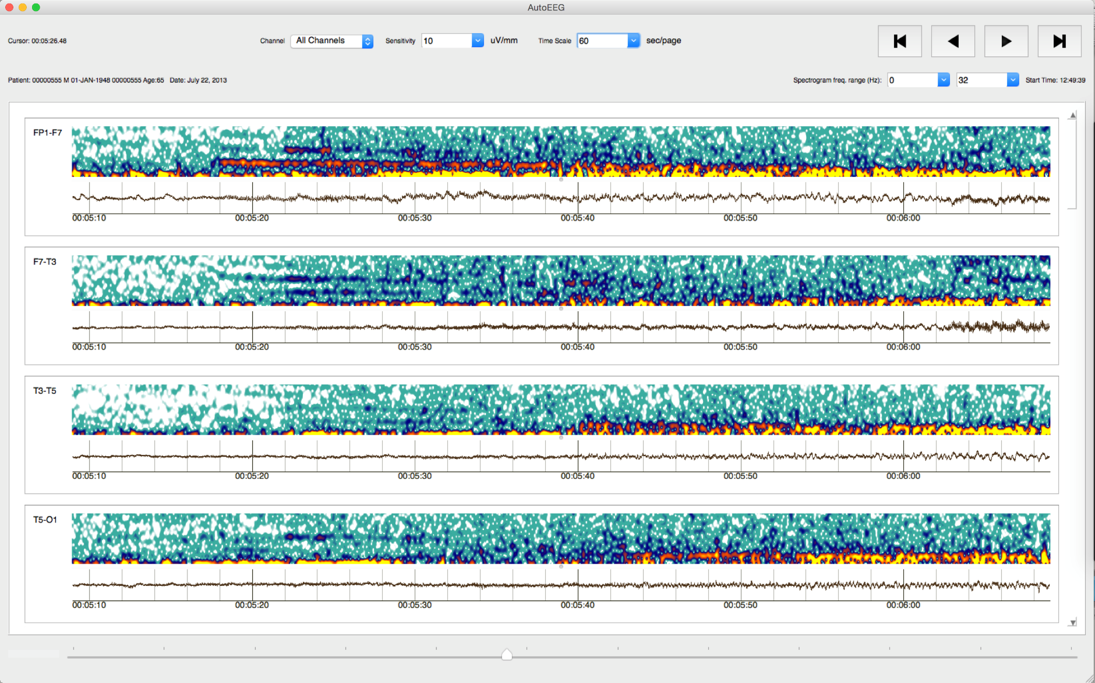
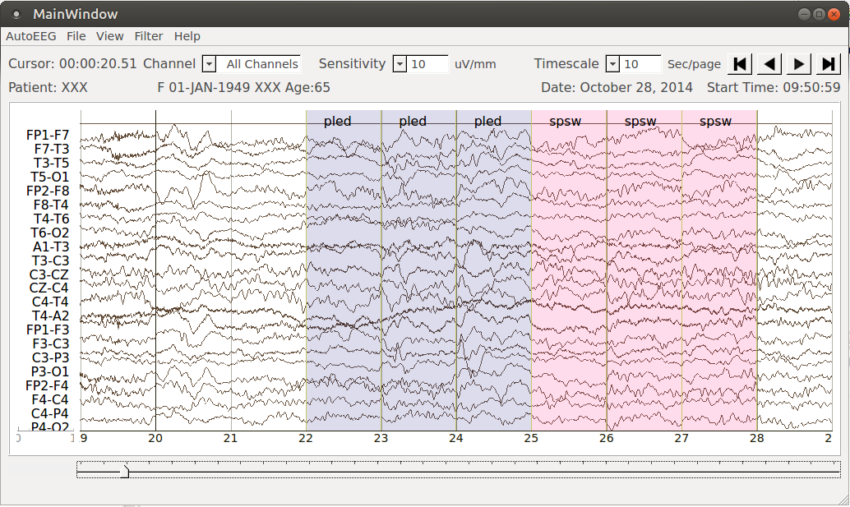
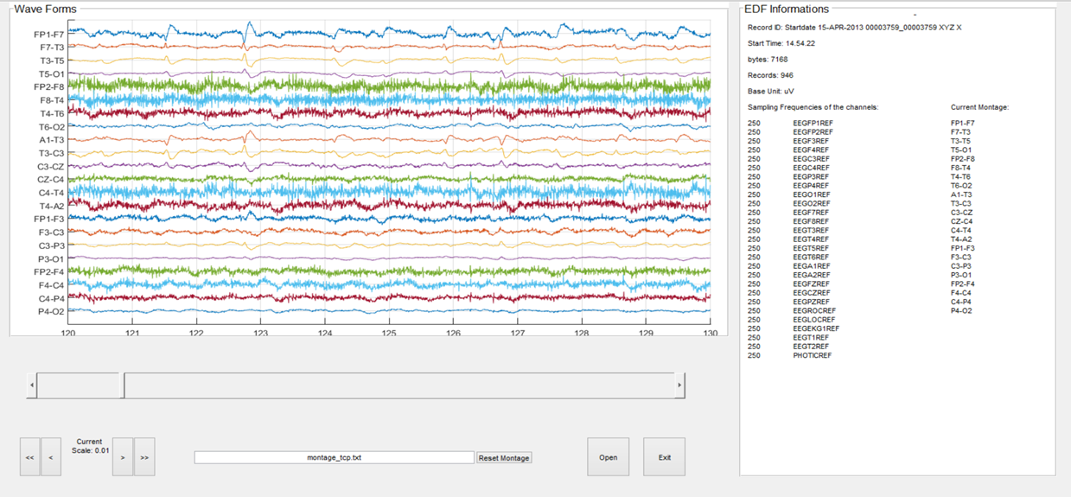
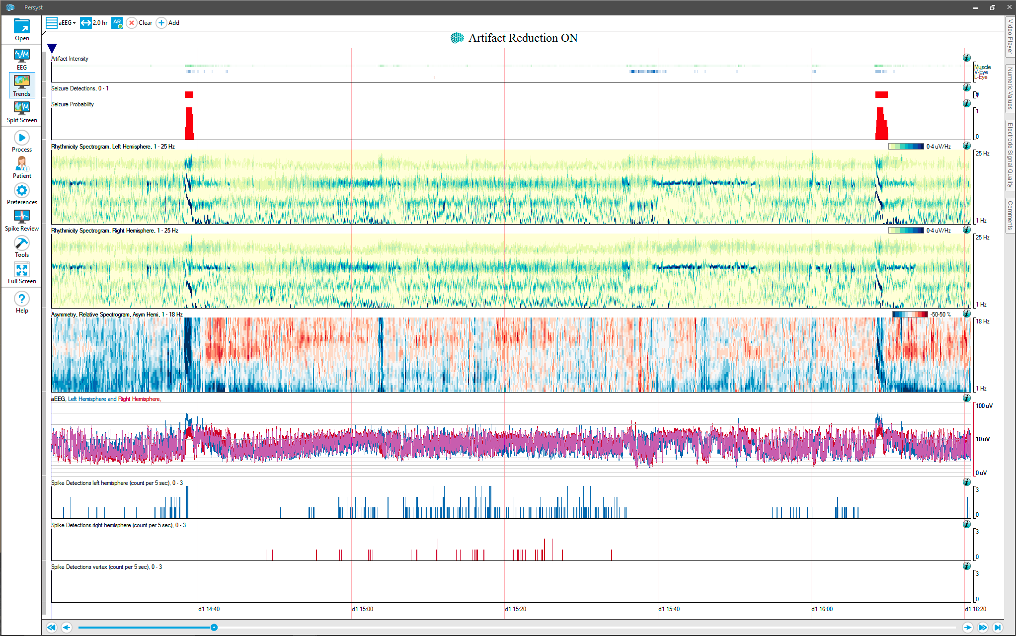
Enhanced Visualizations for Improved Real-Time EEG Monitoring
M. Thiess, E. Krome, M. Golmohammadi, Dr. I. Obeid and Dr. J. Picone
The Neural Engineering Data Consortium, Temple University
College of Engineering
Temple University
www.isip.piconepress.com
Abstract
An electroencephalogram, or EEG, is used to monitor the electrical activity in the brain through electrodes placed on the scalp.
AutoEEG is a system which generates time-aligned markers, called annotations, which indicate significant events within these EEG signals.
This demonstration system is a graphical display which incorporates AutoEEG to analyze an EEG recording. The system also displays these recordings graphically as waveforms and overlays colored annotations to show where events occur.
The graphical display is based in PyQt, which is a python extension of the cross-platform Qt application framework. The goal of this project was to expand the available views for analyzing the signals in a manner such that other views could be easily added in the future. In addition to a waveform display, spectrogram and energy views are available.
The ability to view a spectrogram within this software is especially useful in a clinical context because it is a powerful way to visualize signals. Spectrograms are becoming more accepted in continuous EEG (cEEG) monitoring because they allow neurologists to easily view hours’ worth of data to pinpoint areas of concern.
Clinical EEG Data
An EEG is a multi-channel time varying signal describing voltages in different regions on the scalp, measured using electrodes. EEG recordings are interpreted using a montage, which defines the channels as differences between these electrodes.
Overview of Demonstration Software
AutoEEG uses machine learning in the form of hidden Markov models and deep learning to deliver accurate event detection with good performance.
AutoEEG is trained on the TUH-EEG corpus, which is the largest publicly-available EEG corpus, containing over 25,000 clinical recordings.
The demonstration system provides a graphical representation of the data and its associated events.
The application is mostly written in Python, and it relies heavily on the PyQt cross-platform toolkit.
Qt Designer, which is a graphical layout designer included with the Qt framework, was used to create and edit this simple, robust graphical interface.
In the current stable release of this software, the graphical tool displays waveforms read from an EDF file containing a recording of an EEG session.
The tool also overlays colored annotations based on event markers generated by AutoEEG, which include EYEBL, SPSW, GPED, PLED, ARTF, and BCKG.
Users can use the buttons in the corner to quickly search through the annotations.
In addition, the tool provides the ability to hide or show certain types of event markers, change the sensitivity scale, and alter the frame of time displayed in the window.
The goal of this research was to modularize the code so new visualizations can be easily added.
Constructing Multiple Views
The architecture of the window was altered to accommodate switching between waveform, spectrogram, energy, and all combinations of the available views.
Currently, the structure of these combined views includes a scrolling area in which there are multiple channels with labels, and each channel is split into some combination of the three views.
To switch between the views, Python dictionaries are used to show or hide groups of individual plots.
A Python dictionary is a data structure which consists of key-value pairs. This allows the programmer to build a set of objects upon which functions can be performed.
For example, if we want to manipulate all spectrogram widgets, we would build a dictionary which would contain all objects relevant to plotting spectrograms.
Significance of Alternate Plots
A spectrogram is a graphical plot of the frequency content of a signal as a function of time. In a typical spectrogram, the horizontal axis represents time, the vertical axis represents frequency and the color is used to indicate the intensity of each frequency.
An energy plot is simply a plot of the energy of a signal over time using either a log or linear scale.
Plotting multiple spectrograms in real time requires calculating multiple Fast Fourier Transforms (or FFT’s), which can be computationally intensive. Because the goals of spectral resolution and computational speed must be balanced against each other, the number of points included in each FFT is an important design parameter.
Even though plotting spectrograms can require a fair amount of computing power, using documented and well-optimized libraries such as Numpy helps to perform the necessary arithmetic in a more efficient manner.
Sample Views
Waveform Only:
Waveform/Spectrogram Combined:
Users can select any combination of visualizations (e.g., energy, spectrogram and waveform).
Combining the different views allows one to compare between different signal visualizations for more analysis options.
This is important because some seizure events are very subtle and exhibit signatures in the time and frequency domain.
Main Window
Waveform Plot
Energy Plot
Scrolling Area
Channel Frame/Container
Spectrogram Plot
Introduction
There are many open-source tools, such as EDFBrowser, which can be used to view EEG recordings stored in EDF files:
Commercial tools such as Persyst® offer spectrogram analysis. Spectrogram are becoming increasingly popular for real-time applications:
AutoEEG includes a demonstration system that uses a graphical display implemented using the popular Qt framework, making it very portable.
Users can quickly search for events such as seizures, making it very easy to manage long-term recordings in ICU and EMU settings.
Summary
The demonstration system for AutoEEG has been modified to support multiple views and to allow new visualizations to be easily added.
The code has been updated in such a manner that new views can be added in a modular manner using functions that address groups of objects.
Alternate methods for visualizing signals will allow clinicians more diverse inspection tools.
Future work will focus on adding visualization of confidence measures and parameter trending (e.g., the fundamental frequency of a PLED).
New research directions include extending this tool to include image data and integrating other types of signal data (e.g., blood pressure, heart rate).
Acknowledgements
This research was funded by the Temple University Honors Program’s Merit Scholar Stipend Program.

