Slide 1
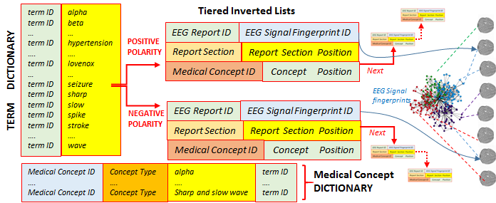
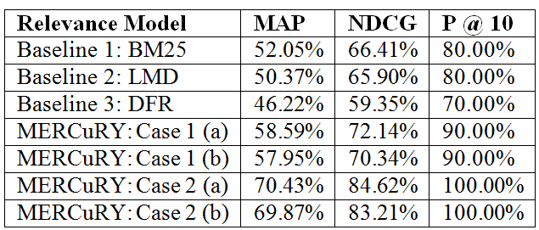
Deep Learning-Based Multi-Modal Indexing of Heterogeneous Clinical Data for Patient Cohort Retrieval
Human Language Technology Research Institute
Sanda Harabagiu, PhD, Travis Goodwin
The Human Language Technology Research Institute
University of Texas at Dallas
www.hlt.utdallas.edu
Abstract
Heterogeneity is one of the attributes of clinical Big Data, as the clinical picture of patients is documented by narratives, images, signals, etc. The ability to search through such data is made possible by multi-modal indexes, capturing the knowledge processed across all forms of clinical documents. Taking advantage of state-of-the-art deep learning methods, we have been able to generate a multi-modal index operating on a vast collection of electroencephalography (EEG) signal recordings and EEG reports and employ it in a patient cohort retrieval system. An EEG records the electrical activity along the scalp and measures spontaneous electrical activity of the brain. The interpretations of EEG recordings are available in EEG reports. When EEG reports were indexed, the sections of the EEG reports were identified and medical language processing was performed. When the EEG signal recordings were processed, they were represented by EEG signal fingerprints as low-dimensional vectors produced by deep learning methods on the Big Data of EEG signals. We developed an multi-modal index based on he EEG corpus available from the Temple University Hospital (TUH), consisting of over 25000 sessions and 15,000 patients collected over a span of 12 years.
We used the multi-modal index in a patient cohort retrieval system, called MERCuRY (Multi-modal EncephalogRam patient Cohort discoveRY), which relies on medical language processing to identify the inclusion and exclusion criteria from the queries generated by neurologists. Using state-of-the-art relevance models adapted for a multi-modal index, we obtained very promising results, indicating that the multi-modal index is bridging the gaps between the electrode potentials recorded in the EEG signal and the clinical findings documented in the EEG reports.
The Multi-Modal Tiered Index used in the MERCuRY System
Medical Language Processing. In order to build (1) the term dictionary; (2) the medical concept dictionary and (3) the two polarity-informed posting lists we have used the following sequence of steps:
(Step 1) Tokenizing the EEG reports: we relied on Stanford’s CoreNLP pipeline¹⁷ to detect sentences and tokens from every EEG report.
(Step 2) Discovering the Dictionary Terms: Each token was normalized in order to account for any lexical variation (e.g. “waves” and “wave” or “markedly and “marked”) using Stanford’s CoreNLP lemmatizer¹⁷. The resultant lemmatized terms formed the basis of the dictionary.
(Step 3) Identifying the Polarity: Term polarity was cast as a classification problem implemented as a conditional random field¹⁸ (CRF). Leveraging our previous experience with the i2b2 challenge, the CRF assigned a binary polarity value (i.e. positive or negative) to each term based on feature vector containing lexical information as well as information from external resources, such as the NegEx negation detection system, the Harvard General Inquirer, the Unified Medical Language System (UMLS) meta-thesaurus, and MetaMap. Specifically, we considered nine features: (1) the section name, (2) whether the term was considered a modifier by NegEx, (3) whether the term was within a NegEx negation span, (4) whether the term was in the ‘IF’ category of the Harvard General Inquirer, (5) the part-of-speech tag assigned to the token by Stanford’s CoreNLP part-of-speech tagger,
(6) whether the term belonged to a UMLS concept, (7) whether the term belongs to a MetaMap concept, (8) the original cased term before lemmatization, and (9) the lowercased and lemmatized form of the term. The classifier was trained using 2,349 manual annotations.
(Step 4) Identifying Medical Concepts: An automatic system for medical concept recognition previously developed for the 2010 i2b2 challenge recognized medical problems, tests, treatments. In addition, we have produced 4,254 new annotations for EEG patterns and events as well as EEG activities and re-trained the concept recognizer to identify all these types of concepts. Concept extraction was cast as a classification task, in which a CRF was used to detect medical concept boundaries. A support vector machine²⁴ (SVM) was used to classify each concept into one of five types: medical problem, medical test, medical treatment, EEG activity, or EEG event.
Generating Fingerprints of EEG Signal Recordings. In the TUH EEG corpus, the EEG signals are encoded as dense floating-point matrices of the form $D∈ℝ^{N×L}$, where $N∈\left[24, 36\right]$ is the number of electrode potential channels in the EEG and $L$ is the number of samples (such that duration of the EEG recording in seconds is equal to $L / 250$ Hz). Thus $D_{ij}$ encodes the magnitude of the potential recording on the $i$-th channel during the $j$-th time sample.
Both the number of channels and the number of samples vary not only across patients, but also across EEG recording sessions. These variations, particularly when considered with the large amount of data encoded in each matrix (typically 20 megabytes), make it difficult to not only characterize the relevance EEG signals to a particular patient cohort, but also to determine the similarity between two EEG signals. For example, consider that a single naïve pass over the TUH EEG corpus requires considering over 400 gigabytes worth of information. Consequently, we devised a representation of the EEG recordings that not only requires less memory, but enables rapid similarity detection between EEG signal recordings. This allows us to compactly encode the information from the EEG signals (reducing 20 megabytes of signal data to a few hundred bytes). Our representation is based on EEG signal recording fingerprints obtained with a recurrent neural network. Recurrent neural networks are deep learning architectures which enabled us to generate fingerprints for each EEG in the TUH EEG corpus in a matter of hours instead of weeks. Because traditional neural networks have difficulty operating on sequential data (e.g. EEG signals) as they cannot consider relationships between successive inputs (e.g. between successive samples), we have used a recurrent neural network (a neural network with a loop) which allowed information learned at each sample to persist between samples in the same EEG signal. The learned information (known as the internal memory state) is updated with each sample until ultimately becoming the fingerprint for that EEG recording.
Relevance Models
The inclusion and exclusion criteria discerned from the query analysis were used by MERCuRY’s relevance models to assess the relevance of each EEG report against the given query. Two relevance models were considered : Case 1, which ignored the EEG signal fingerprints and
(Case 1a) When an inclusion or exclusion criterion is expressed as a phrase.
(Case 1a) When an inclusion or exclusion criterion is recognized as a medical concept.
Case 2, which incorporates EEG signal fingerprints.
The Recursive Neural Network used for Generating EEG Signal Fingerprints
Formally: We define the parameter $K$ as the fingerprint dimensionality, or the number of dimensions of the finger-print vector such that $K ≪N×L$ (where $N$ is the number of channels and $L$ is the number of samples). This allows us to determine the fingerprint vector $f∈ℝ^{1×K}$ for an EEG $D∈ℝ^{N×L}$ by using the fingerprint as the internal memory state of the LSTM chain. In order to ensure that the fingerprint can be used to reconstruct portions of the EEG data, we define an additional parameter, $W$, the sample window, which indicates the number of subsequent samples which should be predicted from each cell. This allows us to learn the optimal fingerprint for each document by determining the vector $f$ which minimizes the cosine distance between the predicted values for each sample ($h_{i}, h_{i+1}, …, h_{i+W}$) and the actual values $(x_{i+1}, x_{i+2}, …, x_{i+ W+1}$). Note, that the fingerprint vector and prediction vector are both $K$-dimensional, while each sample vector is only $N$-dimensional. Thus, before comparing, we must project the output vector $h_{i}$ into $N$ dimensions by defining a projection matrix $W∈ℝ^{K×N}$ and a bias vector $b∈ℝ^{1×N}$. Unlike the fingerprint vectors, which are optimized for each individual EEG, $W$ and $b$ are optimized over the entire corpus. Thus, the optimal fingerprint vector $f$ for each document was computed by minimizing the cosine distance between the output of the LSTM cell and the next $W$ samples: $f=\min_{f′}{\sum_{i=0}^{L−W}{\sum_{j=i}^{W}{\cos\left(\operatorname{lstm}\left(f′, D_{i}^{T}\right)∙W+b, D_{j}^{T}\right)}}}$
where $\operatorname{lstm}\left(f, D_{i}^{T}\right)$ refers to the standard LSTM loss function. As defined, the recurrent neural network allows us to generate the optimal fingerprint $f$ for each EEG signal by discovering the vector $f$ which is best able to predict the progression of samples in each EEG recording according to the LSTM. In this way, the fingerprint is able to provide a substantially compressed view of the EEG signal while still retaining many of the long-term interactions and characteristics of the signal.
The MERCuRY (Multi-modal EncephalogRam patient Cohort discoveRY) System
Examples of Patient Cohort Descriptions (Queries)
EEG showing generalized periodic epileptiform discharges (GPEDs)
Patients with anoxic brain injury and EEGs demonstrating sharp waves, spikes, or spike/polyspike and wave activity or seizures.
Brain tumor and sharp waves, spike/polyspike and wave or spikes
Patients with stroke and an EEG demonstrating sharp waves, spikes, or spike/polyspike and wave activity
Patients experiencing seizures and generalized shaking
Acknowledgements: Research reported in this poster was supported by the National Human Genome Research Institute of the National Institutes of Health under award number 1U01HG008468. The content is solely the responsibility of the authors and does not necessarily represent the official views of the National Institutes of Health

